Slide 1
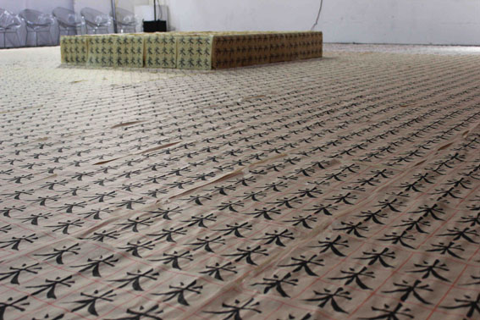
汉字
Chinese characters
Tenthousand Monika Lin 2012
HSBC Primary Mandarin Project Programme of Study version ii
UCL IOE Confucius Institute for Schools
James Trapp – Primary Network Co-ordinator

Slide 2
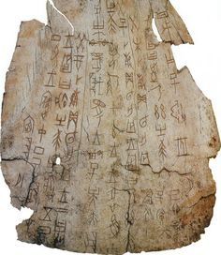
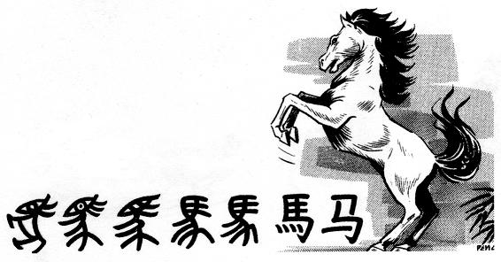
More than just a word
Development of the character 马 horse from oracle bone to modern simplified form
Oracle bone – Shang Dynasty 13thc BCE
All of Chinese history is contained in them…

Slide 3
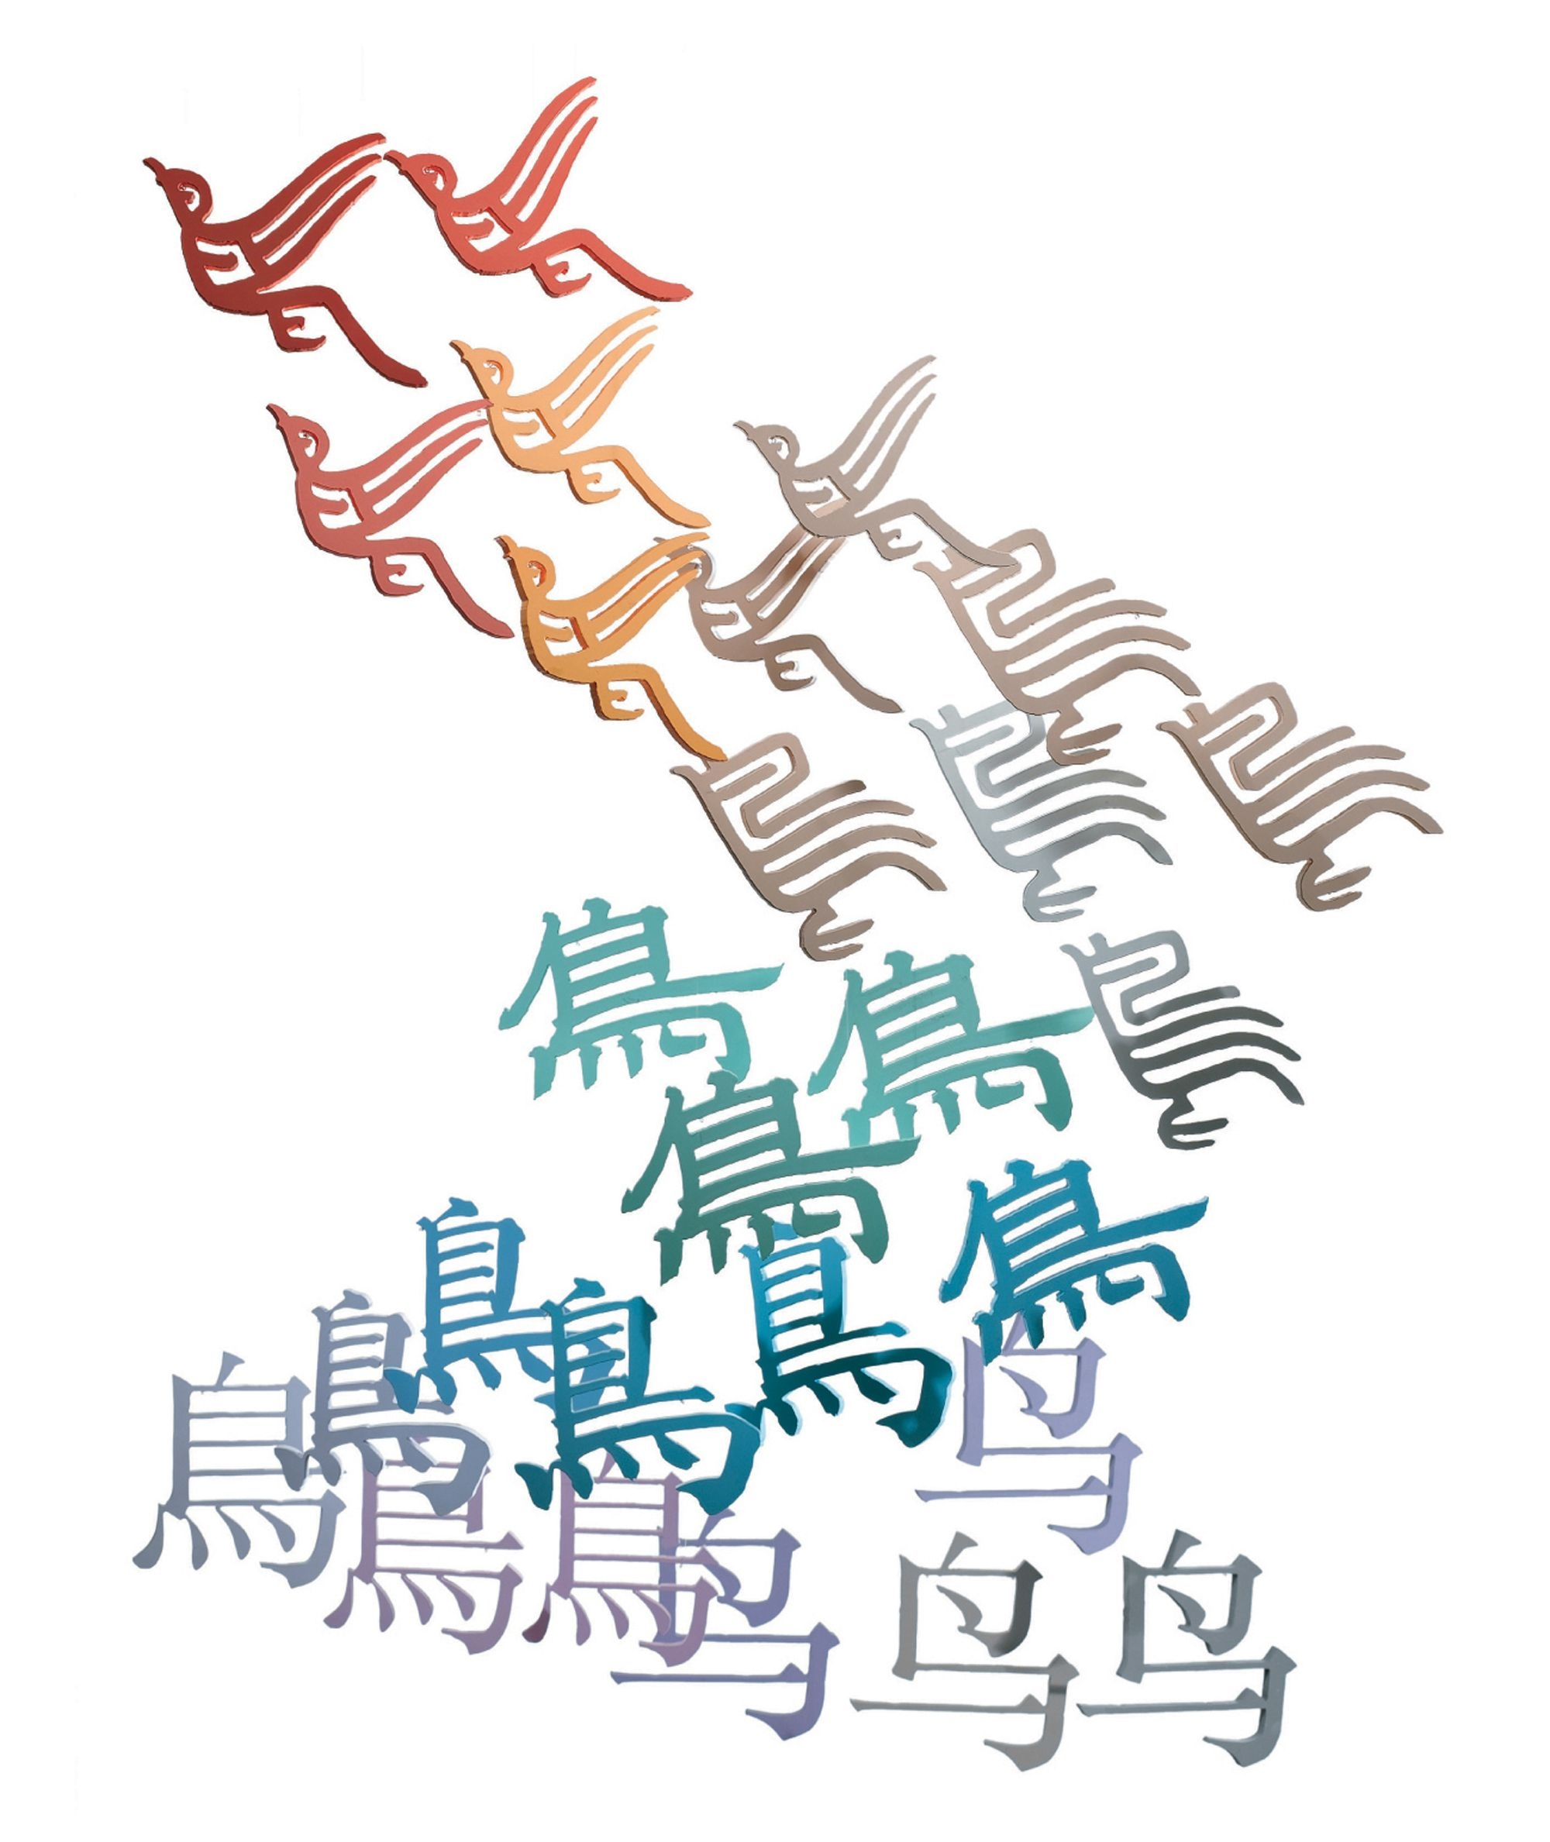
More than just a word…
…….they are captive ideas waiting to be set free

Slide 4

They seem really difficult…………..
But don’t be
Scared!!!!!!

Slide 5

They are quite friendly once you get to know them:

Slide 6
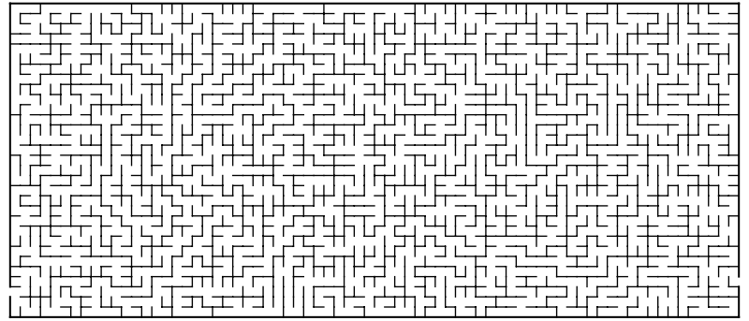
So where do you start?
汉字

Slide 7
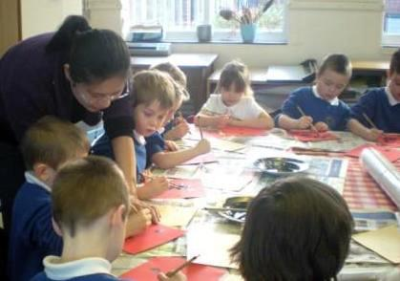
You are off to a flying start because…
….children love writing Chinese characters

Slide 8
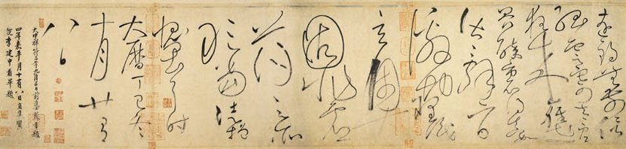

And the more you know about them the more you can harness that enthusiasm….
…..because…..
Calligraphy 8th c CE
characters are the heart and soul of China, ancient and modern
Shanghai 21st c CE

Slide 9
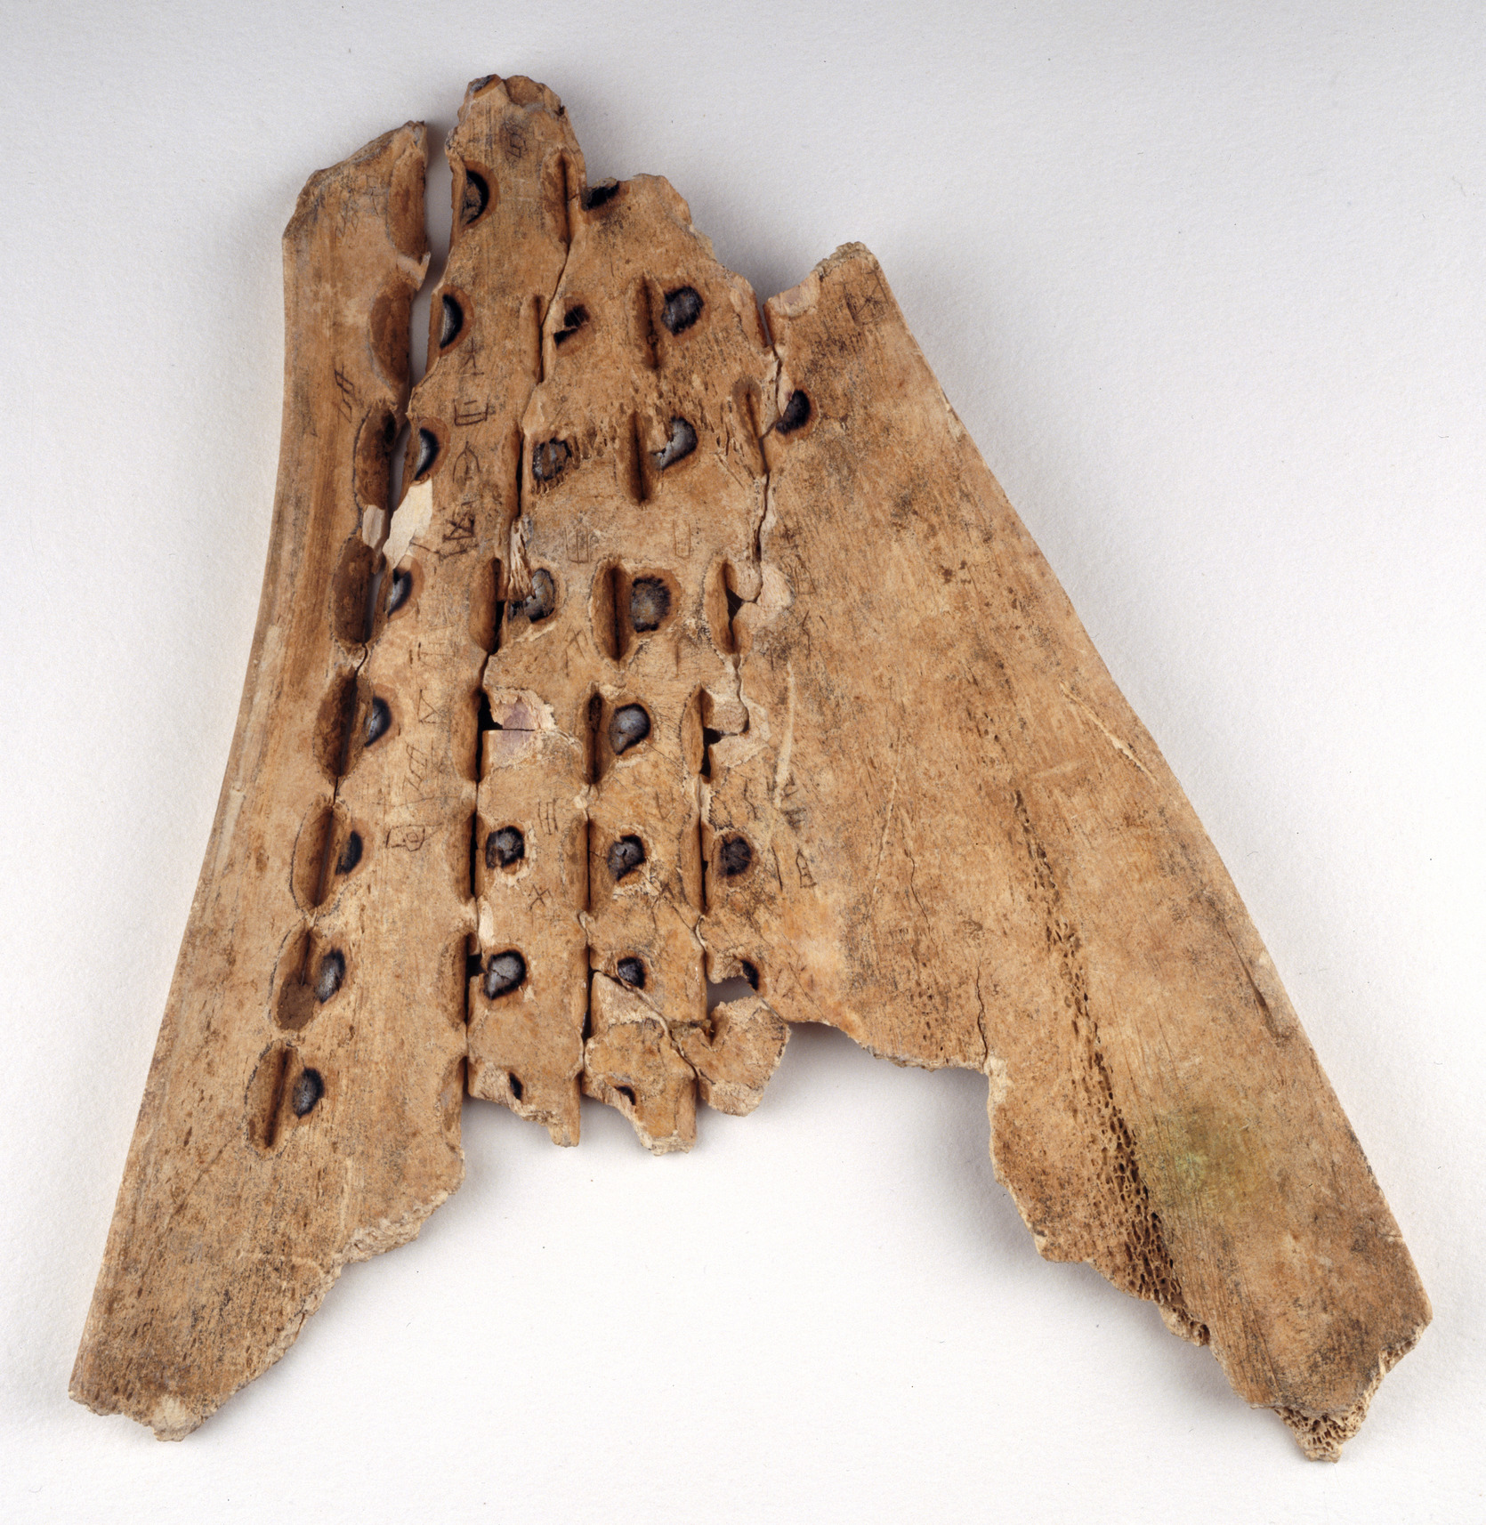

Oracle bones were used for telling the future by priests during the Bronze age Shang dynasty. Their answers to questions asked by the ruler were scratched onto the ox bones or tortoiseshells used in the divination process…
Where it all began
These pictograms were the first recognized form of Chinese writing
Holes drilled in the back of the bone had a heated spike applied to them to make the bone crack
Priests read the future from the way the bone cracked

Slide 10




Only about 4% of modern Chinese characters are pictograms – but they are a good place to start….
Some of them are more recognizable than others
ShaoLan – Chineasy – Thames & Hudson 2014 (www.chineasy.org)

Slide 11








Every character represents a word/idea in its own right
But some characters were formed by combining two ideas to make a new one:
+
=
hǎo
good, love, complete
nǚ woman
zǐ child
míng
bright, light, clear
rì sun
yuè moon

Slide 12
The great majority of characters are combinations of a different kind……radical/phonetic compounds
Radicals are your friends!
There are 214 radicals – some much more common than others
The radical gives you an idea of the overall class of meaning of the character and is an anchor point for remembering the whole character
The phonetic is the rest of the character, but despite its name, is no longer any reliable guide to pronunciation; it is however often formed of another recognized character
Recognizing the common radicals is the first stage in getting comfortable with characters

Slide 13
First find your radical; here are some of the common ones:
讠 indicates speech or talking 氵indicates water or liquid
扌indicates using the hand somehow 口 indicates using the mouth
饣indicates food and eating 钅 indicates metal
艹indicates plants and flowers 忄indicates feelings and emotions
See here for a video of the 20 commonest radicals
Click here or here for a downloadable printable poster of all the radicals

Slide 14
Radicals usually appear on the left-hand side of a character, sometimes at the top and sometimes at the bottom –and occasionally at the right…..
Spot the radicals in these characters
怕 pà fear 草 cǎo grass
钱 qián money 话 huà speech
海 hǎi sea 吃 chī eat
推 tuī push 饭 fàn cooked rice, food

Slide 15
In some of them, the “phonetic” is also a common character; this doesn’t help with sound or meaning BUT it is another memory hook:
怕 pà fear - 白 bái white
草 cǎo grass - 早 zǎo early
话 huà speech – 舌 shé tongue
海 hǎi sea - 每 měi each
饭 fàn cooked rice, food – 反 fǎn opposite, against, reverse

Slide 16
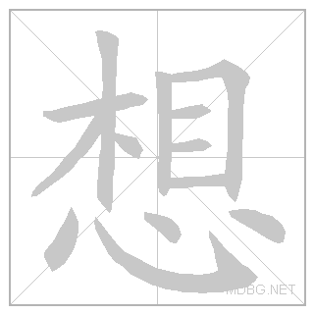
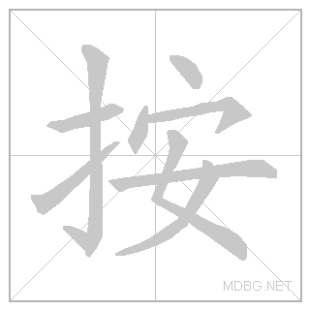

In these character animations, can you work out which colour is the radical and which the phonetic?

Slide 17

Writing characters: a question of balance
均
Characters are not symmetrical, but they are always balanced and in proportion

Slide 18


Every character fits harmoniously in a square
From the simplest:
To the more complicated:

Slide 19
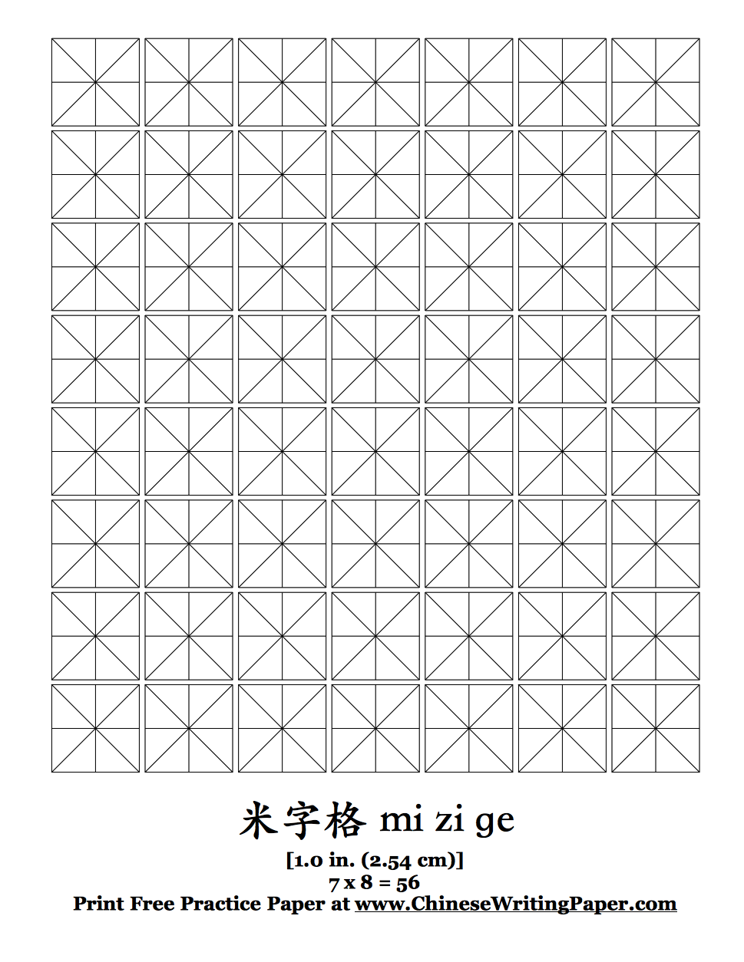
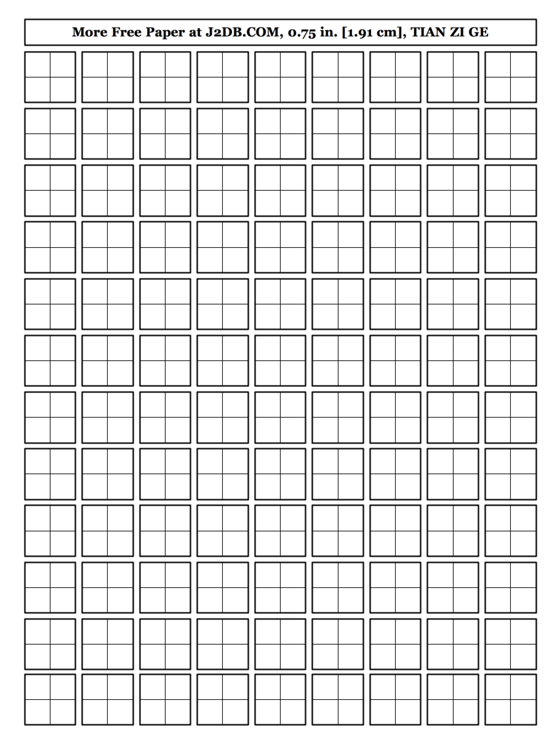
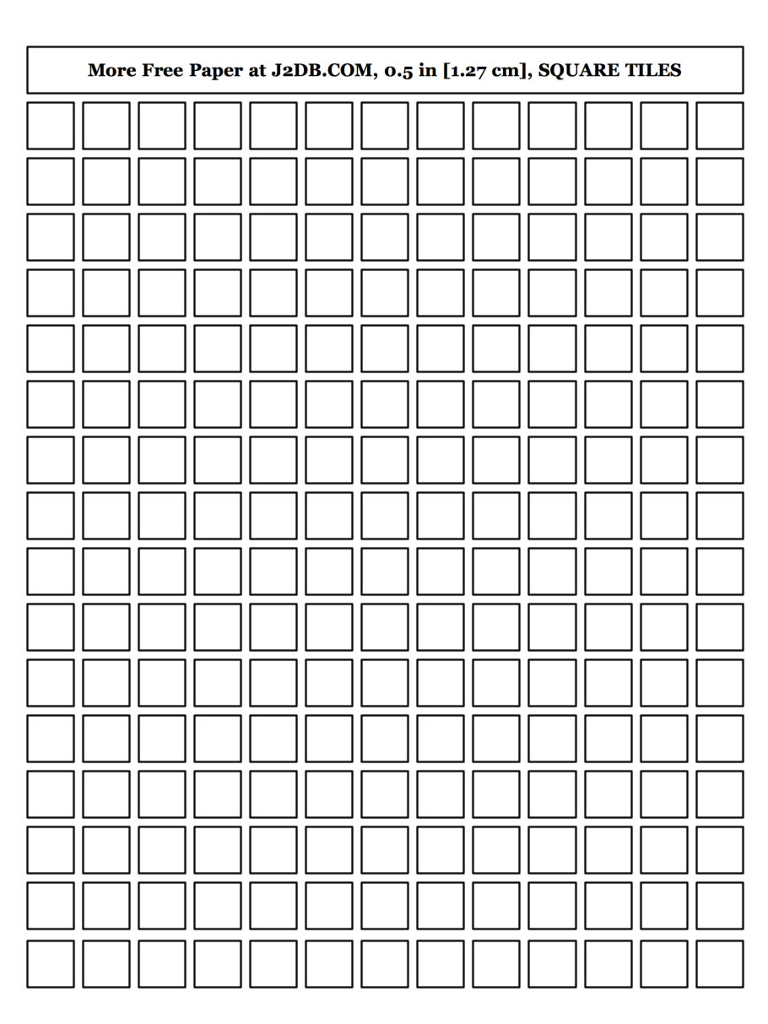
So it is best to practice on squared paper which you can download here

Slide 20
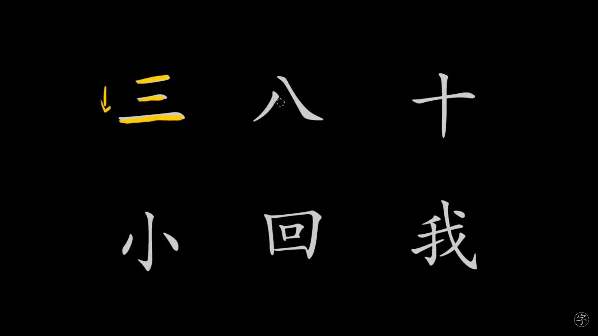
There is a correct stroke order for writing characters and they never look quite right if you don’t follow it….but the rules are quite confusing
So here's video that gives a simple guide:

Slide 21


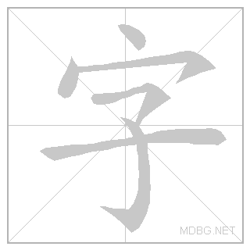
Like most things with characters, practice is the best way to learn…
and animated characters really help:
xiě hàn zì write Chinese characters

Slide 22
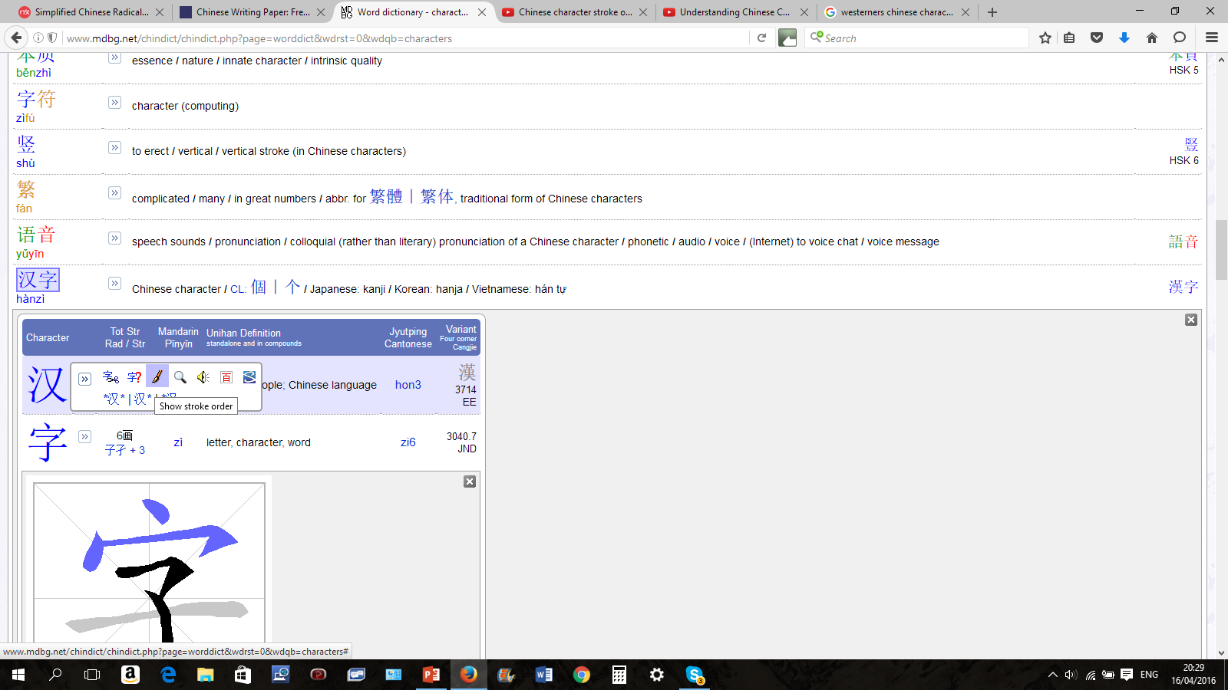
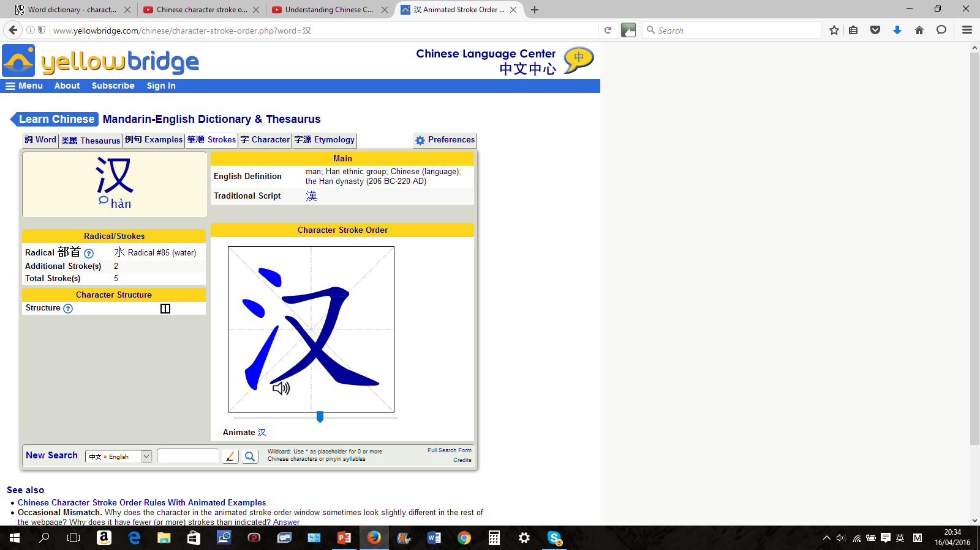
There are several online dictionaries which give you both animated stroke order and sound files for pronunciation. These are two of the best:
http://www.yellowbridge.com/chinese/dictionary.php
www.mdbg.net
There are links to MDBG entries for all the characters in the Programme of Study in the accompanying vocabulary list

Slide 23
N.B.There is no relation between the complexity of a character and its meaning
Learning to write characters takes longer than learning oral vocabulary
DO NOT expect your students to be able to write all they can say
DO NOT worry about this!
Time spent at this stage getting familiar with the basics of characters is invaluable for the future
Time spent writing a few characters correctly and attractively is time well-spent
Concentrate on characters that are useful in the classroom and are fun for your students
Incorporate some character practice into every lesson – it doesn’t have to be a routine but keep emphasizing the basics

Slide 24
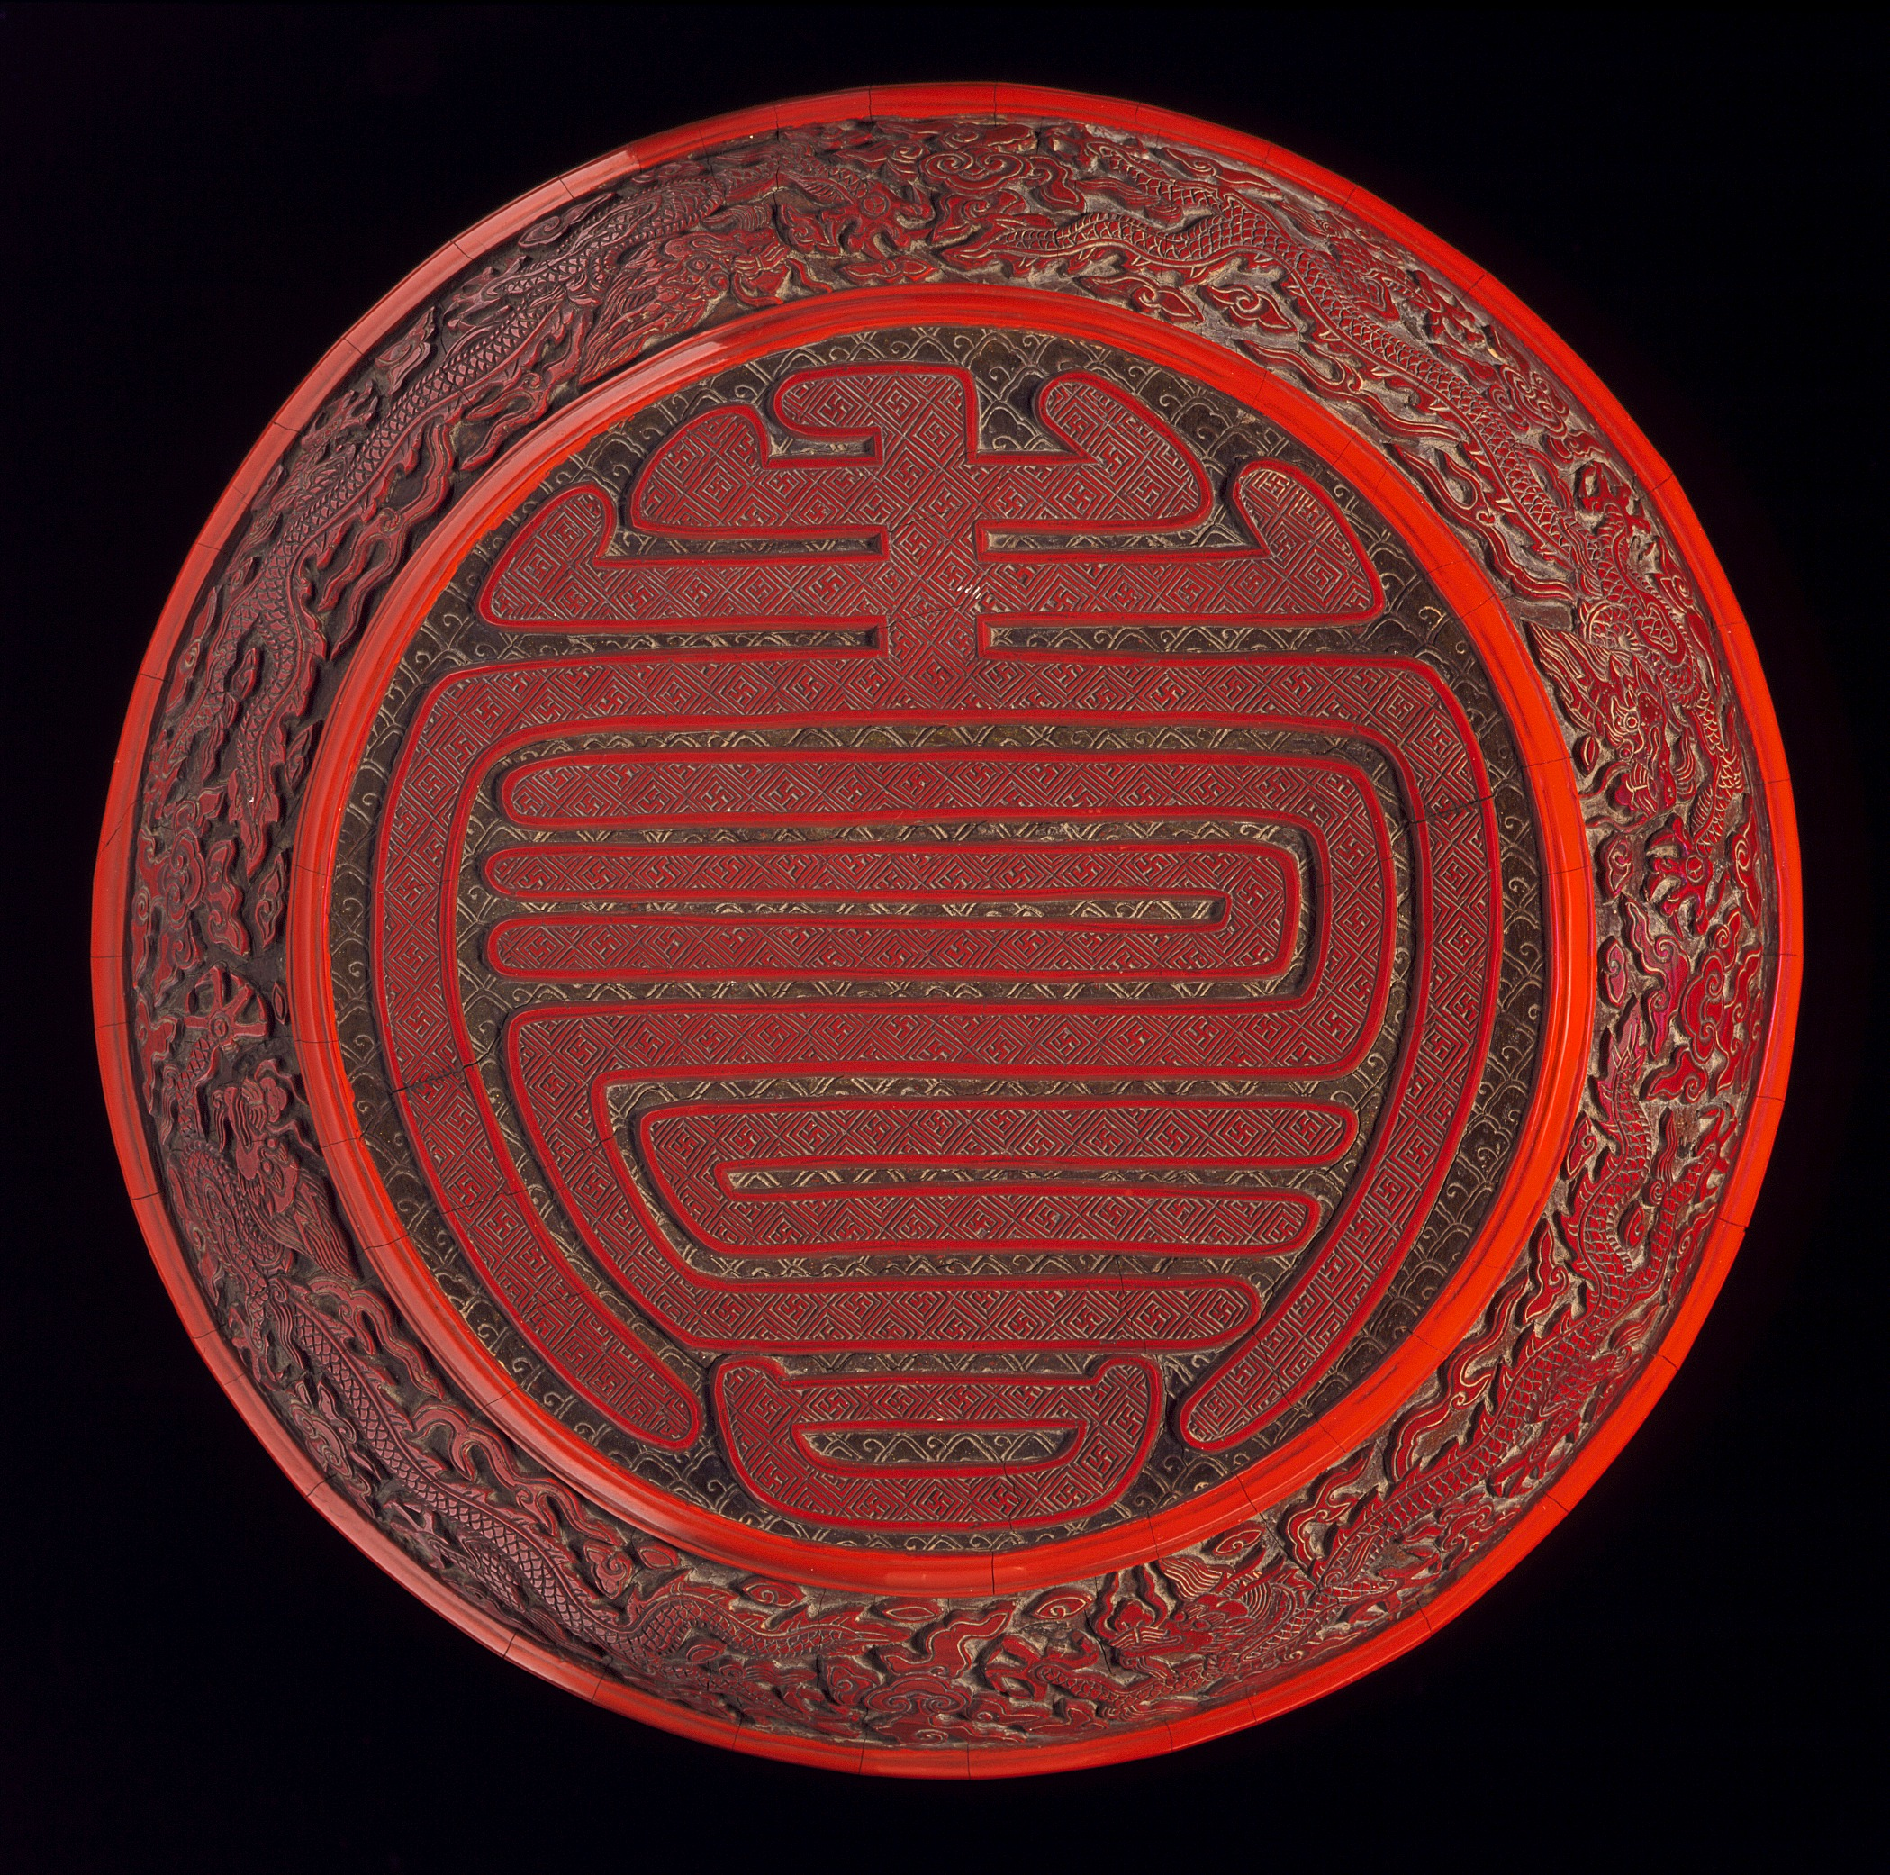
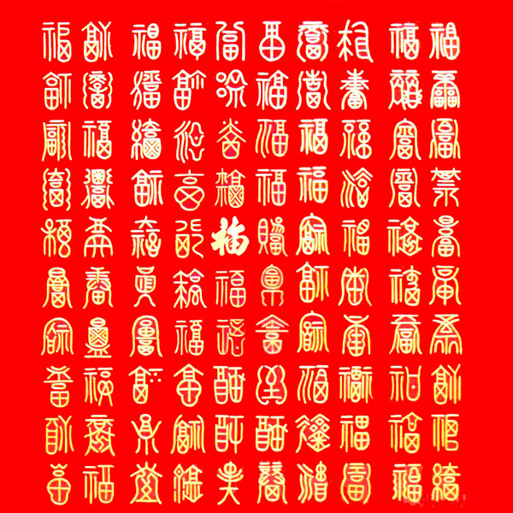
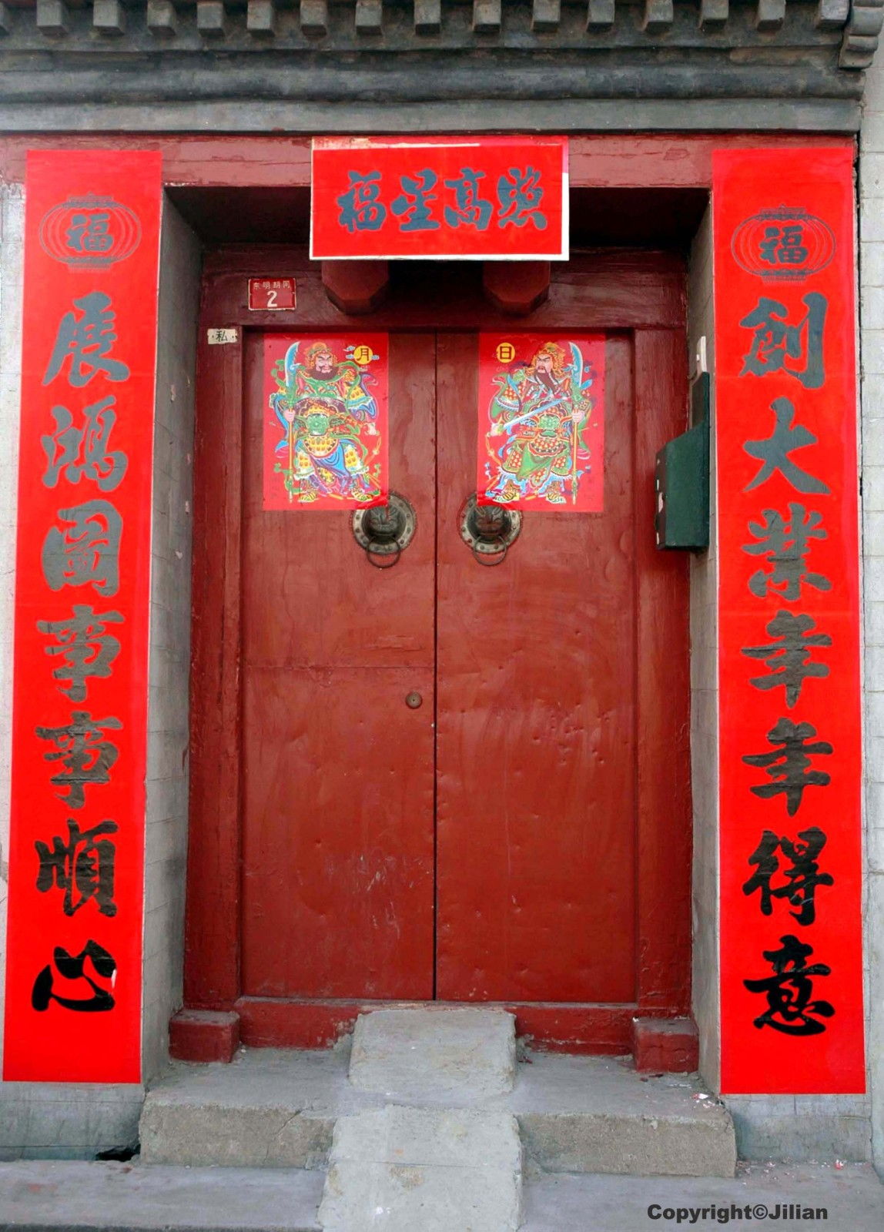
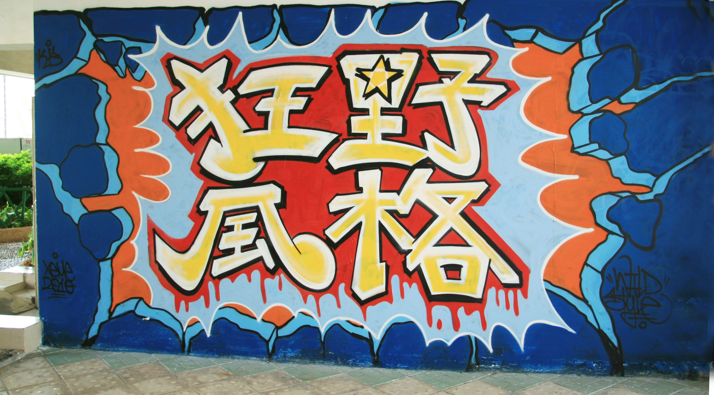

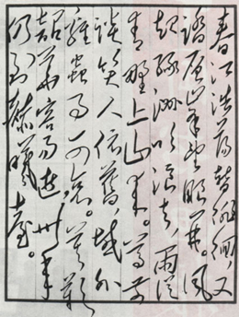
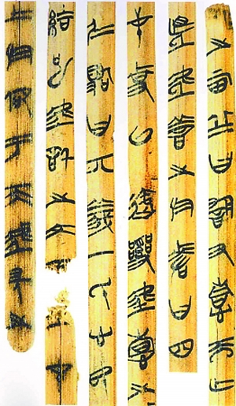
In real life, characters come in all shapes, sizes and situations!!

Slide 25
Finally!
Remember that your students really love writing characters
They will understand that characters have to be written properly
So do use character squares and encourage correct stroke order
Put up labels, signs and posters in characters around the classroom and the school
Respect characters but do go a bit wild from time to time
Characters have 3000 years of history so they can stand up to a bit of mucking around
Have a Chinese graffiti board
Use brushes, pens, pencils, magic markers……….
Buy some magic water paper
Try water calligraphy the playground
Use different colours and fonts
Make 3-d characters in modelling clay and papier mache
Try making “human characters”
Try making your own character animations/illustrations
Have fun!

