Slide 1


学生你们好
xué sheng nǐmen hǎo
老师你好
lǎo shī nǐ hǎo

Slide 2
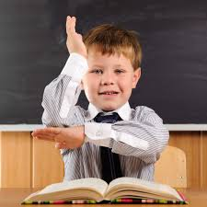



举手
安静
看老师
两两练习
jǔ shǒu
ān jìng
kàn lǎo shī
liǎng liǎng liàn xí

Slide 3
LO: To describe the main characters in ‘Journey to the West’
日期：3月12日

Slide 4
The Four Tones
First – dentist ā
Second – what? á
Third – ‘really?’ ǎ
Fourth – No! à

Slide 5
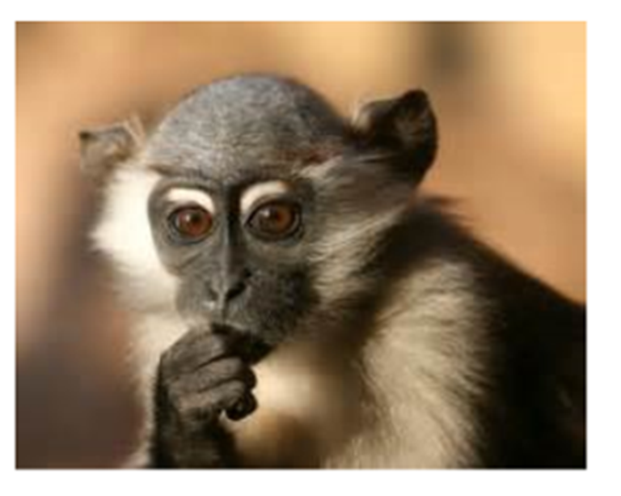
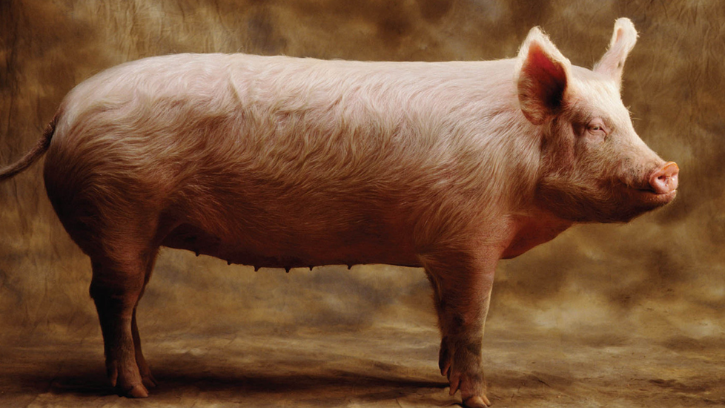
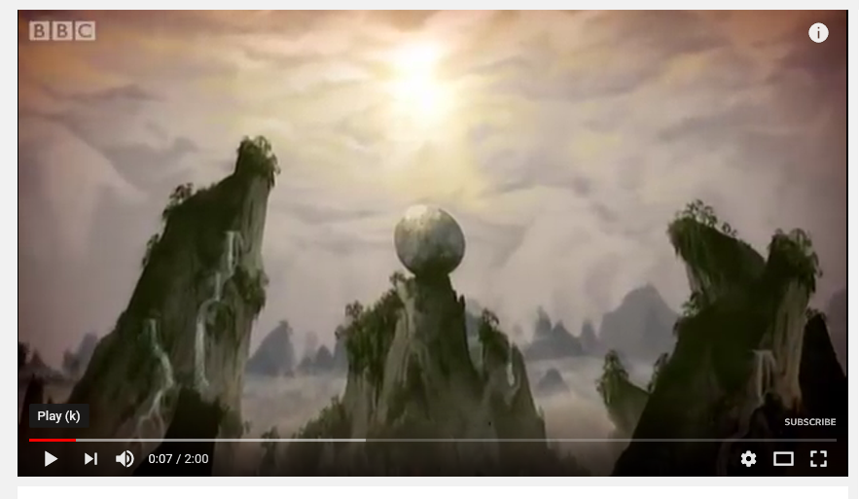
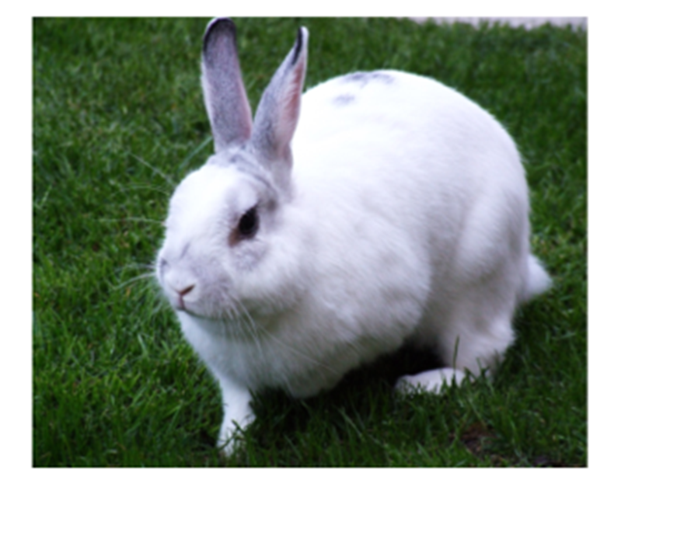
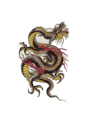

hóu zi
zhū
tù zi
lóng
gǒu
TPS: which of these animals appears in the video?
Notes:
https://www.youtube.com/watch?v=Yr5ZWYRaAyw&feature=youtu.be&safe=active

Slide 6
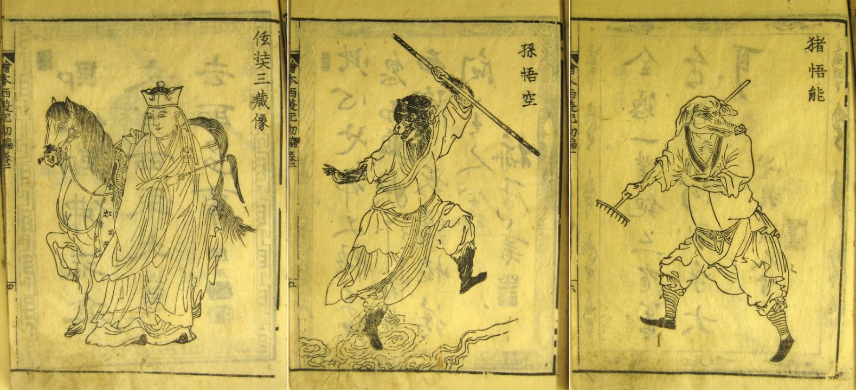
The Journey to the West
Notes:
The Monkey King is a main character in The Journey to the West (Wu Cheng’en), published around 1592, over 400 yrs ago. It is the most famous novel in Chinese literature. The main characters, Monkey, Pigsy and Sandy, are all immortals who have done something wrong and are being given a chance to make up for it by escorting a monk on a special journey.

Slide 7
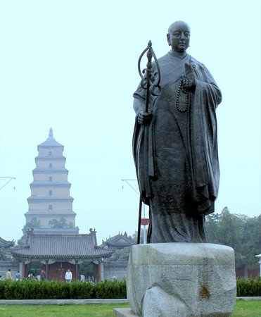
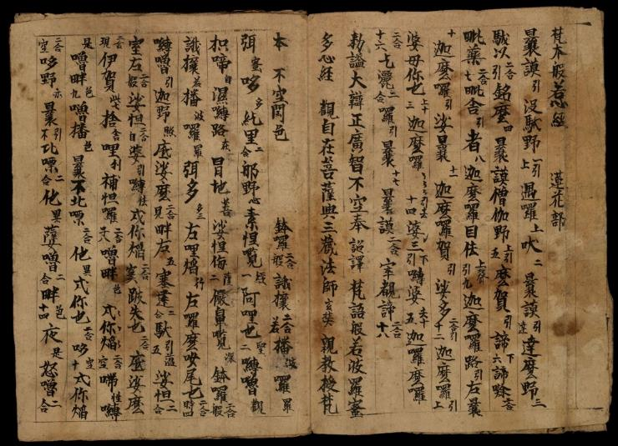
Xuán Zàng
Notes:
The novel is based on real-life travels of Buddhist monk, Xuan Zang, who journeyed to India to bring back Buddhist holy texts (602-664 CE). It took him 16 years to travel from China to get to India.

Slide 8
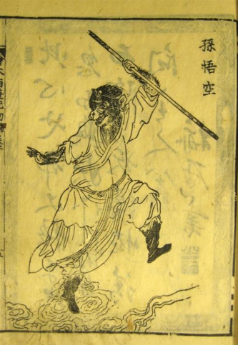
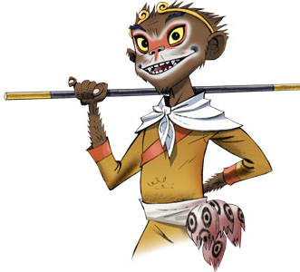
Sūn wù kōng
magic staff
somersault cloud
immortal
can transform
The Monkey King
Notes:
猴子/ 孙悟空 After causing all sorts of trouble in heaven, Monkey had been imprisoned under a mountain. He was held there for 500 years before being freed by Guanyin, the Goddess of Mercy, so that he could accompany and protect Xuan Zang on his journey. Monkey’s weapon is a magic staff that was once a pillar form the Dragon King’s palace. He can make it change size, and shrinks it to the size of a needle to carry behind his ear.

Slide 9
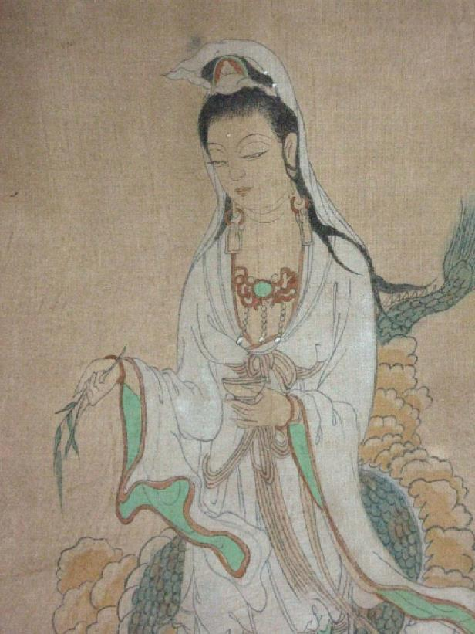
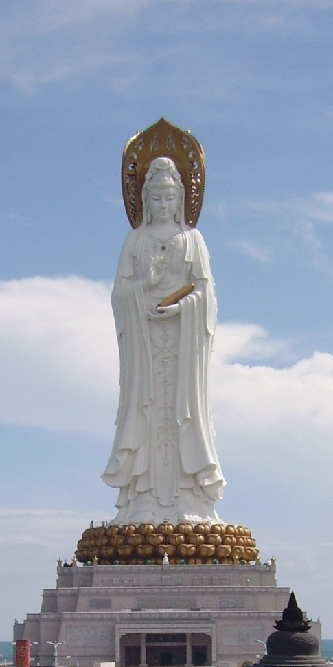
Guān yīn
goddess of mercy
Notes:
观音 After causing all sorts of trouble in heaven, Monkey had been imprisoned under a mountain. He was held there for 500 years before being freed by Guanyin, the Goddess of Mercy, so that he could accompany and protect Xuan Zang on his journey. She also gives him 2 companions to help him complete his journey.

Slide 10
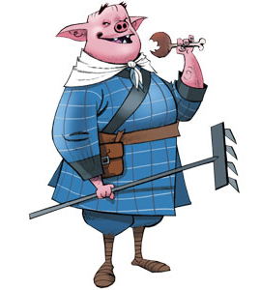
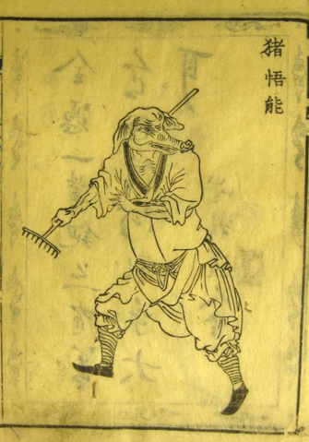

Zhū bā jiè
Rake
Very strong
Stupid and greedy
Pigsy
zhū
Notes:
Zhu Bajie 猪八戒 was a heavenly general who disgraced himself and was turned into a pig monster. He is very strong but also very stupid and greedy (and is always chasing beautiful women). His weapon is a rake.

Slide 11
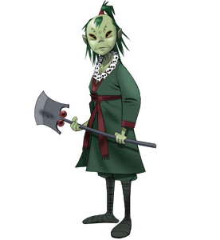
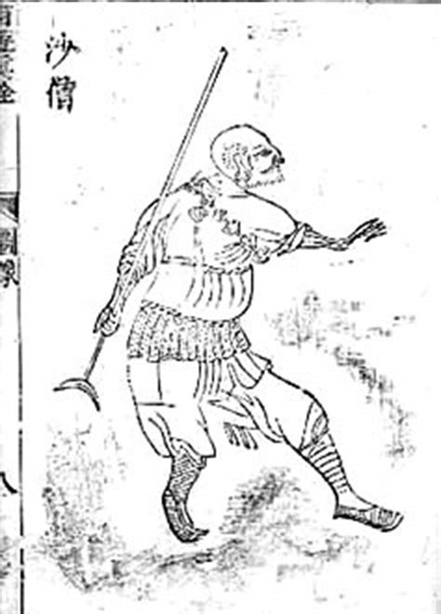
Shā Wùjìng
Spade
Swimming
Sandy
Notes:
Sha Wujing 沙悟净 was a heavenly general who broke one of the Jade Emperor’s precious vases. His punishment was to be turned into a man-eating sand-demon. His weapon is a spade.

Slide 12
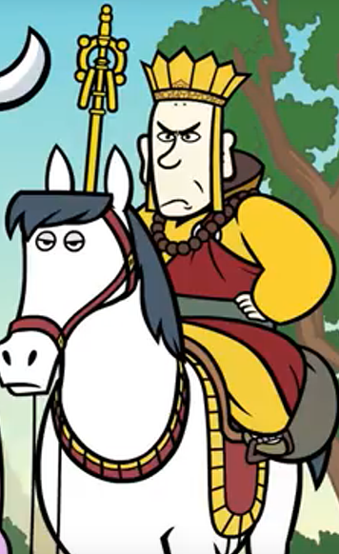
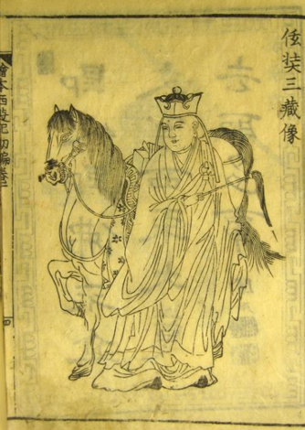
Táng sān cáng
Buddhist monk
Horse
Shī fù
Notes:
师父 Wise Buddhist monk. He is travelling to India to collect previous holy books. Monkey is protecting him on his journey.

Slide 13
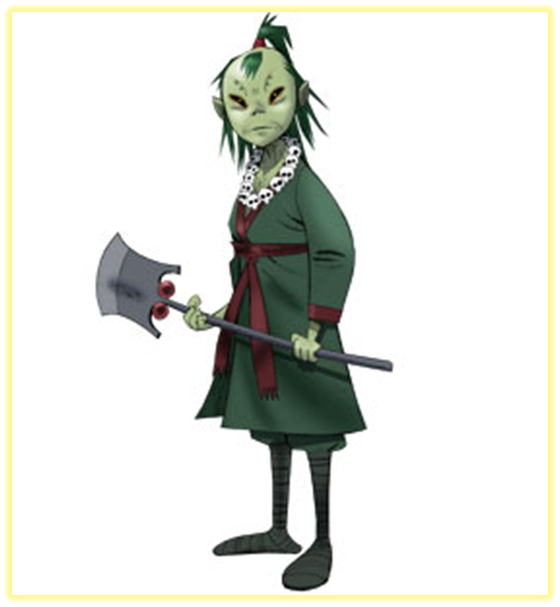
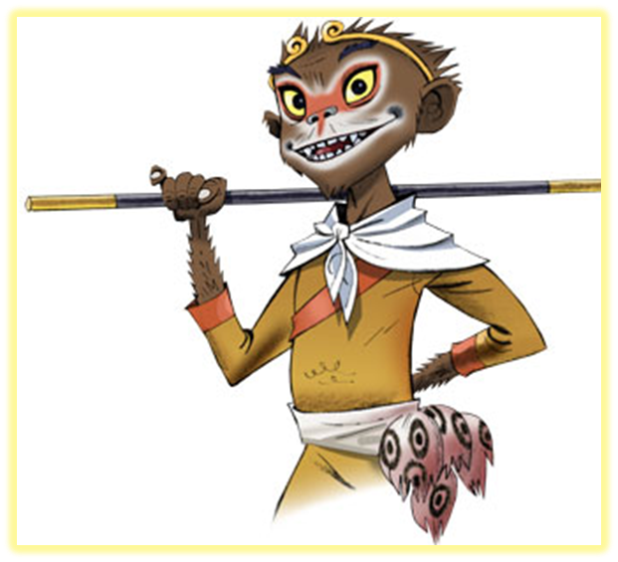
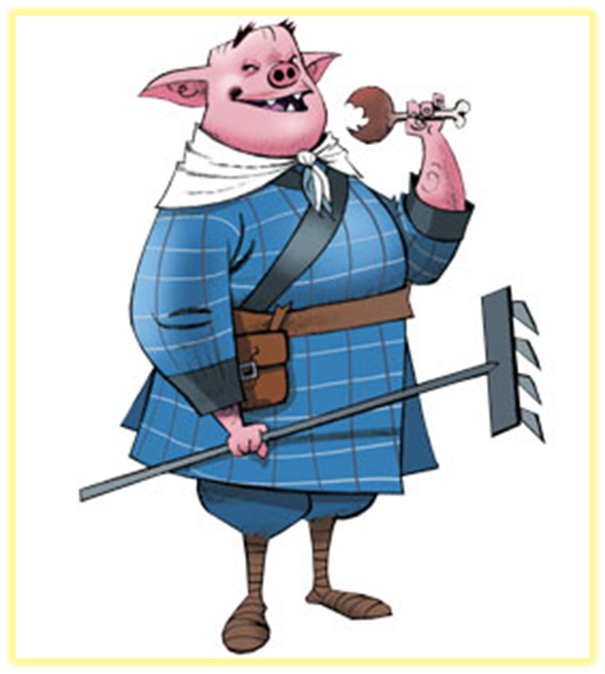
lǜ sè hé cháng de tóu fā
Journey to the West
Character Map
hóng sè de yǎn jīng
méi yǒu tóu fā
Shā Wùjìng
Sūn wù kōng
Zhū bā jiè

Slide 14
lǜ sè
Journey to the West
Character Map
hóng sè
Shā Wùjìng
Sūn wù kōng
dà
Zhū bā jiè

Slide 15









1
hěn lèi
2
gāo xīng
3
hài pà
4
xīng fèn
5
shēng qì
6
nán guò
7
hěn hǎo
8
rè
9
lěng

