Slide 1
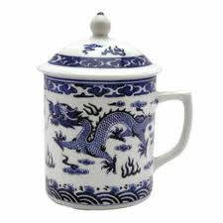
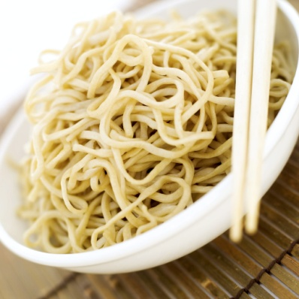
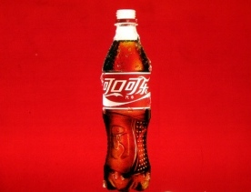
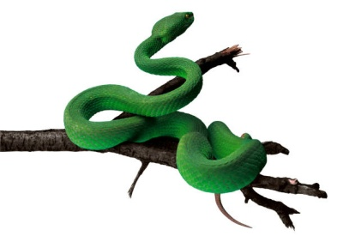
量词 measure words
liàng cí

Slide 2
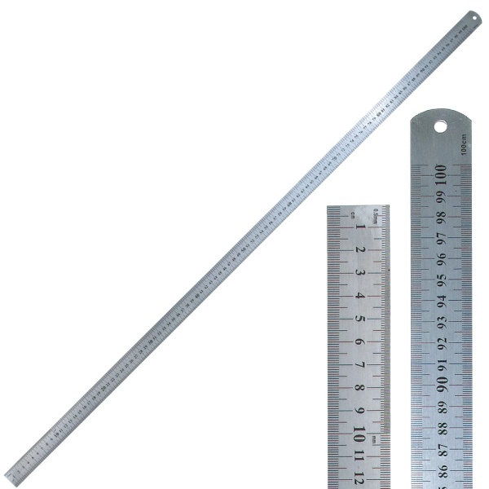
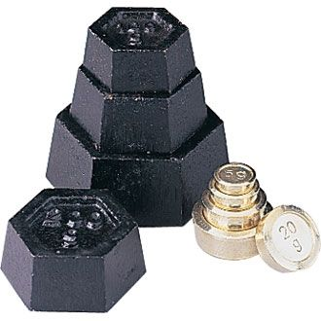
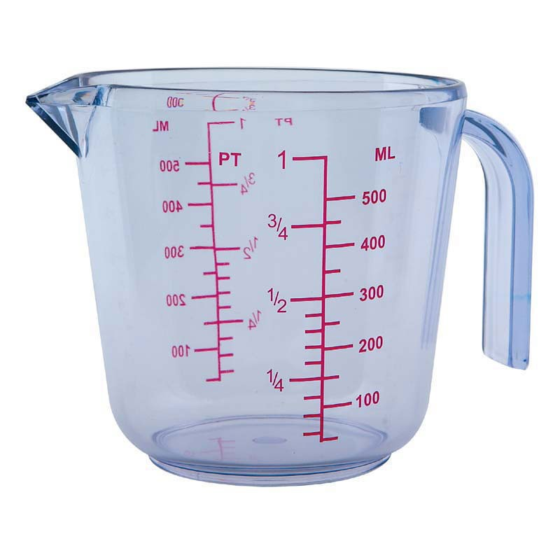
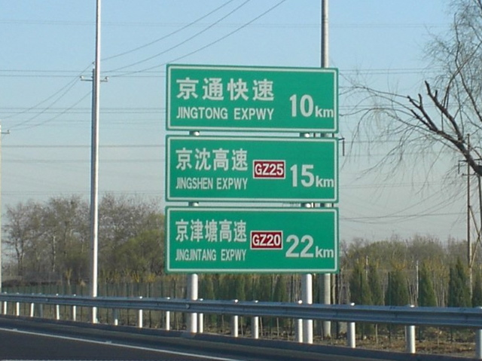
厘米 米
cm m
lí mǐ mǐ
克 公斤
g kg
kè gōng jīn
Standard measures
公勺 公升
cl l
gōng gōng
sháo shēng
公里
km
gōng lǐ

Slide 3


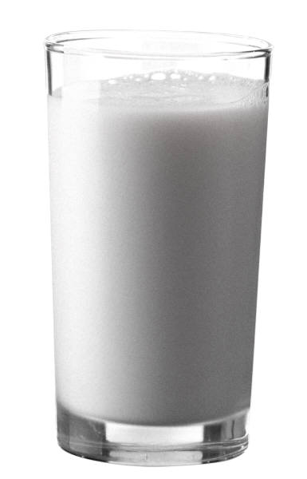
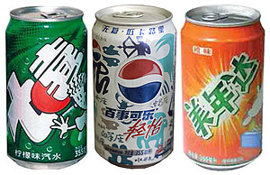
杯 cup/glass
碗 bowl
bēi
INFORMAL MEASURES
wǎn
瓶 bottle
罐 can
píng
guàn

Slide 4
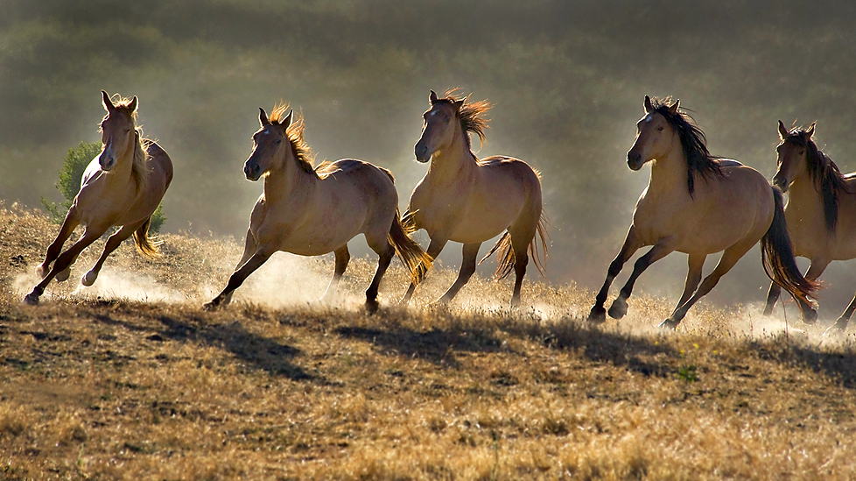
General measures
Measure words have their origins in stock-taking in the Bronze Age
馬 : 五 馬 mǎ : wǔ mǎ
Horses - 5 horses

Slide 5

This became:
馬 : 五 匹 mǎ : wǔ pǐ
Horses - 5 units
and that’s how it has stayed

Slide 6
And this became:
五 匹 馬 wǔ pǐ mǎ
5 units of horse = 5 horses

Slide 7
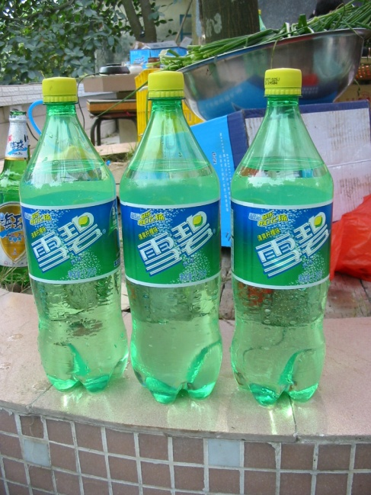
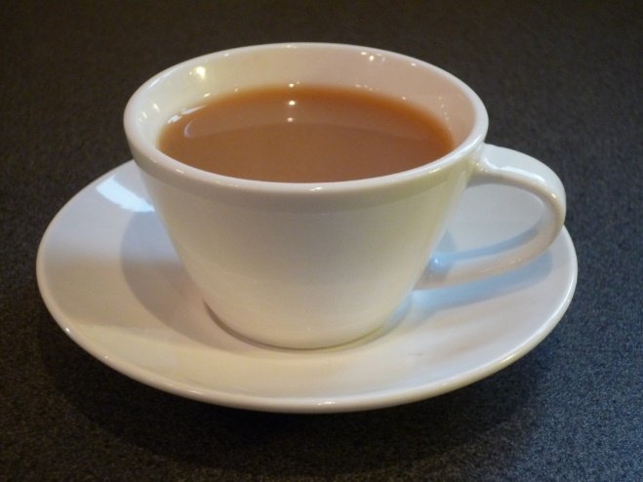
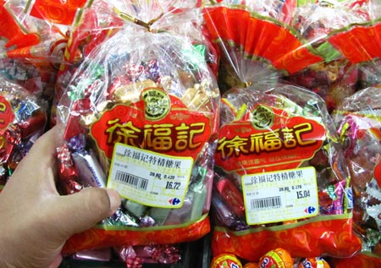
一杯茶 三瓶雪碧 两包糖果
yī bēi chá sān píng xuě bì liǎng bāo táng guǒ

Slide 8
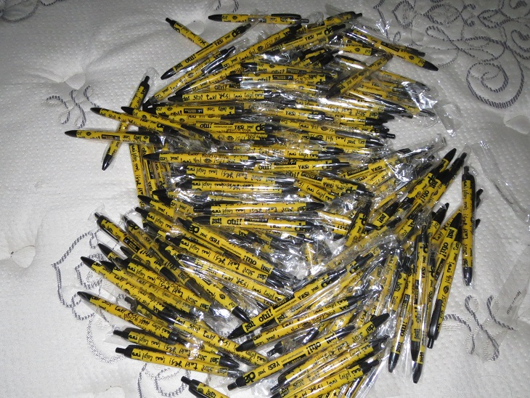
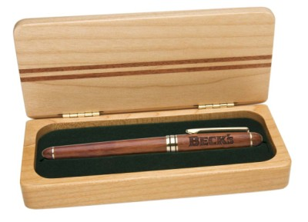
A pile of pens is difficult to count
but it’s easier if you put each into a special container for long straight things called a 支 zhī
一支笔
yī zhī bǐ

Slide 9
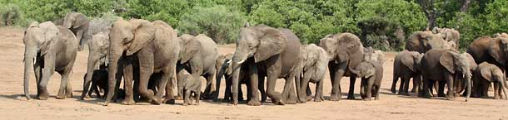
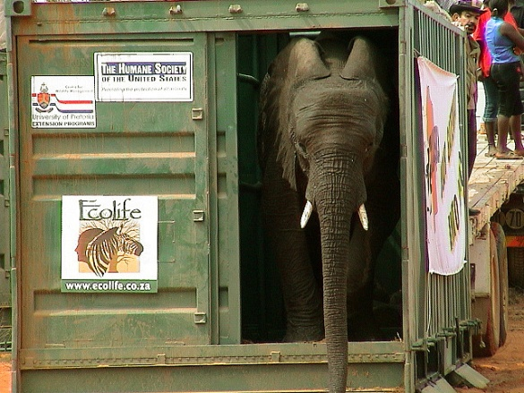
Different categories of things have different “containers”…..
Most animals fit in a different kind of zhī 只
一只象
Yī zhī xiàng

Slide 10
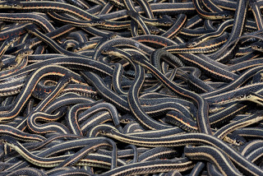
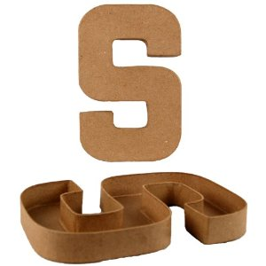
Long thin wiggly things like snakes (but also fish, roads and rivers) go in a 条 tiáo
yī tiáo shé

Slide 11
But if you’re stuck, you have a best friend
个 gè
which is a general purpose container and is very flexible

Slide 12
You can find more information on measure words here:
http://mandarinchallenge.blogspot.co.uk/2012/06/chinese-measure-words.html
http://laowaichinese.net/top-10-measure-words-to-know.htm
http://www.languagerealm.com/chinese/chinese_measure_words.php
http://www.ctcfl.ox.ac.uk/Grammar%20exercises/Measure%20words.htm

