Slide 1

Numbers 2016年9月14日
Starter:
Copy the title and date. What do you notice about the date in Chinese?
Lesson Objectives:
Say and read numbers 1-10 in Chinese
Be able to write the 8 basic strokes & understand the rules for writing characters
Be able to copy 1-10 with the right stroke order

Slide 2

yī
一

Slide 3

èr
二

Slide 4

sān
三

Slide 5

sì
四

Slide 6

wǔ
五

Slide 7


3
2
4
5
1

Slide 8

12
1
3
2
5
4

Slide 9

五
一
三
二
四

Slide 10

liù
六

Slide 11

qī
七

Slide 12

bā
八

Slide 13

jiǔ
九

Slide 14

shí
十

Slide 15


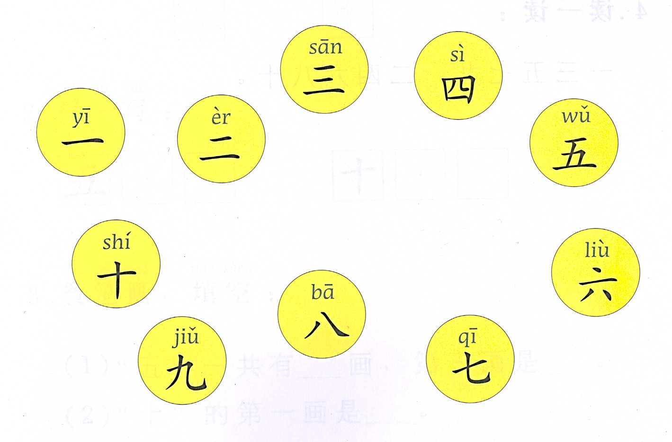








https://www.youtube.com/watch?v=2eLP3FuuEVs

Slide 16
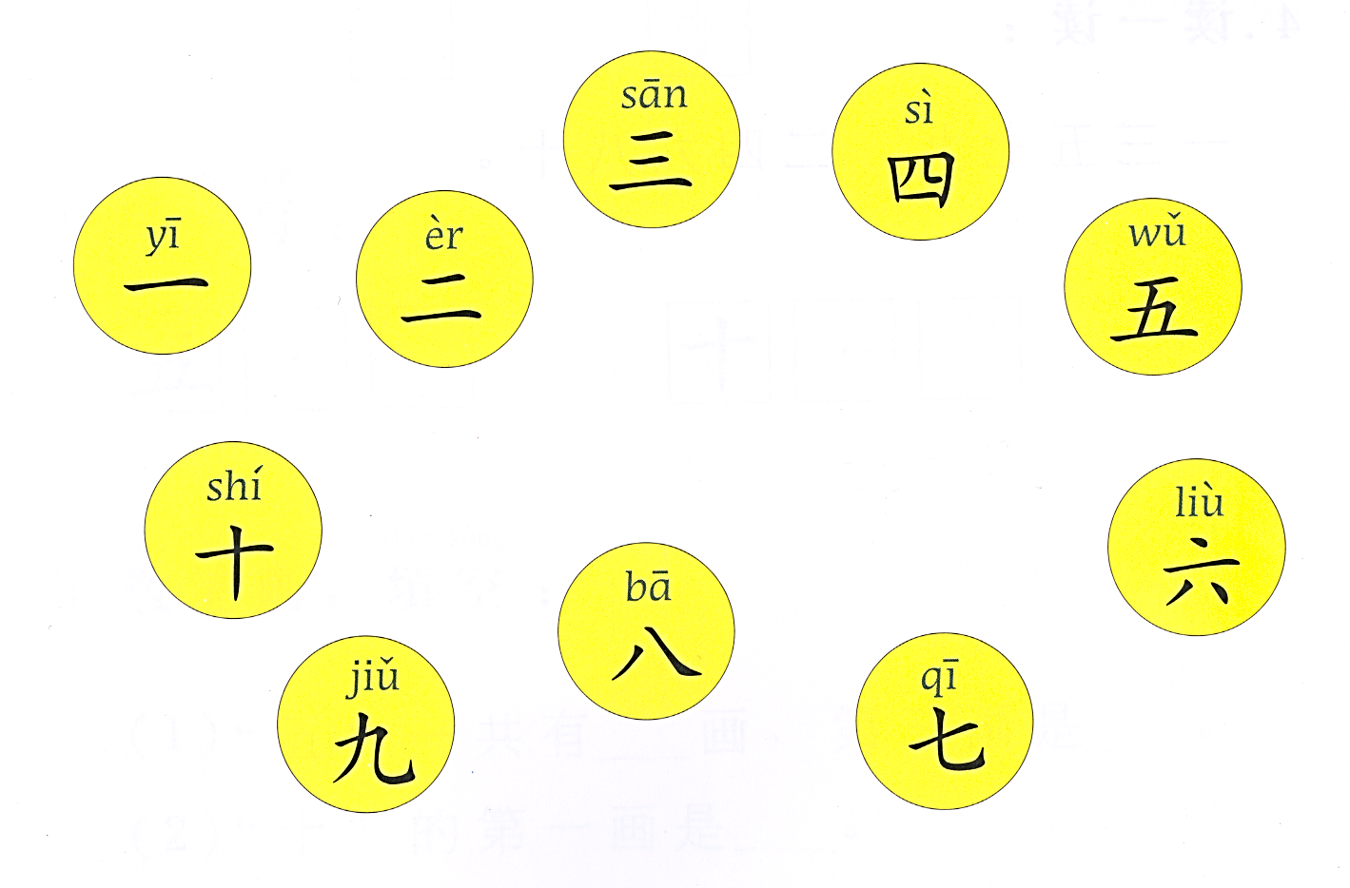

Slide 17
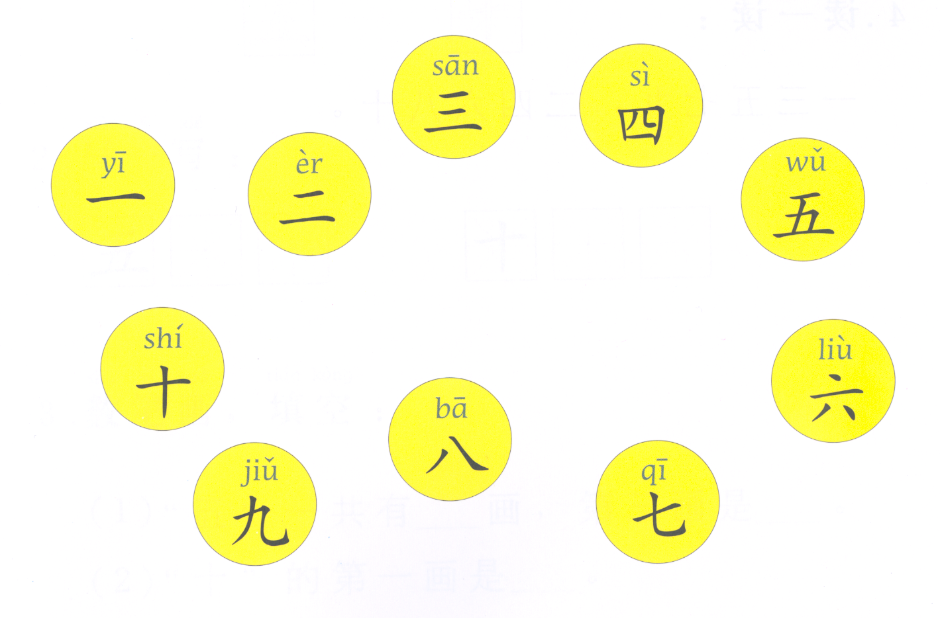

Slide 23
作业！
Copy the numbers characters in your yellow workbook (after pg. 10). Pay attention to stroke order
Learn to recognise and write the characters for numbers 1-10
Learn to say numbers 1-10
Numbers vocabulary test on Monday (listening, reading and writing)

