Slide 1
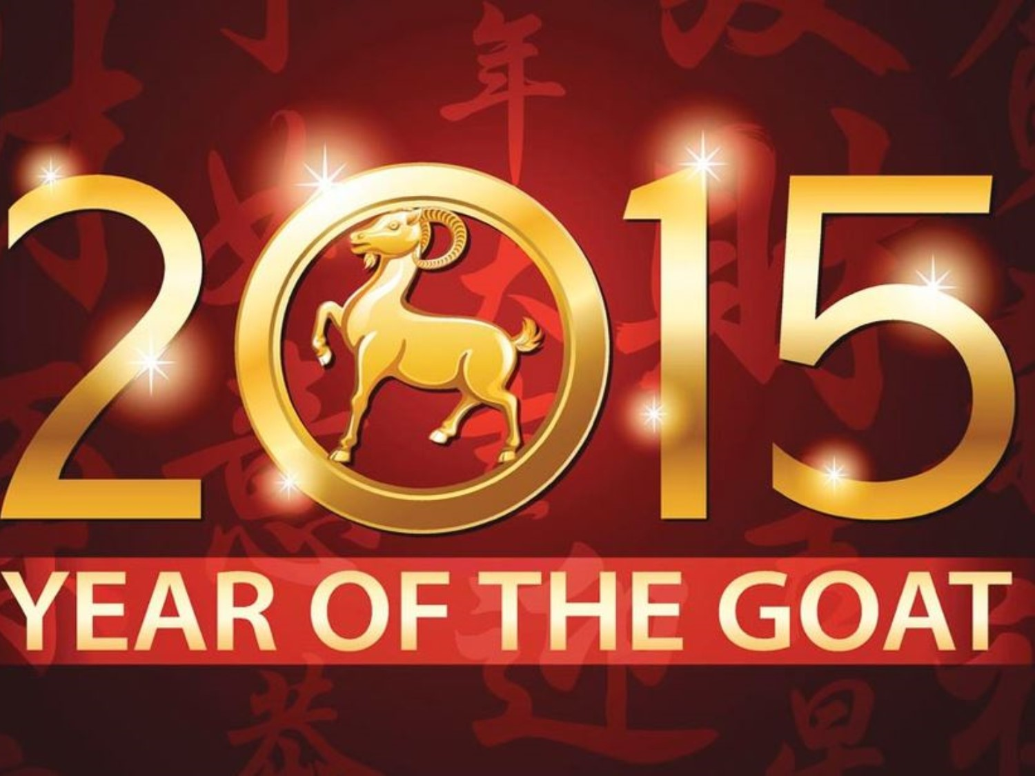
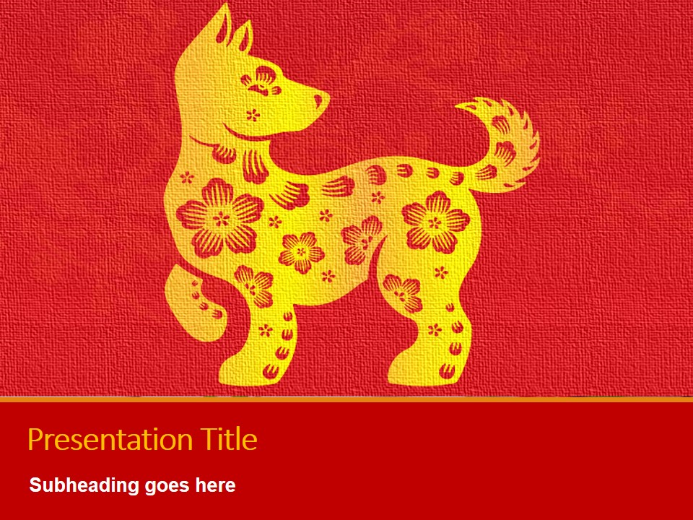
Theme: Chinese New Year, Year of the Dog!
Please listen to the music and look at the screen!How many pieces of information have you gathered before I start talking?
Learning Objective:
To know some of the traditions of Chinese New Year
To name some of the decorations
To say : 新年快乐！

Slide 2

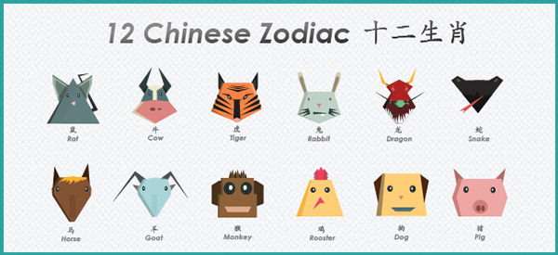
Which one is for Chinese 2018?

Slide 3
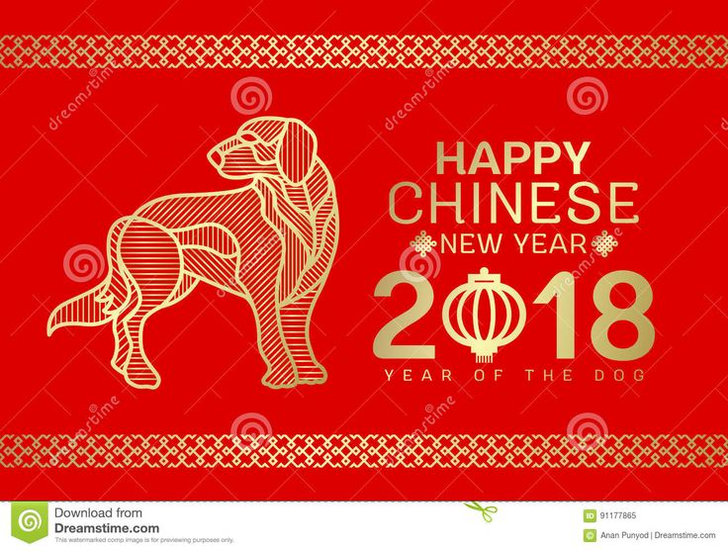
2018: Year of Dog

Slide 4
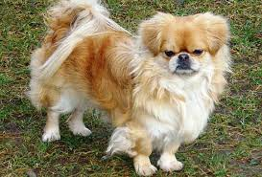
When is Chinese New Year ?
This year it is on 16 February and is the year of the
Dog

Slide 5
Fortune Teller
The Zodiac animal of the year you were born suggests your personality.
Which year were you born?

Slide 6
If you were born in
2008.....you are a rat 10 years old
2009.....you are an ox 9 years old
2010....you are a tiger 8 years old
2011 … you are a rabbit 7 years old
2012 … you are a dragon 6 years old
2013… you are a snake 5 years old
2014… you are a horse 4 years old

Slide 7
What do the Chinese families do on New Year Day?

Slide 8
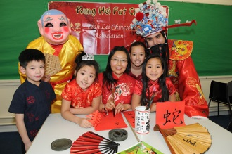
Whole families celebrate together

Slide 9
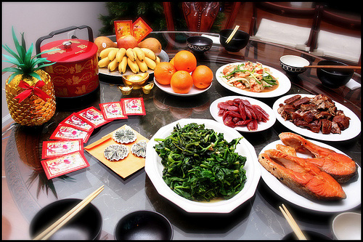
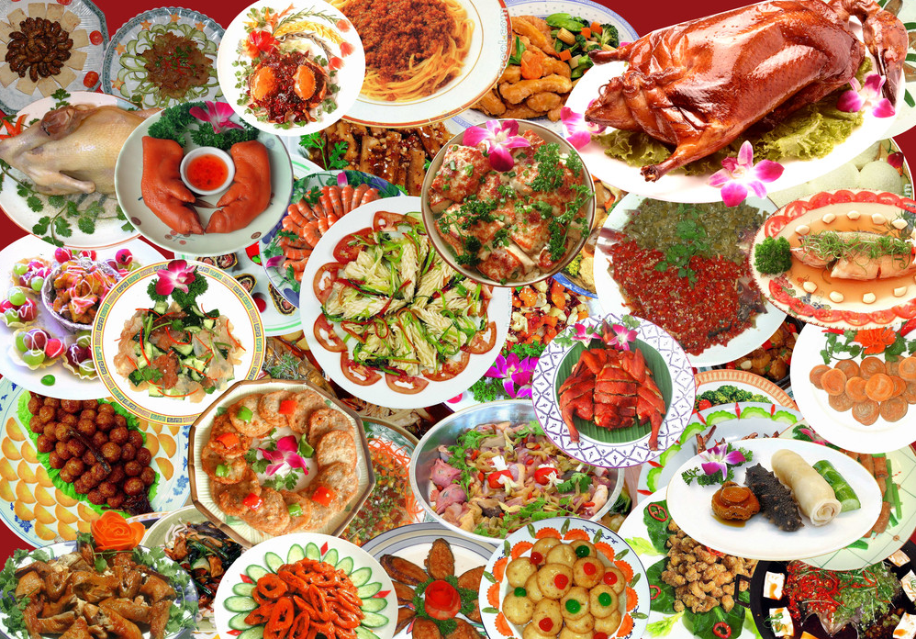
Food -lot of it !!!
Notes:
9

Slide 10
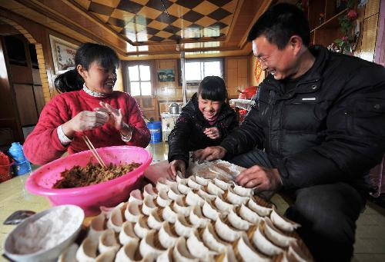
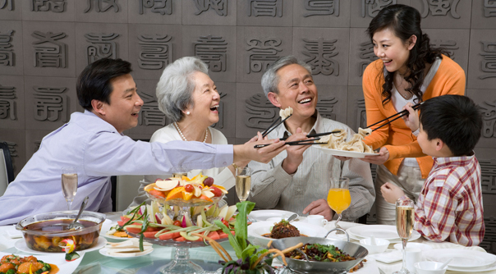
Making dumplngs
bao jiao zi
包 饺 子
Notes:
10

Slide 11
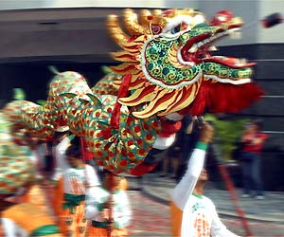
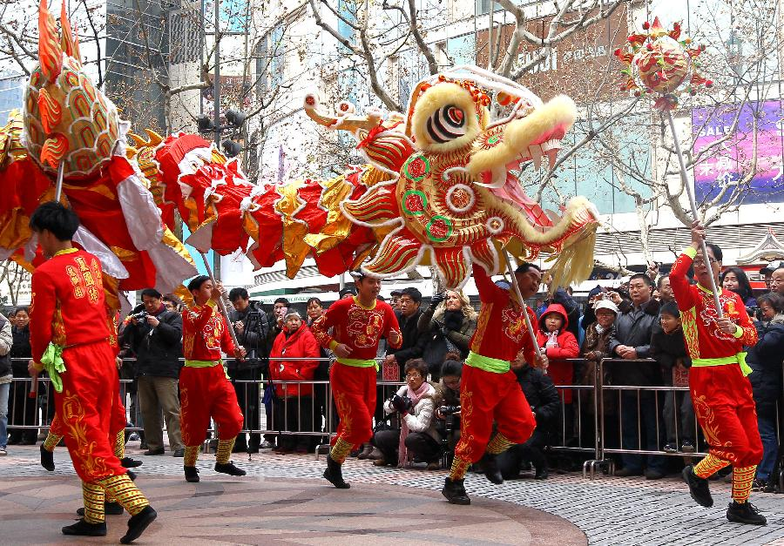
A dragon dance
Notes:
11

Slide 12
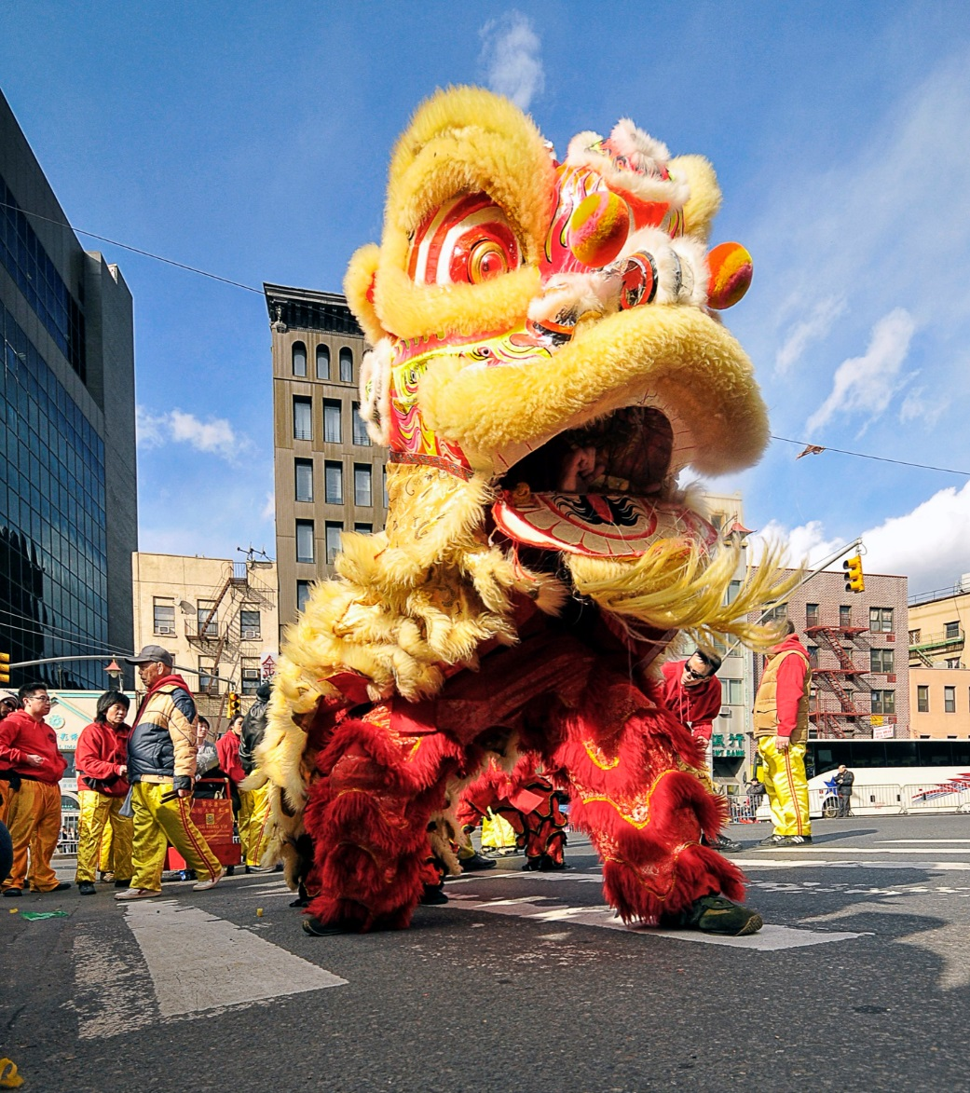
A lion dance

Slide 13
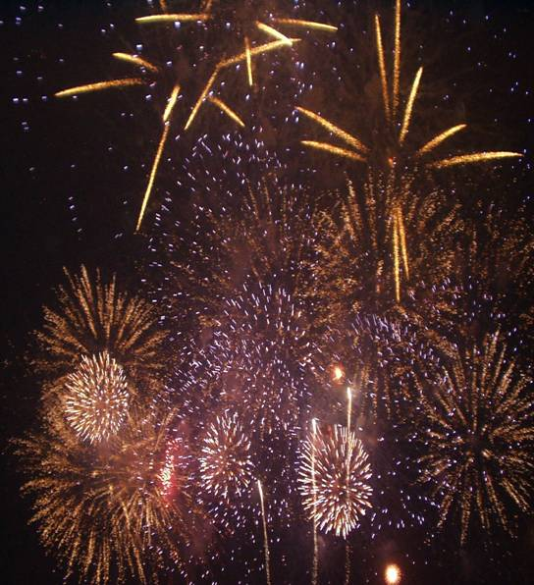
Fireworks
fang
放
yan
烟
huo
火
Notes:
13

Slide 14
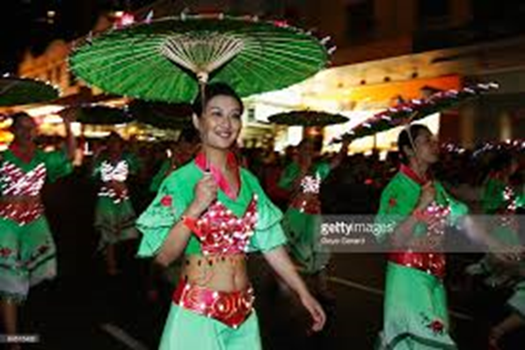
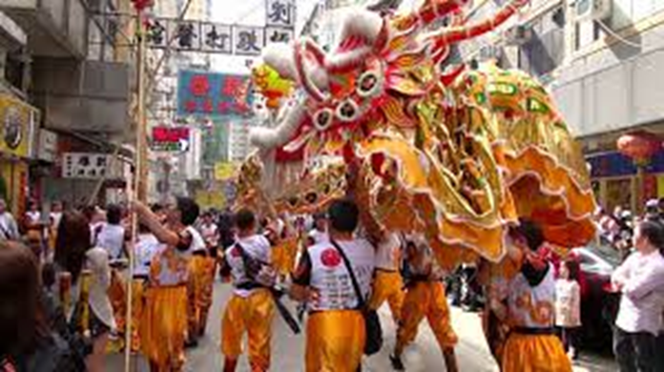
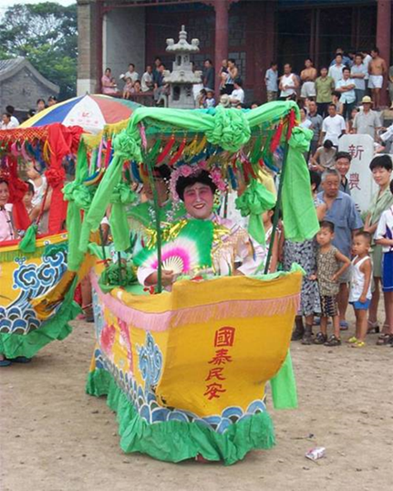
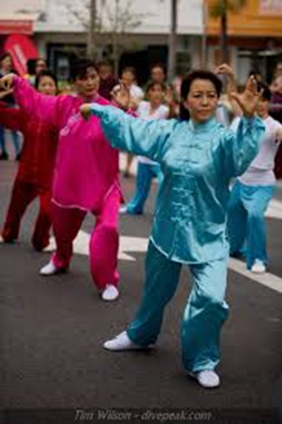
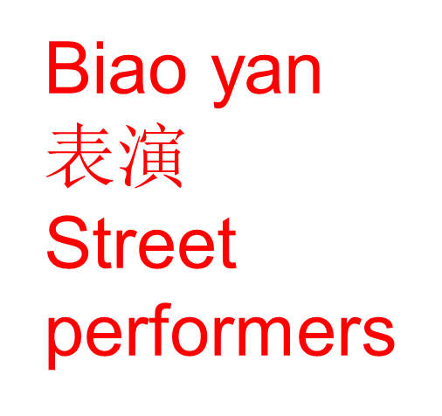

Slide 15
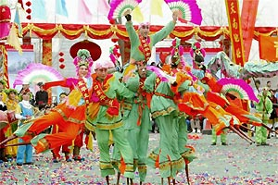
Walking tall
Actors and actress perform on
stilts at a fair In Beijing.
Notes:
15

Slide 16
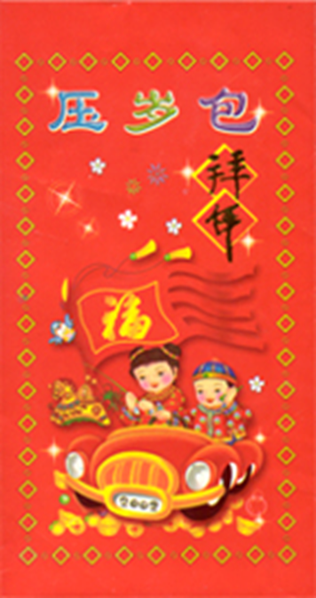
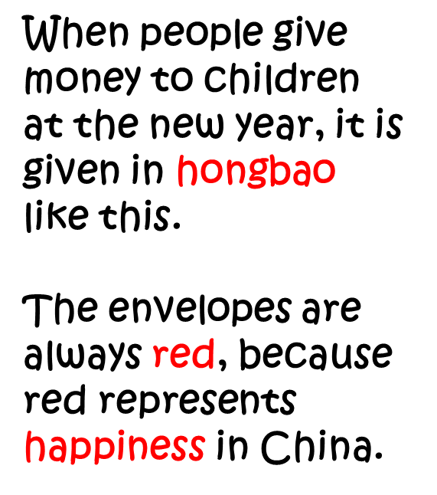


Slide 17
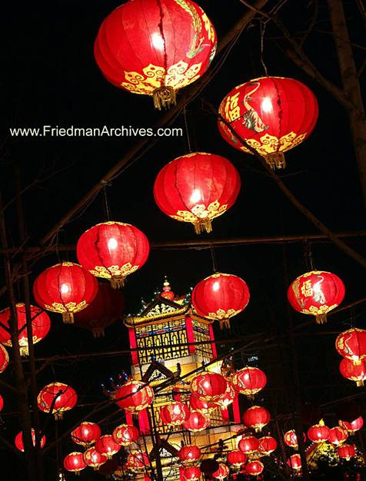
The Lantern Festival
Notes:
17

Slide 18
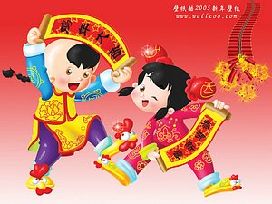
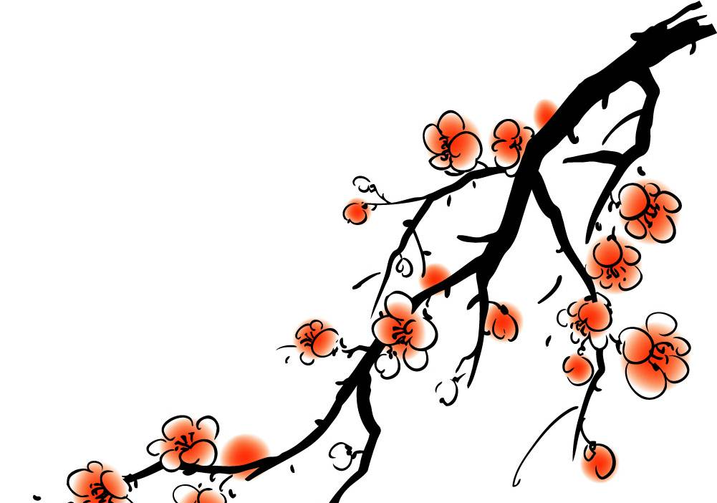
xīn nián
kuài le
新年
快乐
New Year
Happy

Slide 19
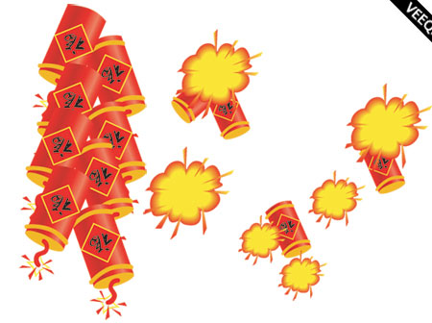
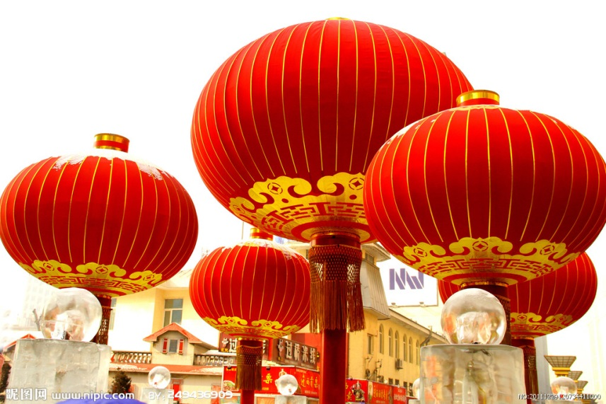
dēng lóng
biān pào
灯笼
鞭炮
Set off firecrackers: http://www.youtube.com/watch?v=zoctgUa3v_I

Slide 20
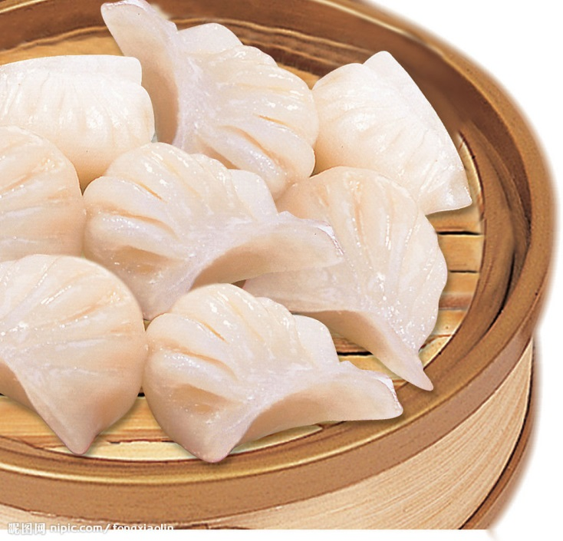
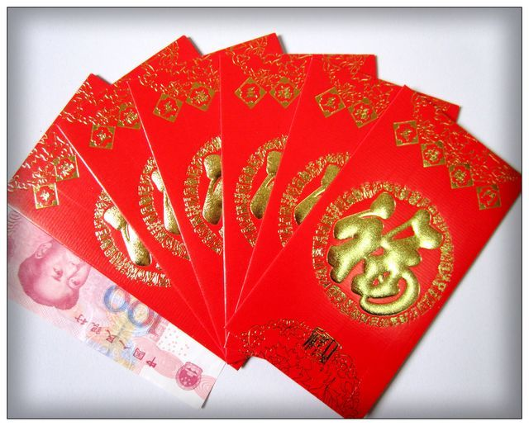
jiǎo zi
hóng bāo
饺子
红包

Slide 21
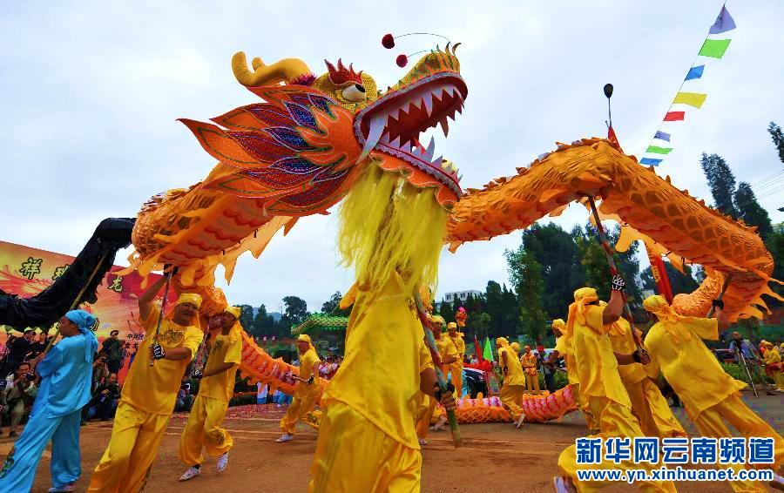
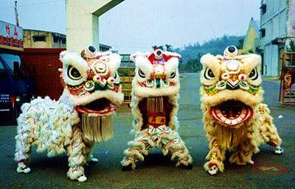
舞龙
舞狮
See lion dancing: http://www.youtube.com/watch?v=vXUyRSPg19E

Slide 22
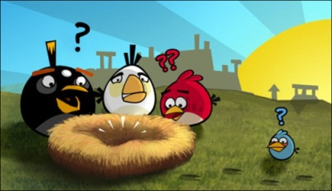
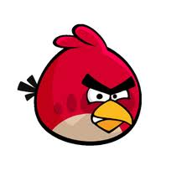


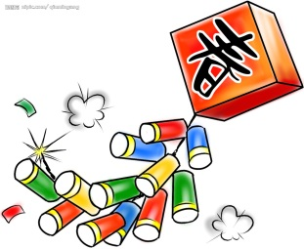
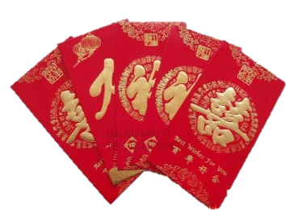
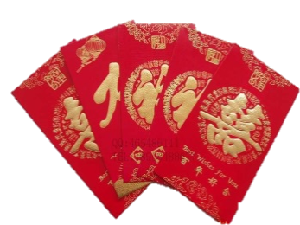
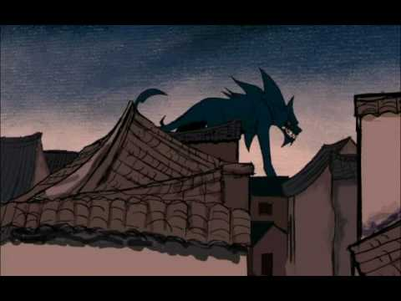

Where is Angry Bird?

Slide 23
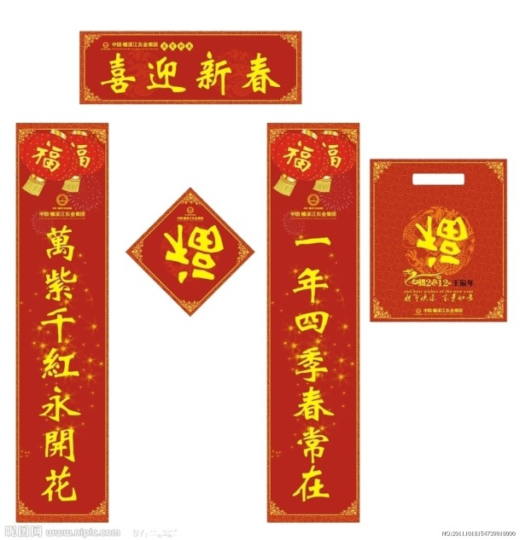
chūn lián
春联 couplets
三羊开泰心想事成
万事如意
羊年大吉
恭喜发财
步步高升春节快乐
大吉大利
恭贺新禧

Slide 24
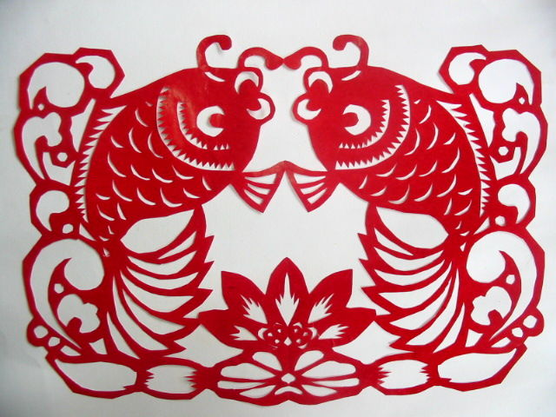
年
年
有
余
yú
鱼

Slide 25
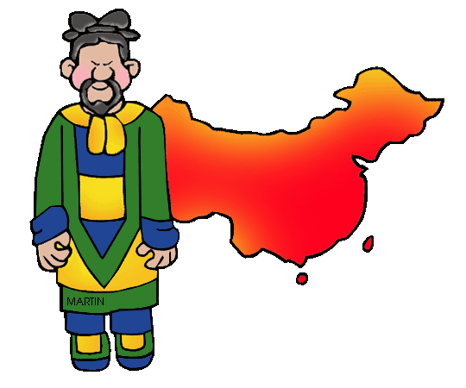
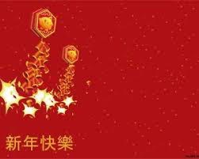

There are many ancient and delightful superstitions surrounding this holiday. This is one of our favorites.

Slide 26
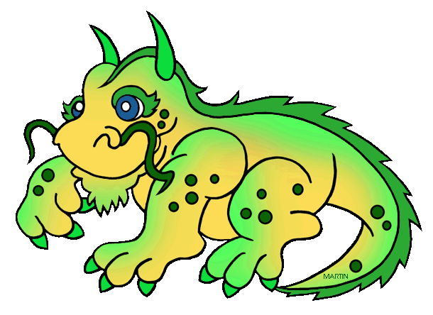
Long ago, in Han times, there was a monster whose name was "Nian". This monster came once each year to a little village and scared everyone!

Slide 27
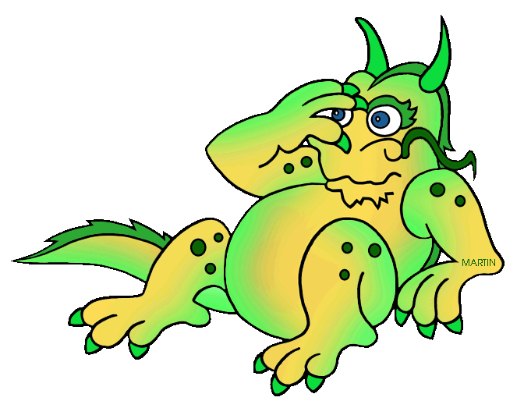
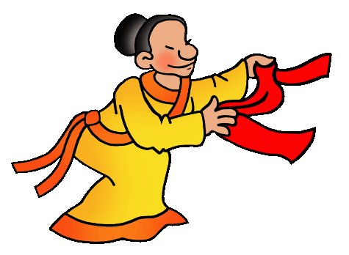
One day, just by luck, the villagers discovered that "Nian" had a couple fears of his own. He was afraid of the color red. He was even more afraid of scary loud noises!

Slide 28
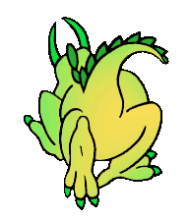
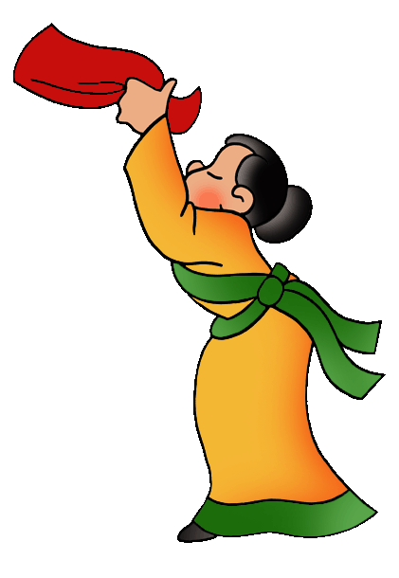
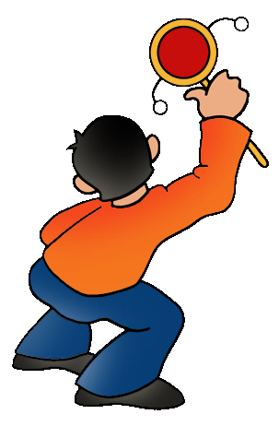
The villagers prepared.
When "Nian" appeared, everyone in the village ran for the red banners and noise makers they had made. They waved their banners and rattled their noise makers. This scared "Nian" so much that "Nian" ran away and was never heard from again!

Slide 29
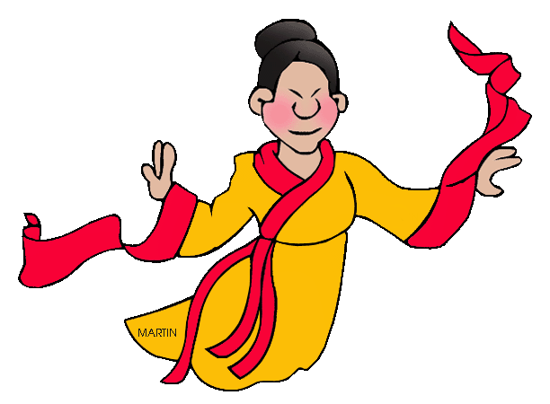
Which all goes to explain why people in China believe the color red signifies joy and luck, and why noise makers are
rattled on Chinese New Year. At midnight, firecrackers, paper dragons, noise makers, the waving of red ribbons and banners all help to drive away any lingering evil spirits from the old year. (In case "Nian" is still lurking about somewhere!)

Slide 30

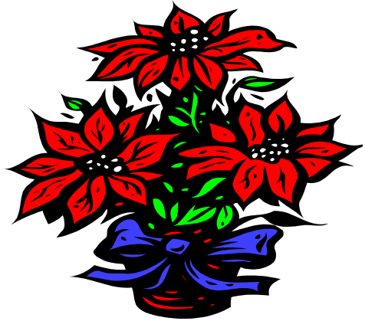
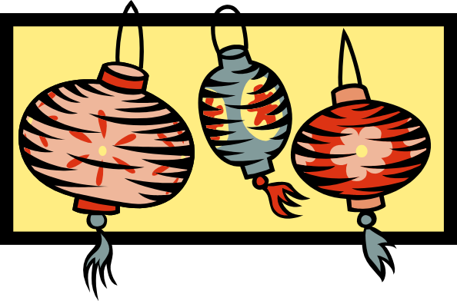


Happy new year
Happy new year
Happy new year
Happy new year to you all
We are singing
We are dancing
Happy new year to you all
Notes:
30

Slide 31

Xin nian ge
Xin nian hao ya
Xin nian hao ya
Zhuhe da jia xin nian hao
Wo men chang ge
Wo men tiao wu
Zhuhe da jia xin nian hao
Notes:
31

