Slide 1
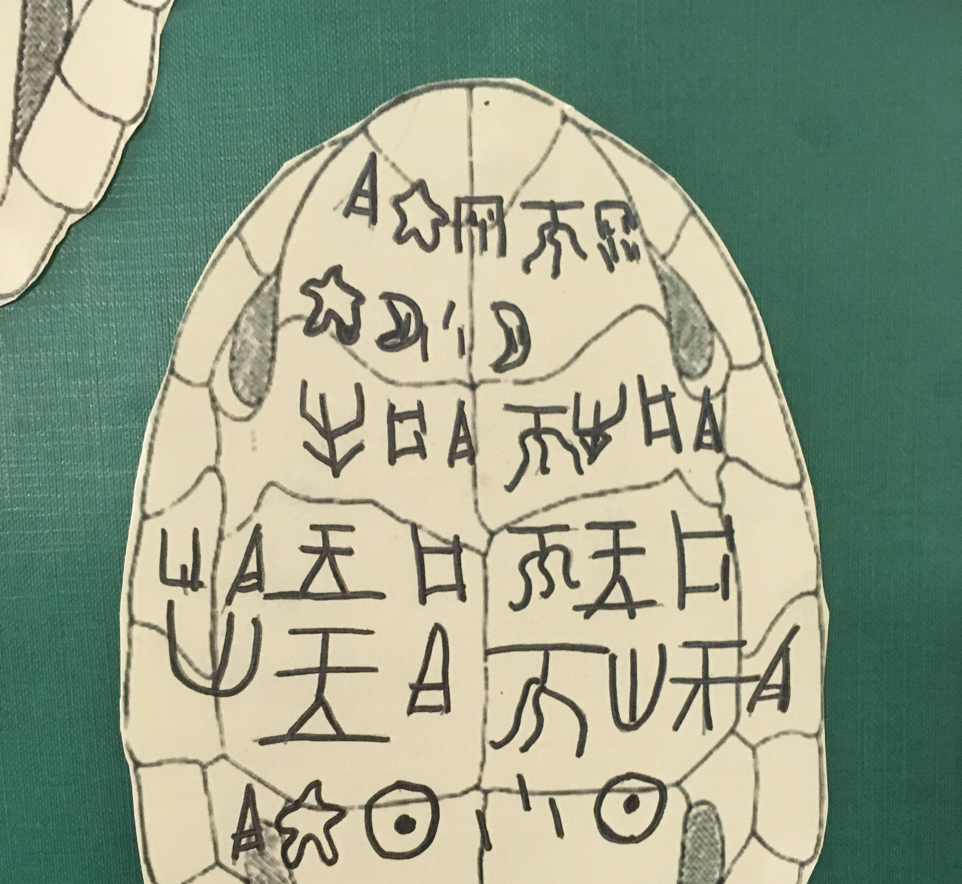
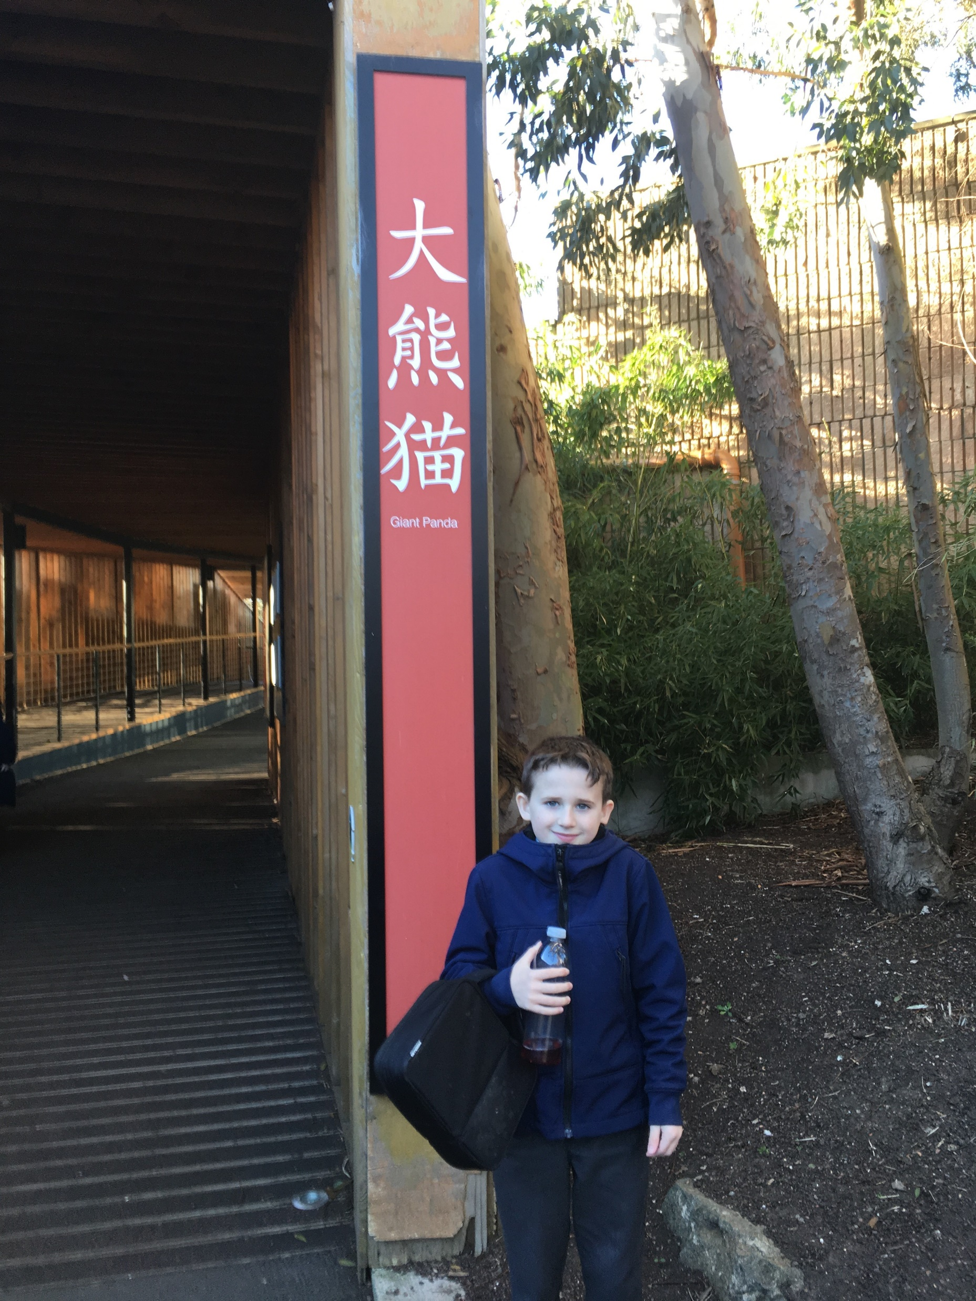
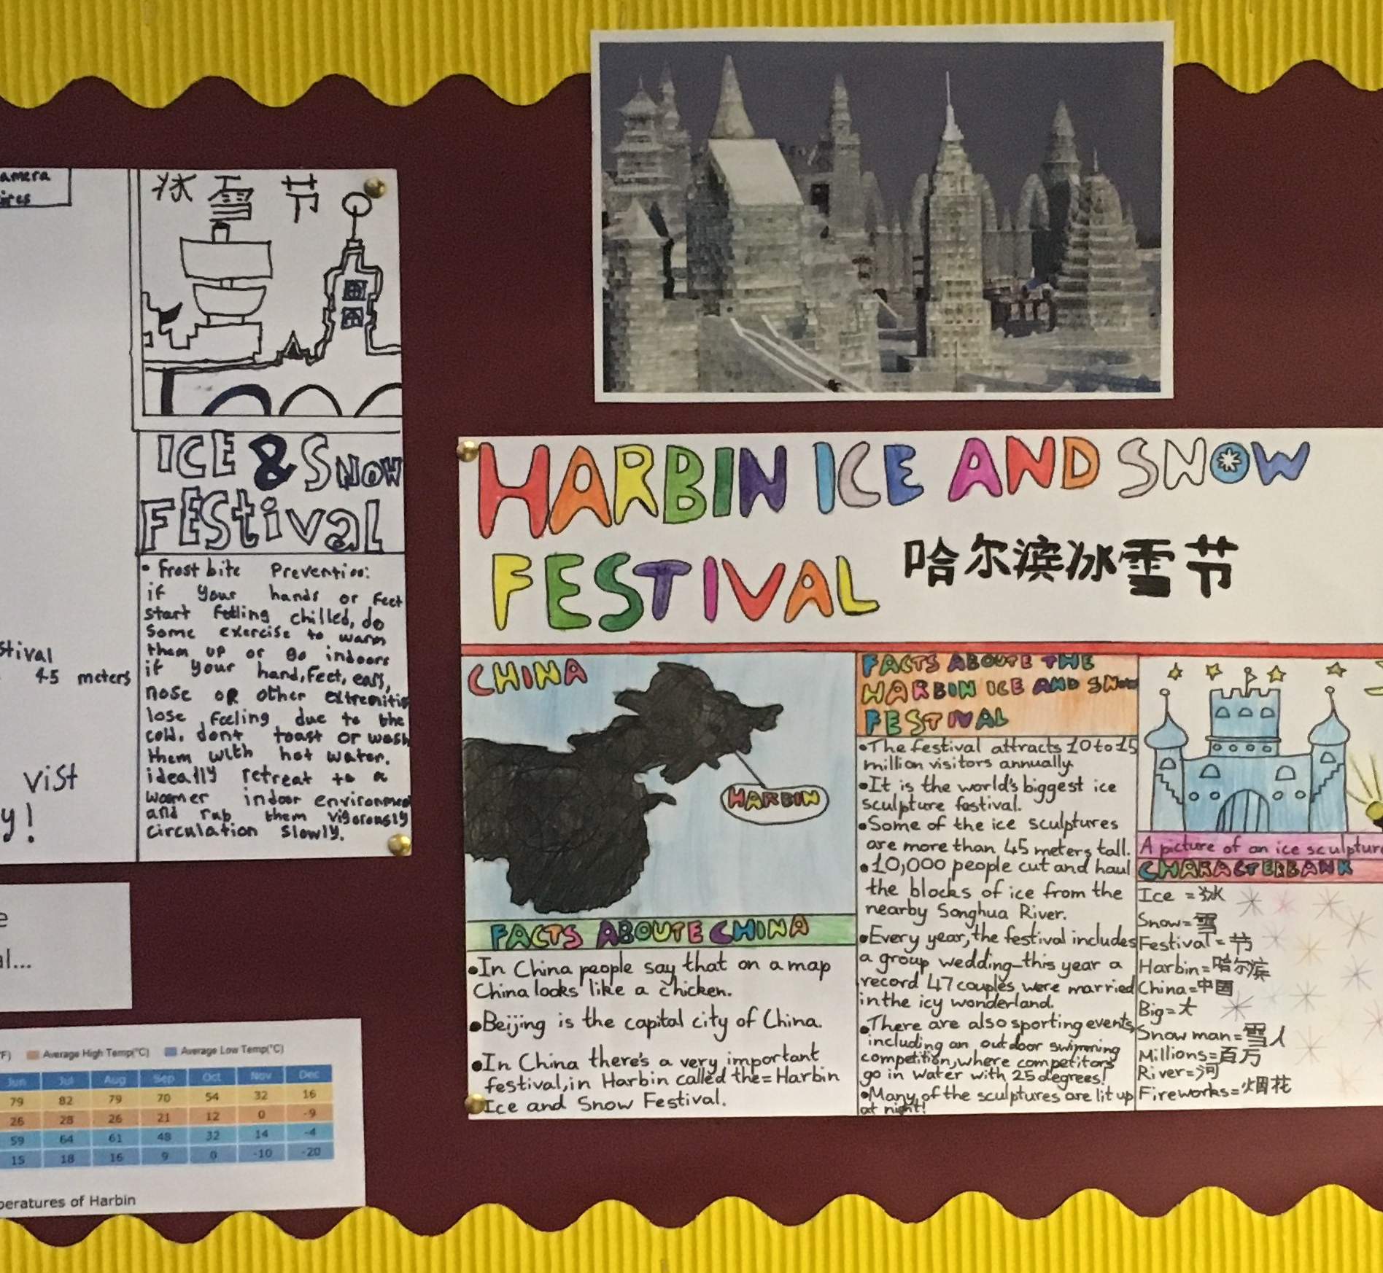
Embedding Chinese in your Primary School

Slide 2


The Planning Stage

Slide 3
Aims of Mandarin programme:
increase children’s linguistic competence
raise awareness that languages have structures which might differ from each other
develop positive attitudes to language learning
build up language learning skills that serve as a foundation for future learning
develop children’s intercultural understanding

Slide 4
10 REASONS WHY LEARNING 中文 IS IMPORTANT!
LEARNING MANDARIN………
…….means you can communicate with over a billion new people!
…….improves your English
…….improves your memory
…….gives you an insight into another way of living, thinking and looking at the world
……..can help you get a job – China’s economy is one of the biggest in the world!
……..helps to connect the world and promote peace
……..is fun to learn because of the characters!
……helps you make friends in new countries
……is easy because of the number system!
…….is easy because Chinese grammar is much simpler than English grammar!

Slide 5
What do we mean by cross-curricular/CLIL/IDL?
“When the skills, knowledge and attitudes of a number of different disciplines are applied to a single experience, theme or idea” (Barnes J, 2012).
Notes:
Have you tried CLIL?
Examples of what have you done in your school?

Slide 6
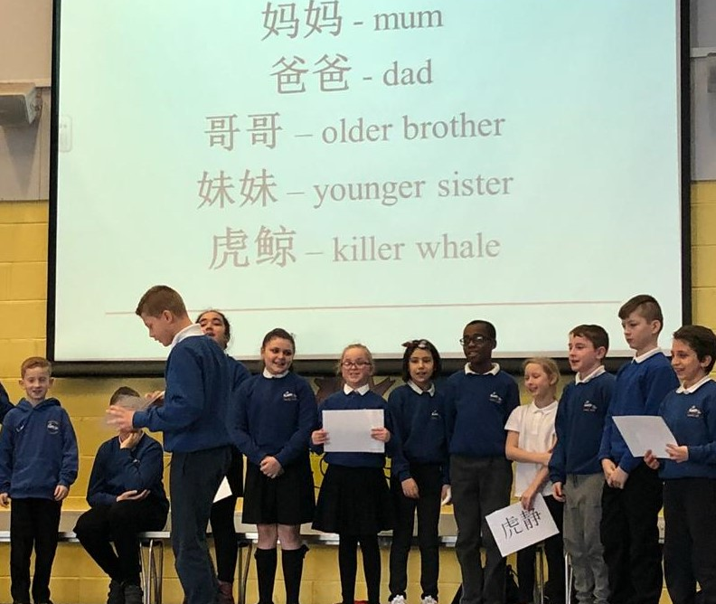
Why cross-curricular links?
-strengthens relevance and coherence of curriculum
- increases pupil engagement
- increases understanding and confidence
- promotes creativity
- creates more language opportunities
- increases profile of Mandarin in the school

Slide 7
How?
- ensure links are real not contrived
- use the lead subject to provide a framework and focus for the cross-curricula lesson/s
aim for progression not just practice
ensure the link provides appropriate coverage and progression in both/all subjects involved
- make links explicit to children

Slide 8
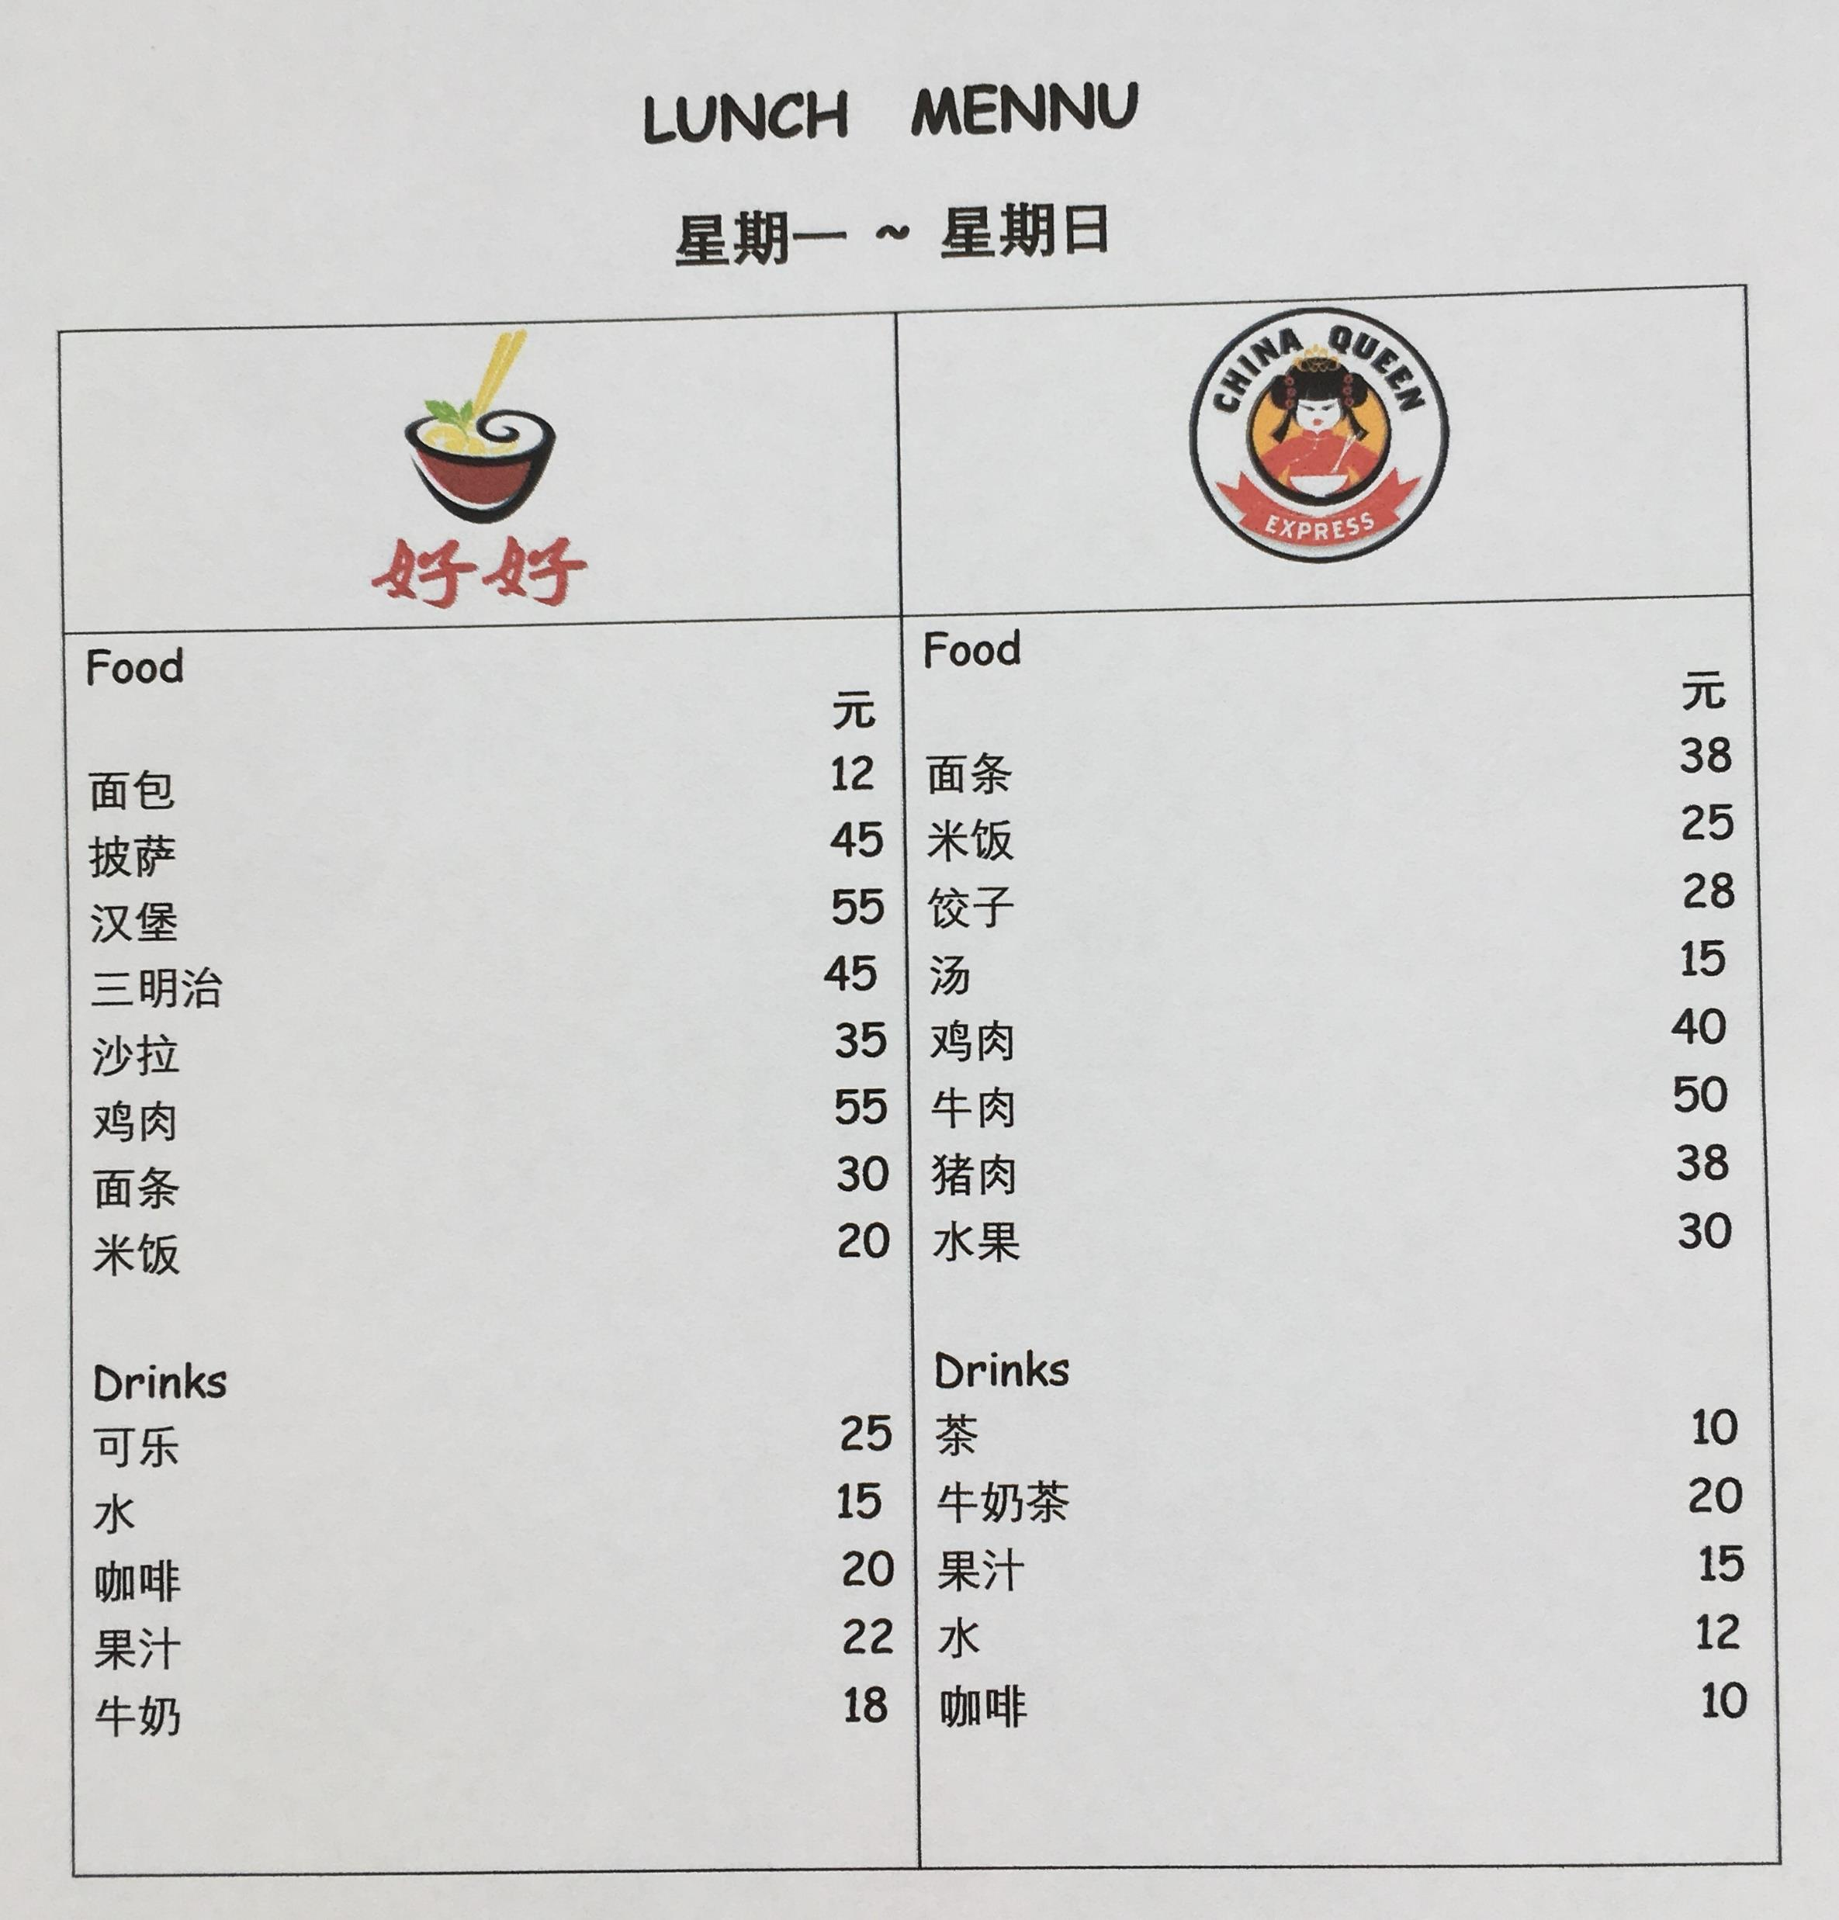

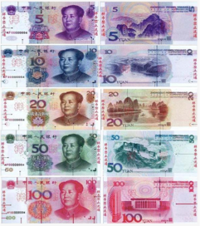
Y4- Mandarin and Numeracy
Money - I can manage money and determine what I can afford to buy.
Key Vocabulary / phrases :
元
钱
多少钱？
你想喝/吃什么？
多少钱？
Further key learning for topic:
饭店
午饭
Prior knowledge to build on:
Numbers: 一 ~ 一百
Loan words: 披萨， 汉堡， 三明治， 沙拉， 可乐， 咖啡，茶
Food vocab: 面包，面条，米饭，牛奶，牛肉，猪肉， 鸡肉，饺子，汤，果汁

Slide 9
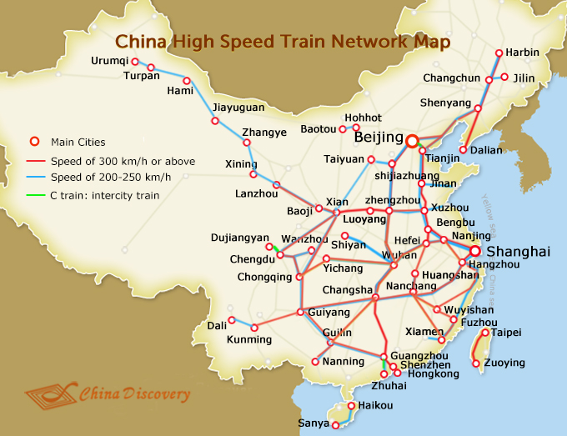
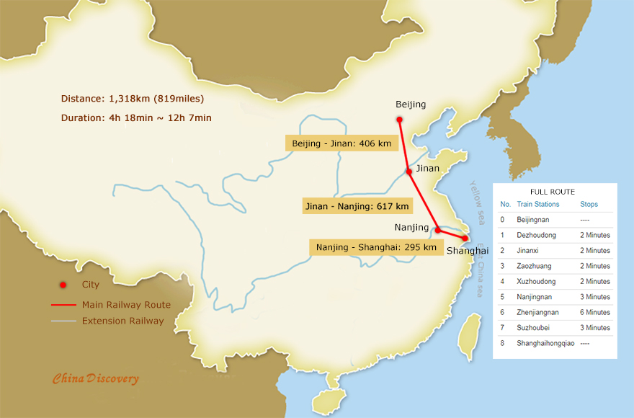
Time - I can use and interpret electronic and paper-based timetables and schedules to plan events and activities, and make time calculations as part of my planning.
火车号 | 出发时间 | 到达时间 | 距离
1461 | 北京 11:54am | 上海 7:19am | 1463km
T109 | 北京 7:33pm | 上海 10:43am | 1463km
D313 | 北京南部 7:34pm | 上海 7:41am | 1454km
D311 | 北京南部 9:16pm | 上海 9:08am | 1461km
D321 | 北京南部 9:23pm | 上海 9:13am | 1461km
火车号 | 出发时间 | 到达时间 | 距离
G101 | 北京 6:44am | 上海 12:38pm | 1318km
G5 | 北京 7:00am | 上海 11:55am | 1318km
G103 | 北京 7:05am | 上海 12:42pm | 1318km
G105 | 北京 7:35am | 上海 1:15pm | 1318km
G11 | 北京 8:00am | 上海 1:10pm | 1318km
G107 | 北京 8:05am | 上海 1:38pm | 1318km
G109 | 北京 8:15am | 上海 2:07pm | 1318km
Key Vocabulary / phrases :
车
火车
火车站
快， 慢
我想买票。去。。。
几点了？
Further key learning for topic:
硬座， 硬卧， 软座， 软卧
Prior knowledge to build on:
一 ~ 六十
北京， 上海， 哈尔滨，西安

Slide 10
Mandarin and Literacy and English
I can make notes, organise them under suitable headings and use them to understand information, develop my thinking and create new texts, using my own words.
I can divide my work into paragraphs in a way that makes sense to my reader.
I punctuate bullet points to list information.
I consider the impact that layout and presentation will have and can combine lettering, graphics and other features to engage my reader.

Slide 11

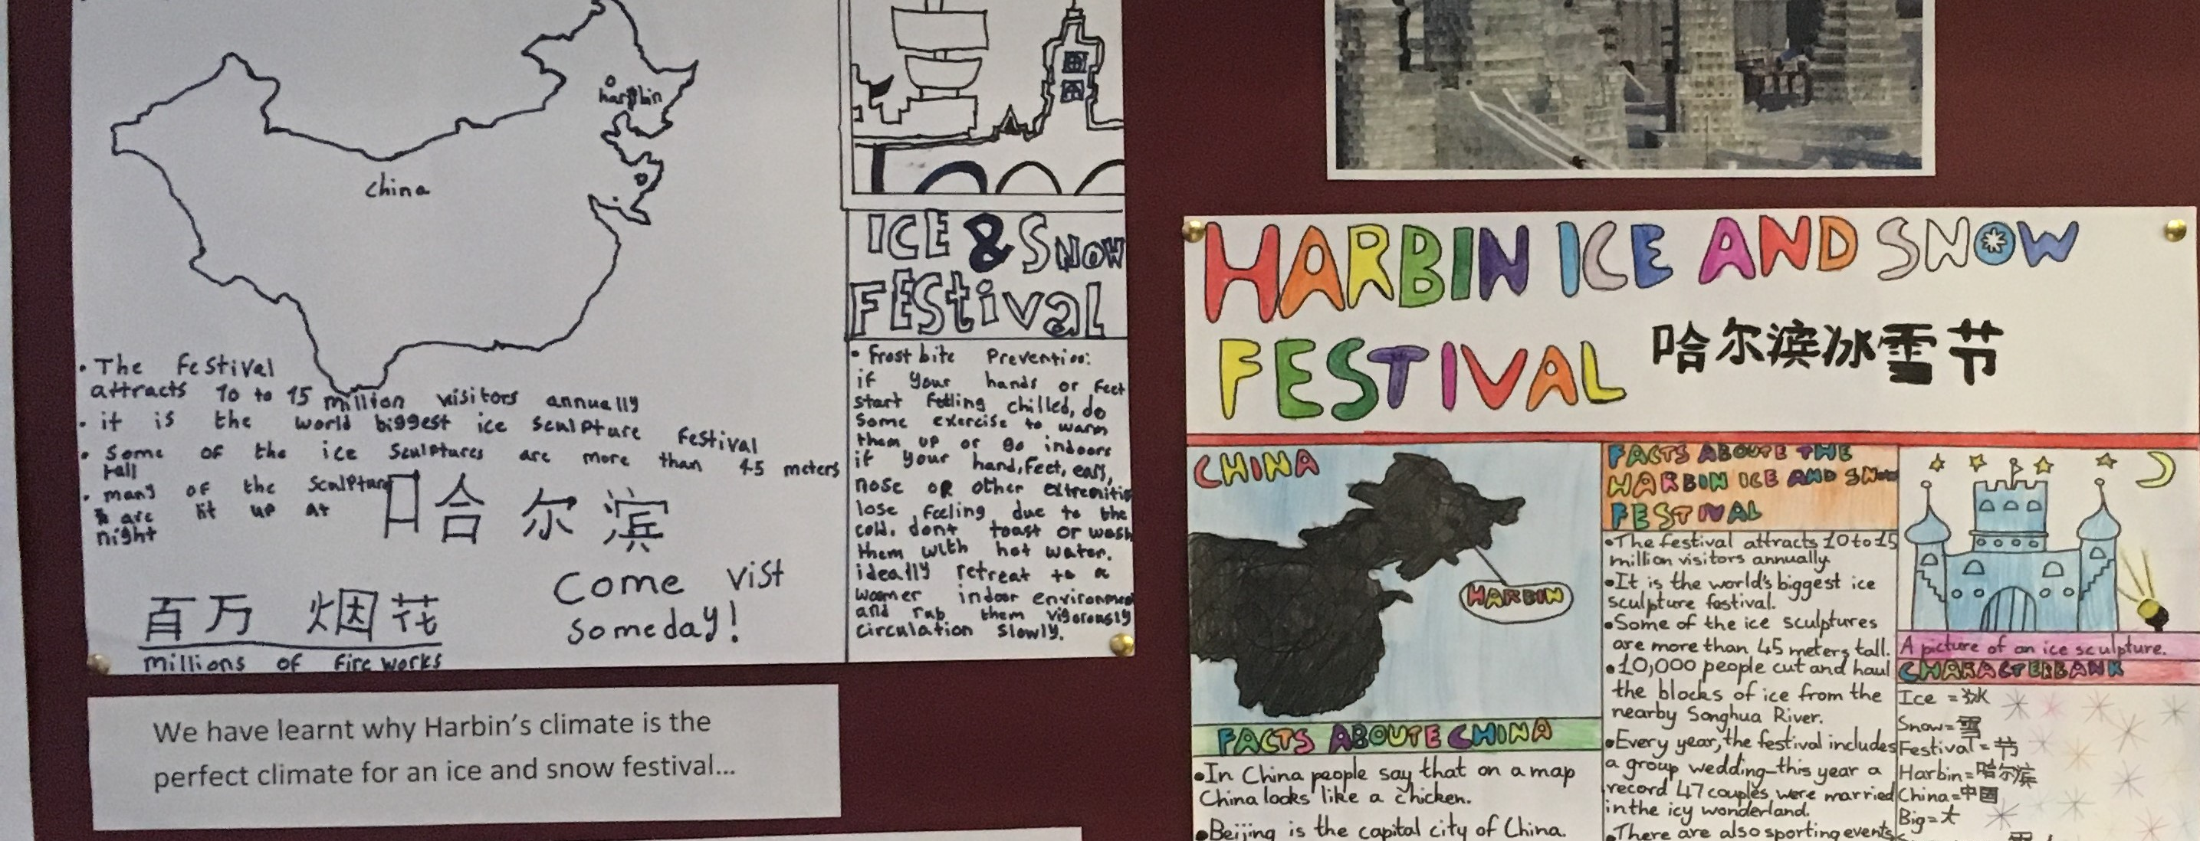
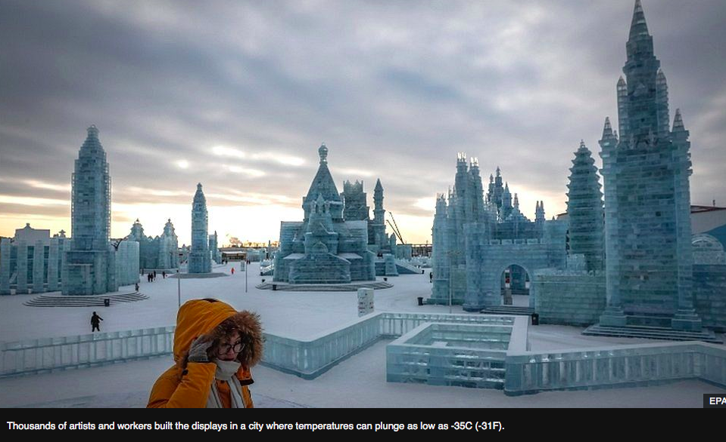
Key Vocabulary / phrases：
冰， 雪， 下雪，节，哈尔滨，大雪，小雪， 雪人
冬天
今天冷吗？
今天很冷， 今天不冷
太冷了！
Further key learning for topic:
秋天，春天，夏天
Prior knowledge to build on:
水， 雨， 下雨， 大， 小
一月~十二月

Slide 12
The Shang Dynasty: History and Mandarin KS2
lesson | objectives | speaking | listening | reading | writing
1 | Locate countries, river, region, city on a map. Know where to locate Shang on a timeline. Answer simple questions about map in Mandarin. | Repeating new vocab Ask and answer simple questions. | New vocab | New vocab | Labelling
2 | To be able to describe the difference between a primary and secondary source. To understand the limitations of artefacts as evidence of the past. Recognise and pronounce 6 new characters (primary sources from Fu Hao tomb). | New vocab | New vocab | New vocab
3 | To understand which aspects of life during the Shang dynasty we can find out about by using the artefacts from Fu Hao’s tomb. Draw and label the contents of Fu Hao’s tomb in Mandarin. | Present tomb drawing to the class, reading numbers and words aloud |  |  | Labelling Numbers
4 | To identify Shang ideas of religion and gods by looking at the Oracle Bones. Write questions for the Shang king in ancient Chinese. |  |  | New vocab | Questions
5 | To compare ancient and modern Chinese characters. To understand that knowing the origins of a character can help you remember it. |  |  | New vocab | New vocab
6 | To use secondary sources to find out more information about Fu Hao. To create a statue/powerpoint/painting of Fu Hao and identify why she is a significant historical figure. To be able to answer 4 key questions about Fu Hao. | New vocab Answer 4 key questions about Fu Hao. | New vocab | New vocab | Some pupils will use character bank to write down answers to key questions.

Slide 13
YCT level 1 words covered in Shang Dynasty Topic:
人， 口，月，鱼，今，水，大，小，明，多，好，中国，中国人，狗，她，个，是，有，谁， 叫，什么，几，多少
一，二，三，四，五，六，七，八，九，十

Slide 14

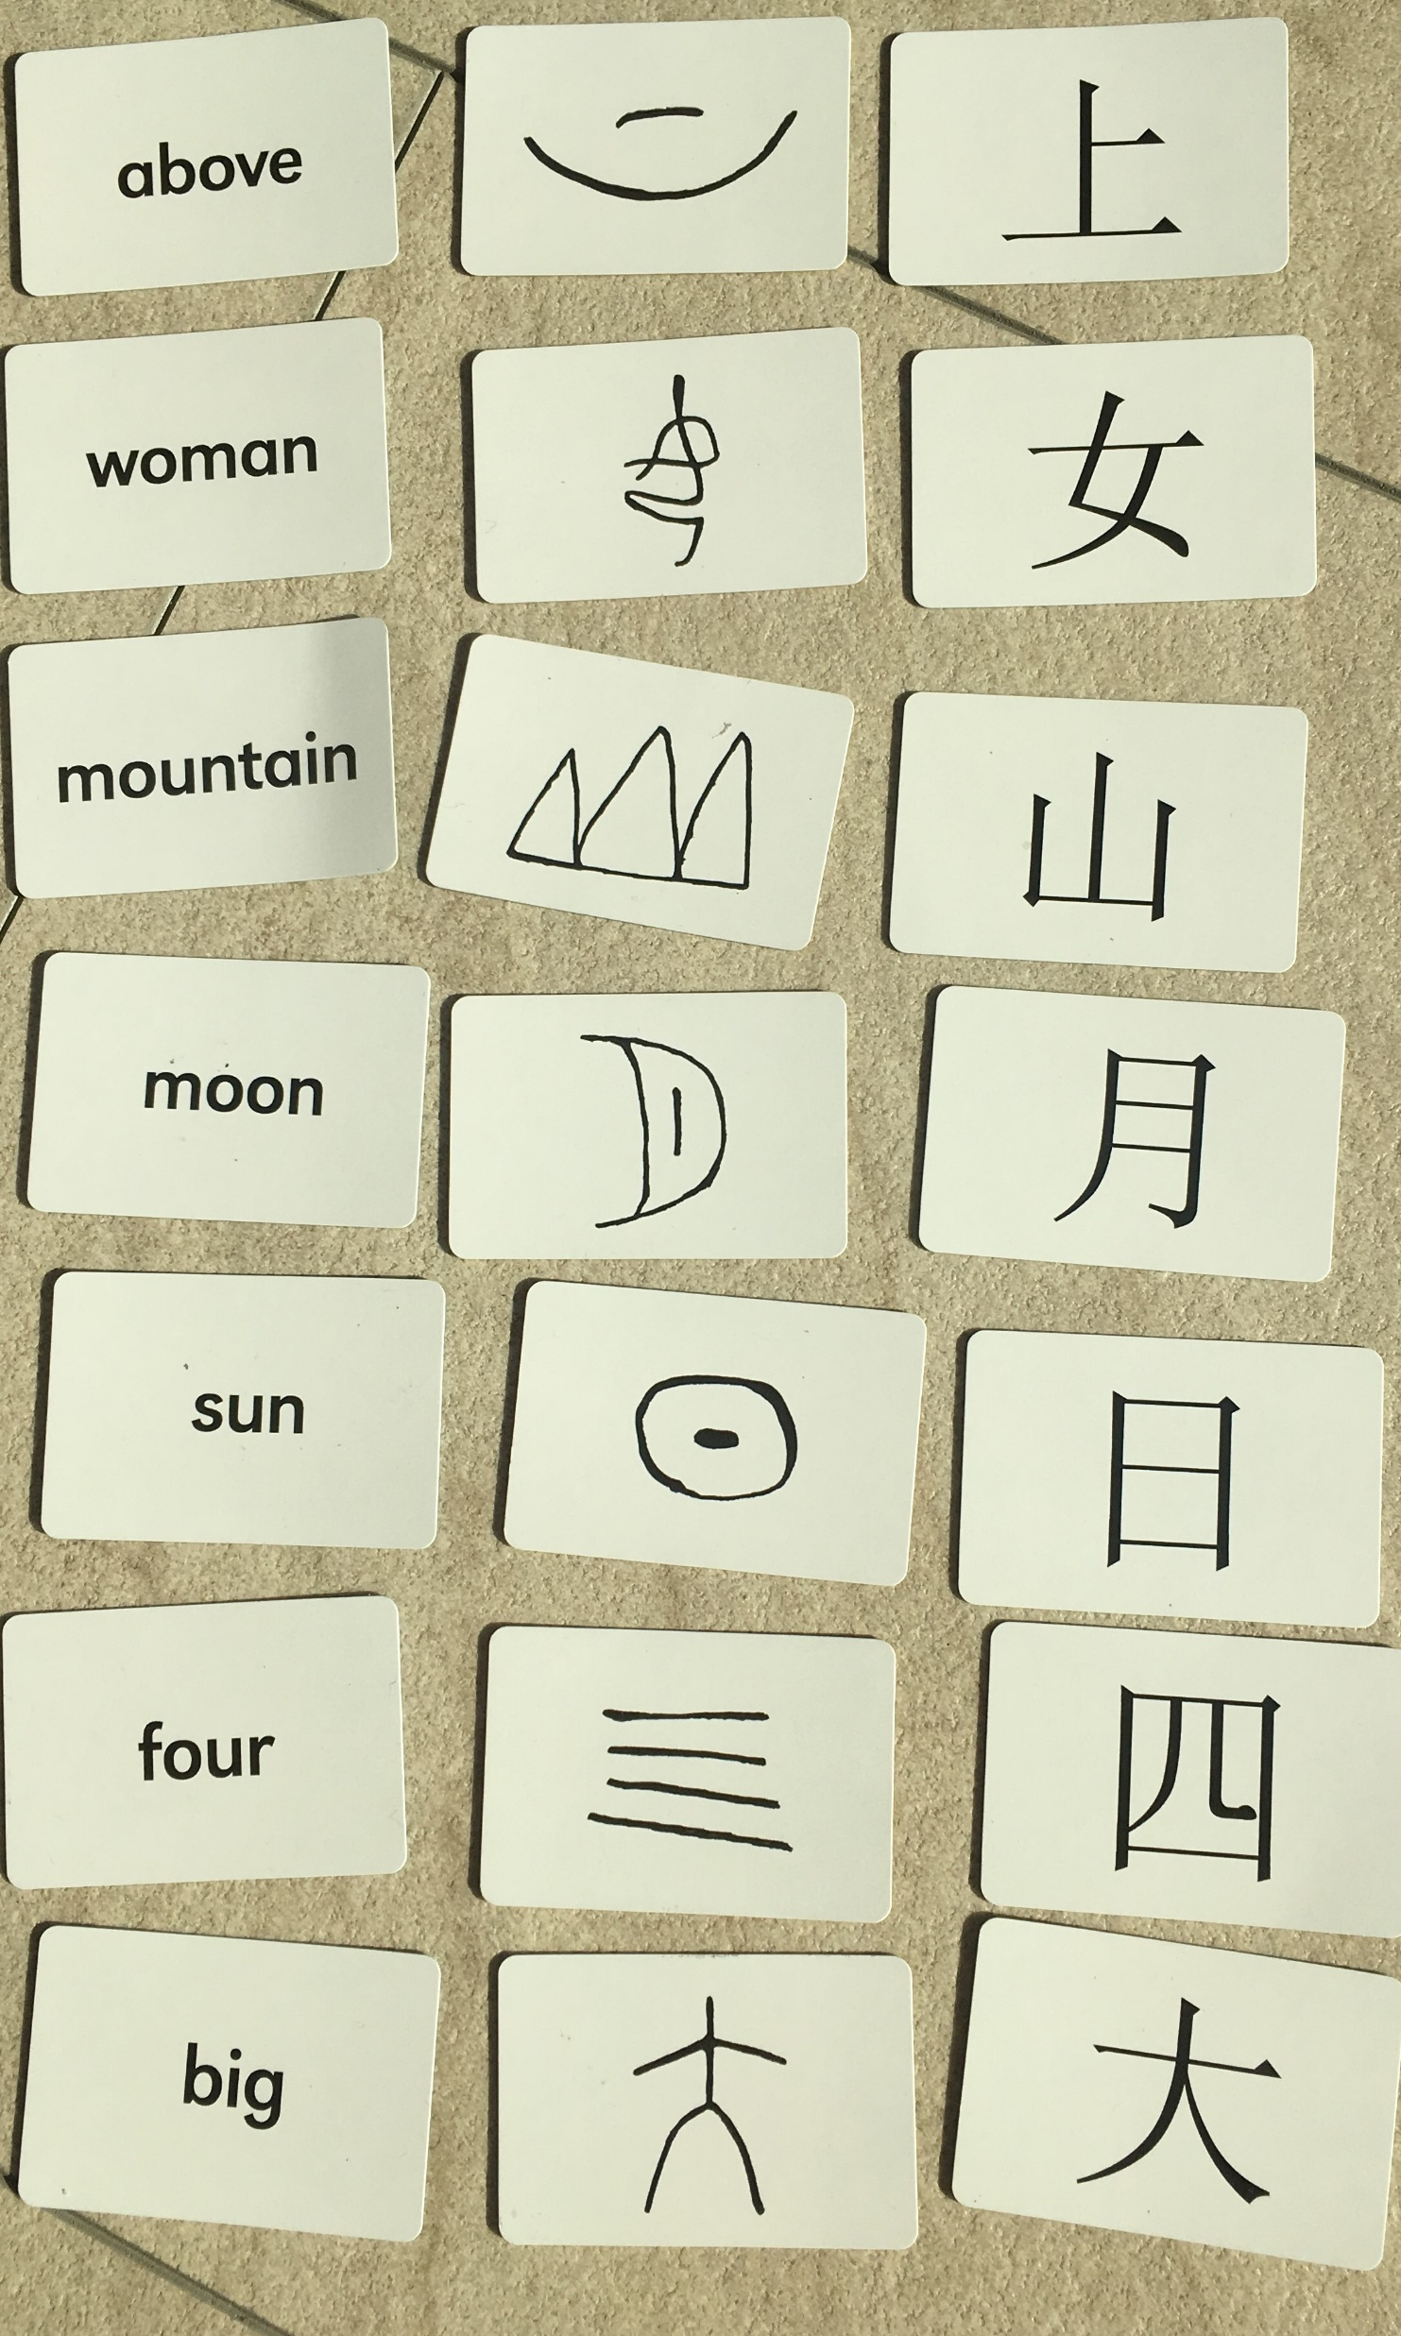
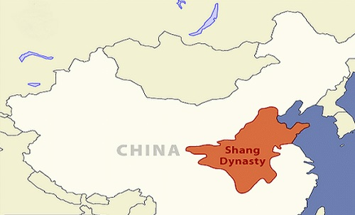
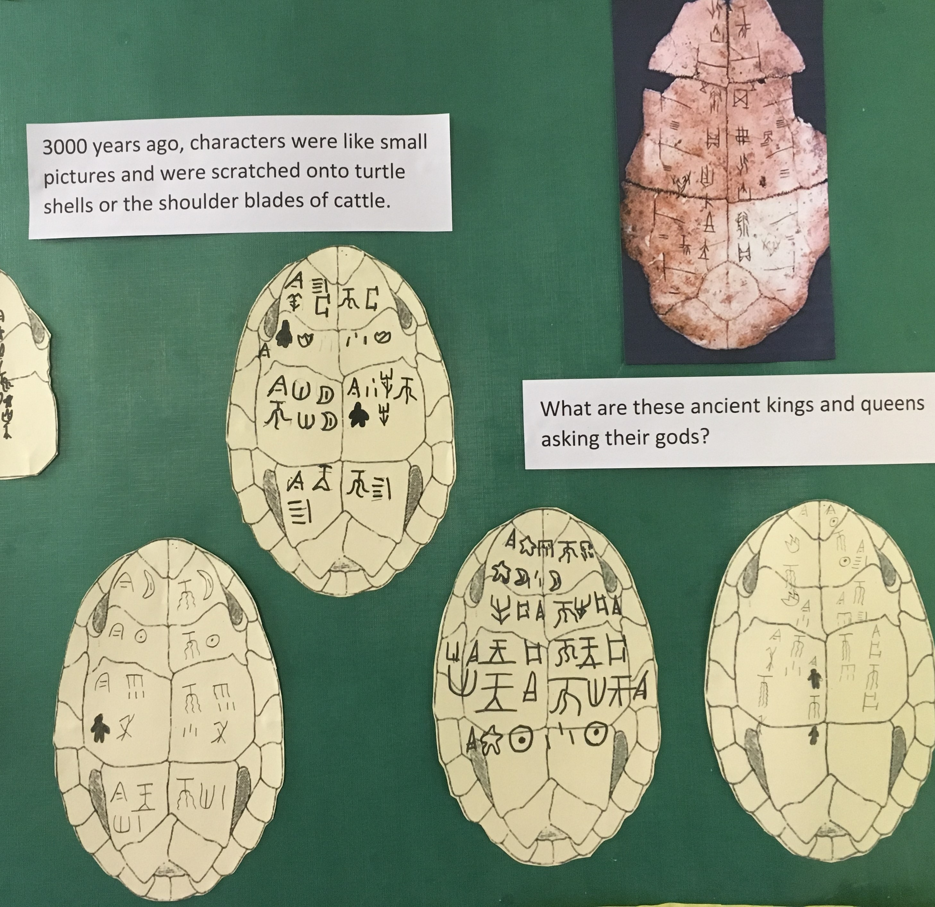
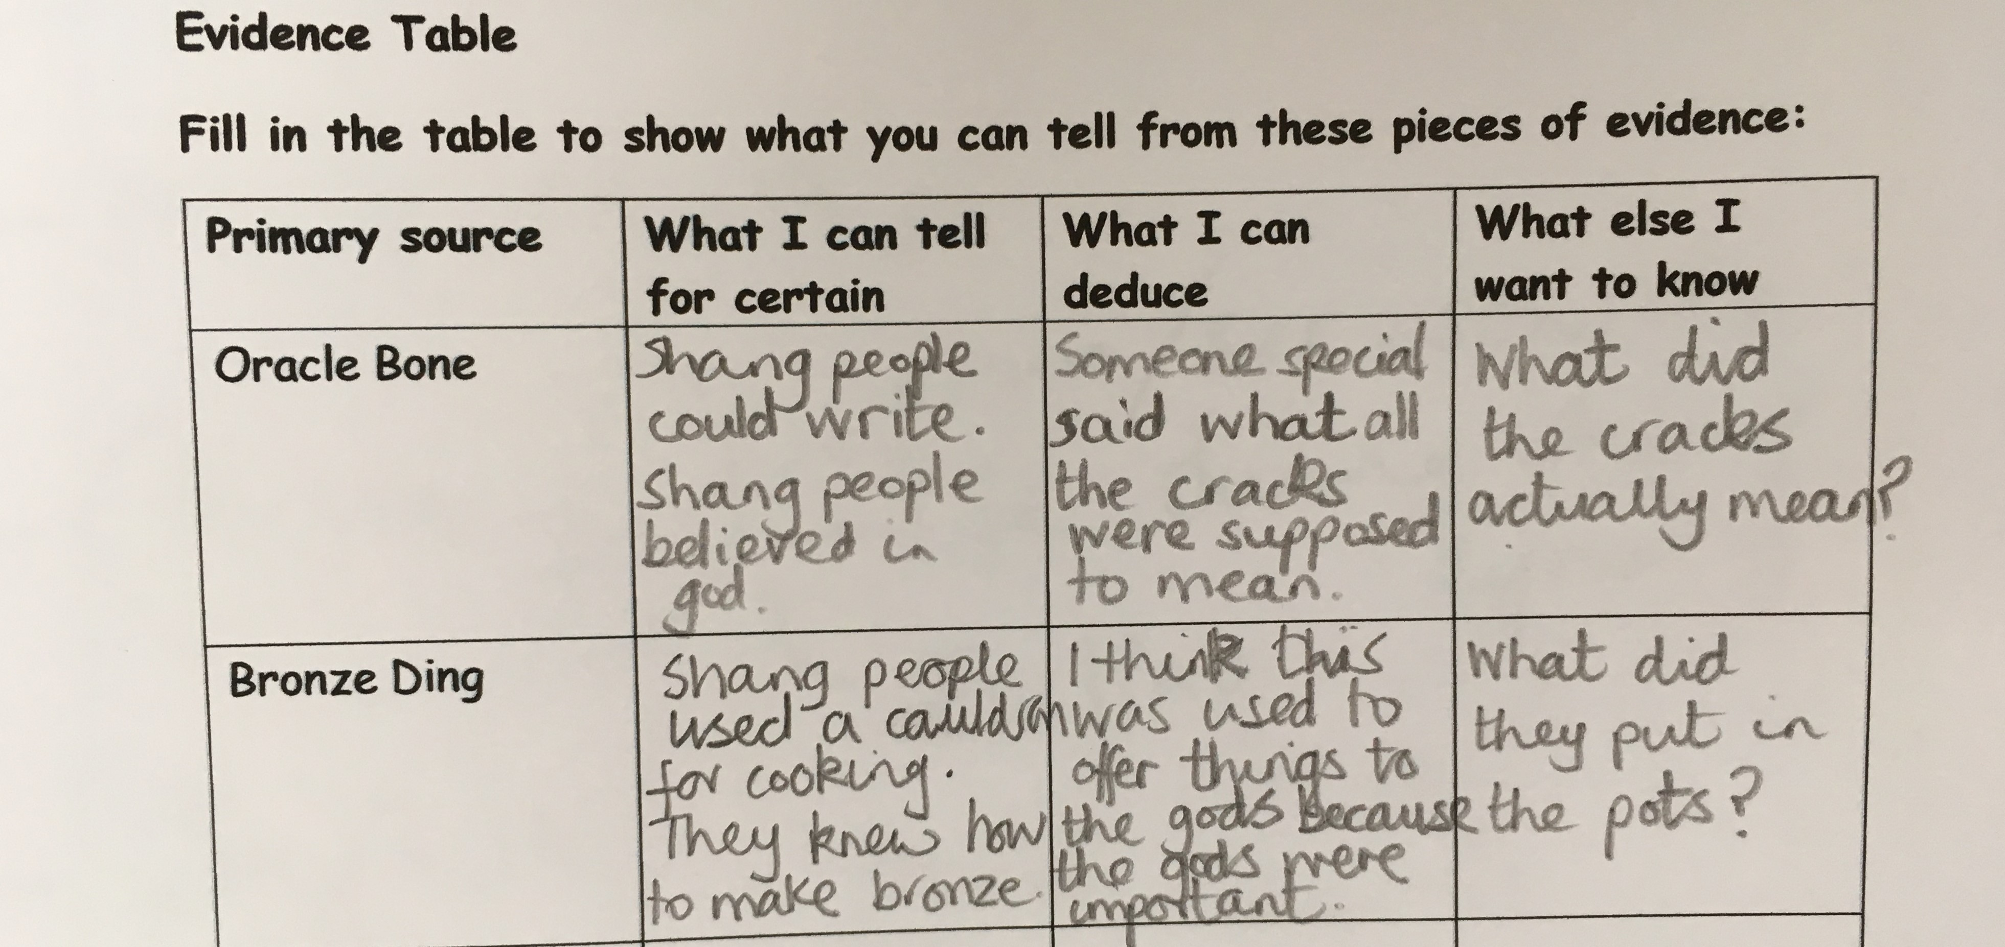

Slide 15


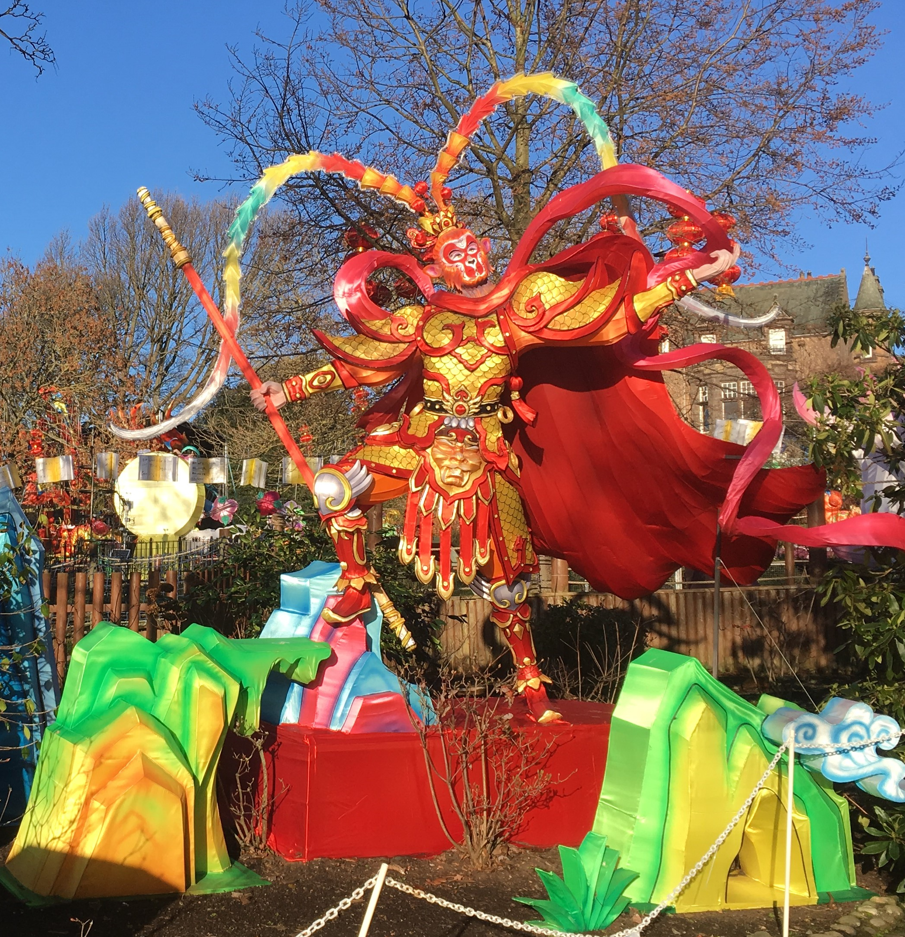
Cross-curricular school trips

Slide 16

Activity 1:
Cross-curricula planning

Slide 17


Slide 18
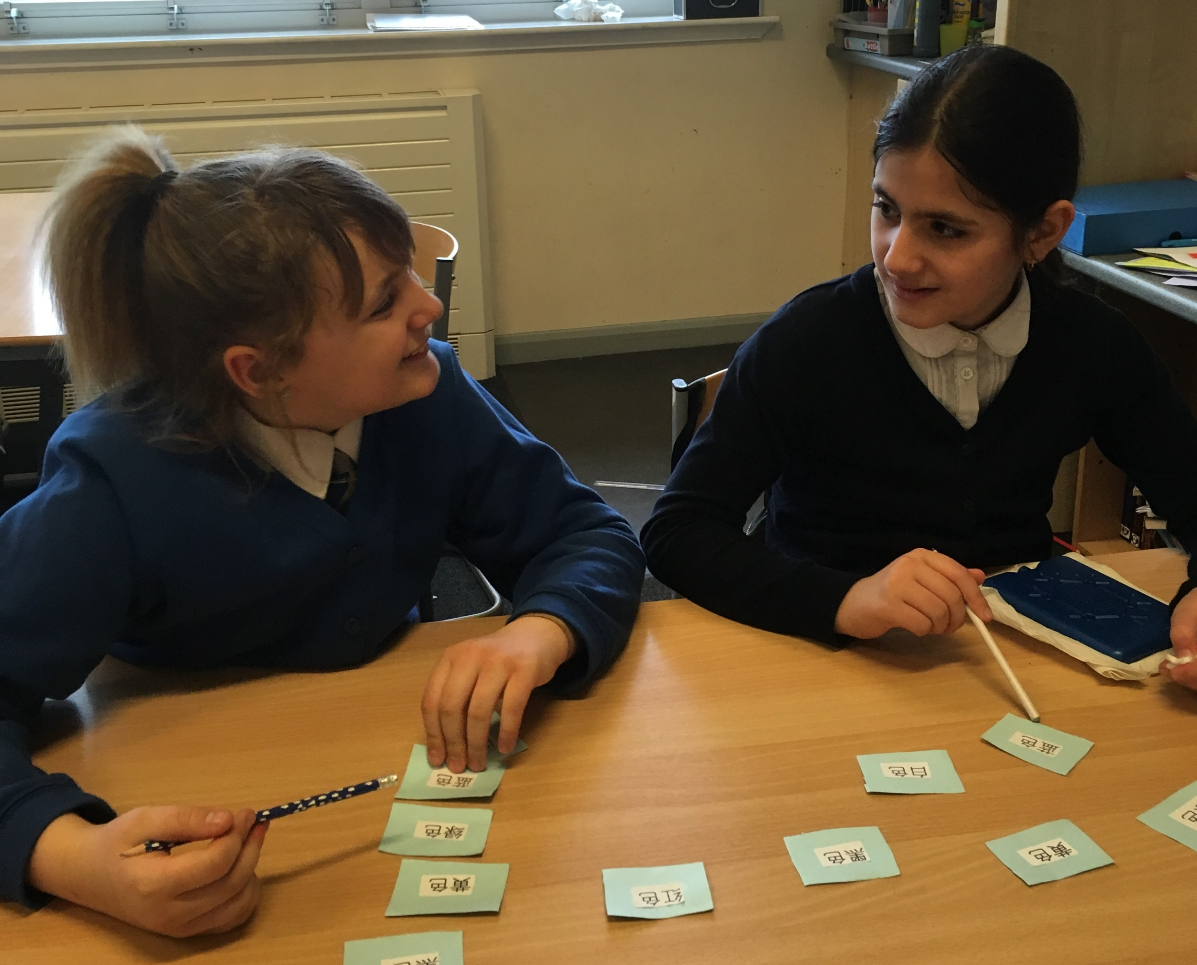
During the Lesson

Slide 19
Team teaching – why?
- allows teachers to blend teaching styles and expertise
- linguistic benefits
- lifts status of language lesson
- improves classroom management

Slide 20

Notes:
How do you approach the subject?
Elements to discuss: classroom management– what are your rules? What language content are you happy to adopt? How and when to plan?....
Through head option

Slide 21
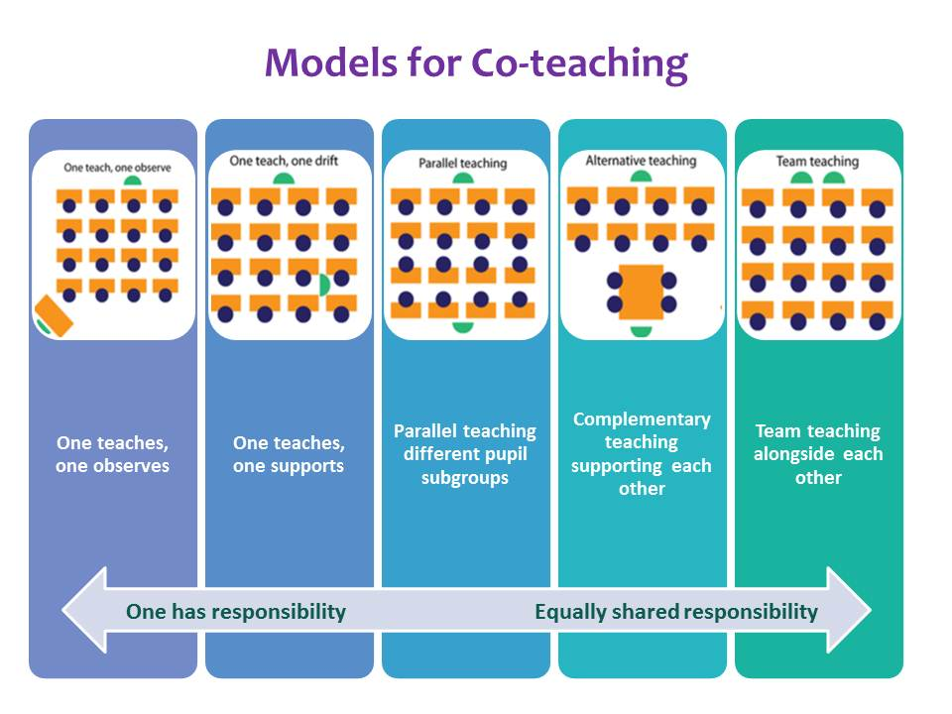

Slide 22
Potential role of class teacher:
use target language for classroom routines, basic instructions, behaviour management, praise, simple questions etc..
tell stories / teach songs with limited Mandarin vocabulary
teach intercultural element
teach language learning strategies
classroom management: homework, group work, explaining games…
role model language learning, increase accessibility of language

Slide 23
Activity 2:
Class teacher and classroom language
Notes:
Do you know what routines are in place in your school? Consistency of style, use same language as the class teacher.

Slide 24
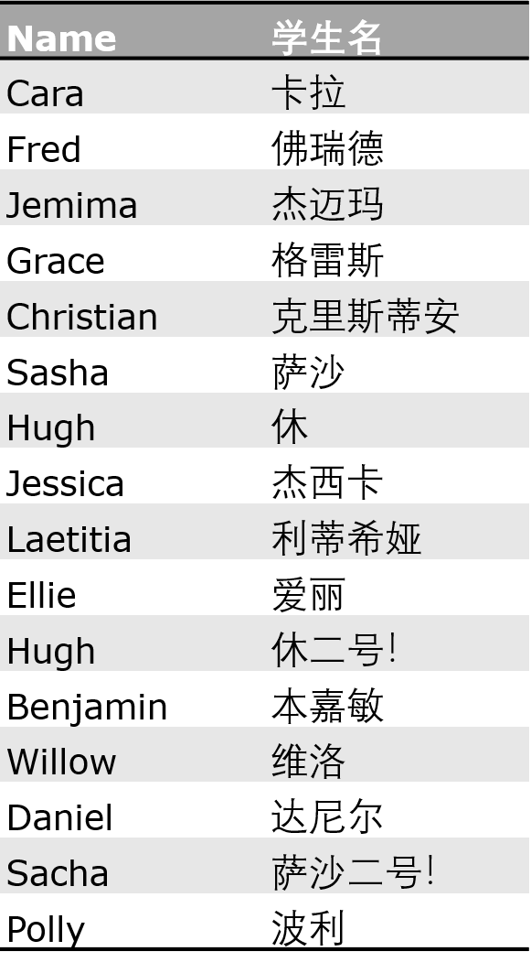
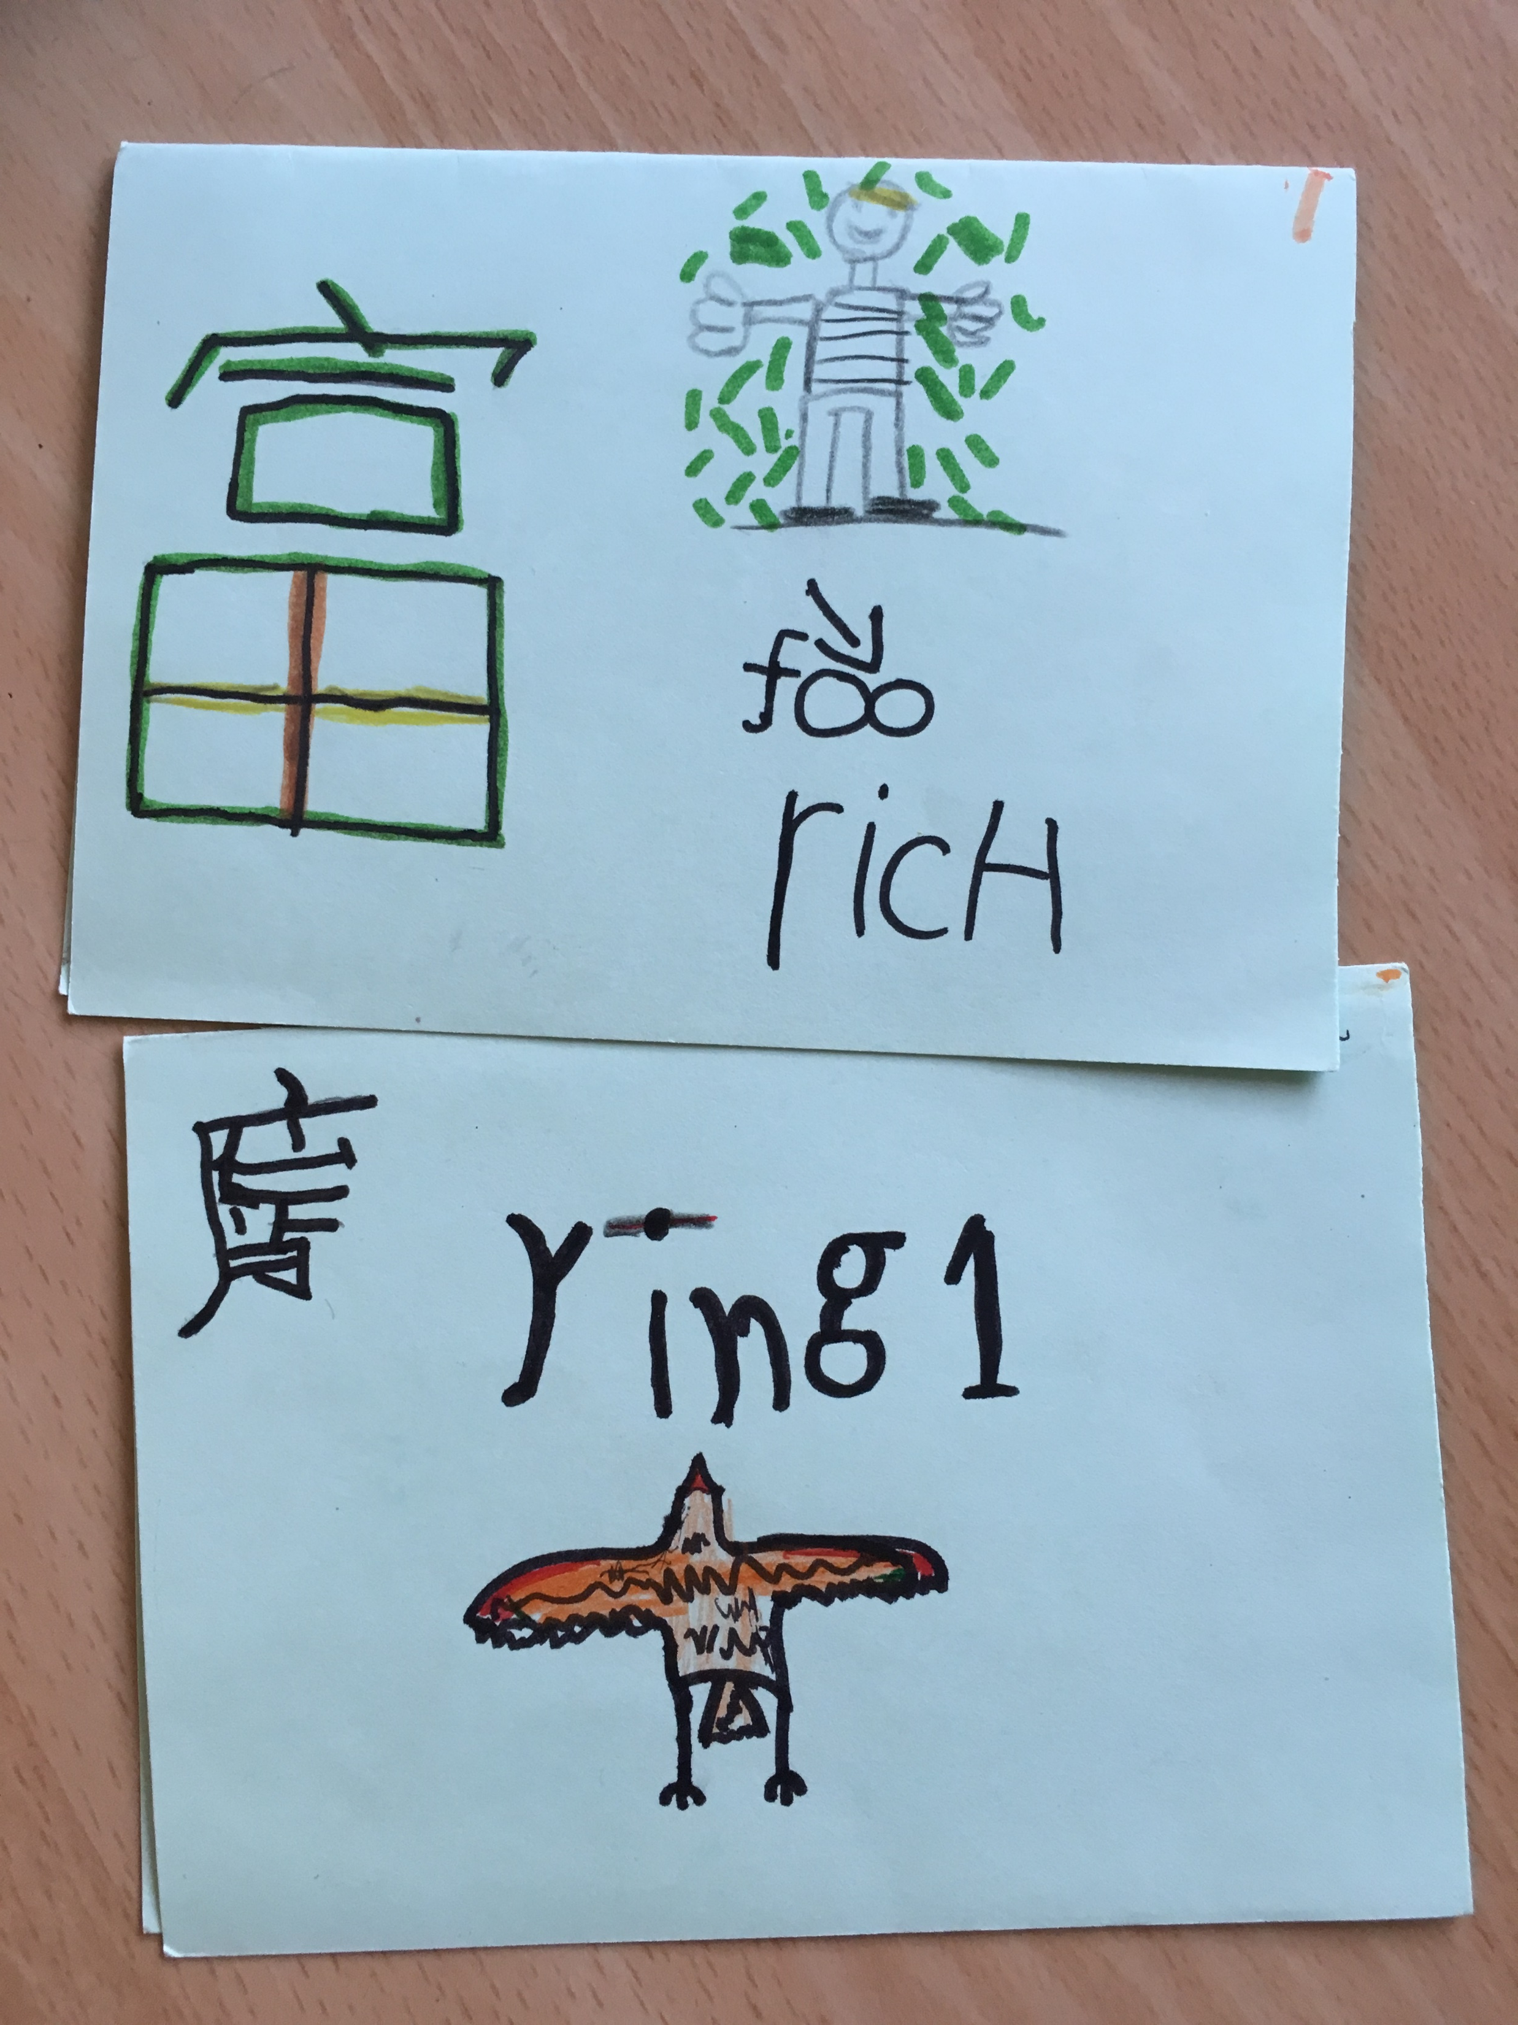
Go here for authentic Chinese names: www.sheup.com/mianfeiqiming.php

Slide 25
Activity 3:
Planning a lesson to team teach
Notes:
Use planning sheets from activity 1, chose Chinese topic and using planning sheet, plan a lesson illustrating role of class teacher / Mandarin teacher

Slide 27
Session 3: Supporting the class teacher outside the language lesson
Teachers CPD
Planning for reviewing
Classroom environment: labels, list of simple instructions, cards for the date and the daily timetable, learning mats, classroom Mandarin display.

Slide 28
Teachers CPD
Week | Focus | Content | Takeaway Mandarin
1 | Mandarin basics | Introductions & training overview Why do primary children love learning Mandarin? What are the 2 biggest differences between Mandarin and English? Greetings and sample games to use when teaching greetings。 | ni hao zaijian
2 | Pinyin | What is pinyin and how much do I need to know? Final and initial sounds needed for Unit 1 When should children learn pinyin? Games and activities for teaching pinyin. | Ni hao ma? Wo hen hao Xie xie
3 | Tones | Are tones important? How can I practise tones? How are tones recorded on words and characters? Using gesture to teach tones. | 一二三四五六七八九十
4 | Listening and talking | Classroom language for unit 1 Jinbu 1 unit 2 Games and activities for teaching listening and talking Online resources to support listening and talking | Qing zuo Qing zhan qi lai Ni duo da? Wo ….sui

Slide 29
Planning for reviewing
Use of ICT: Quizlet, Language Nut, Memrise
Class teacher consolidation sessions outside formal language lesson
Homework
Class review box

Slide 30
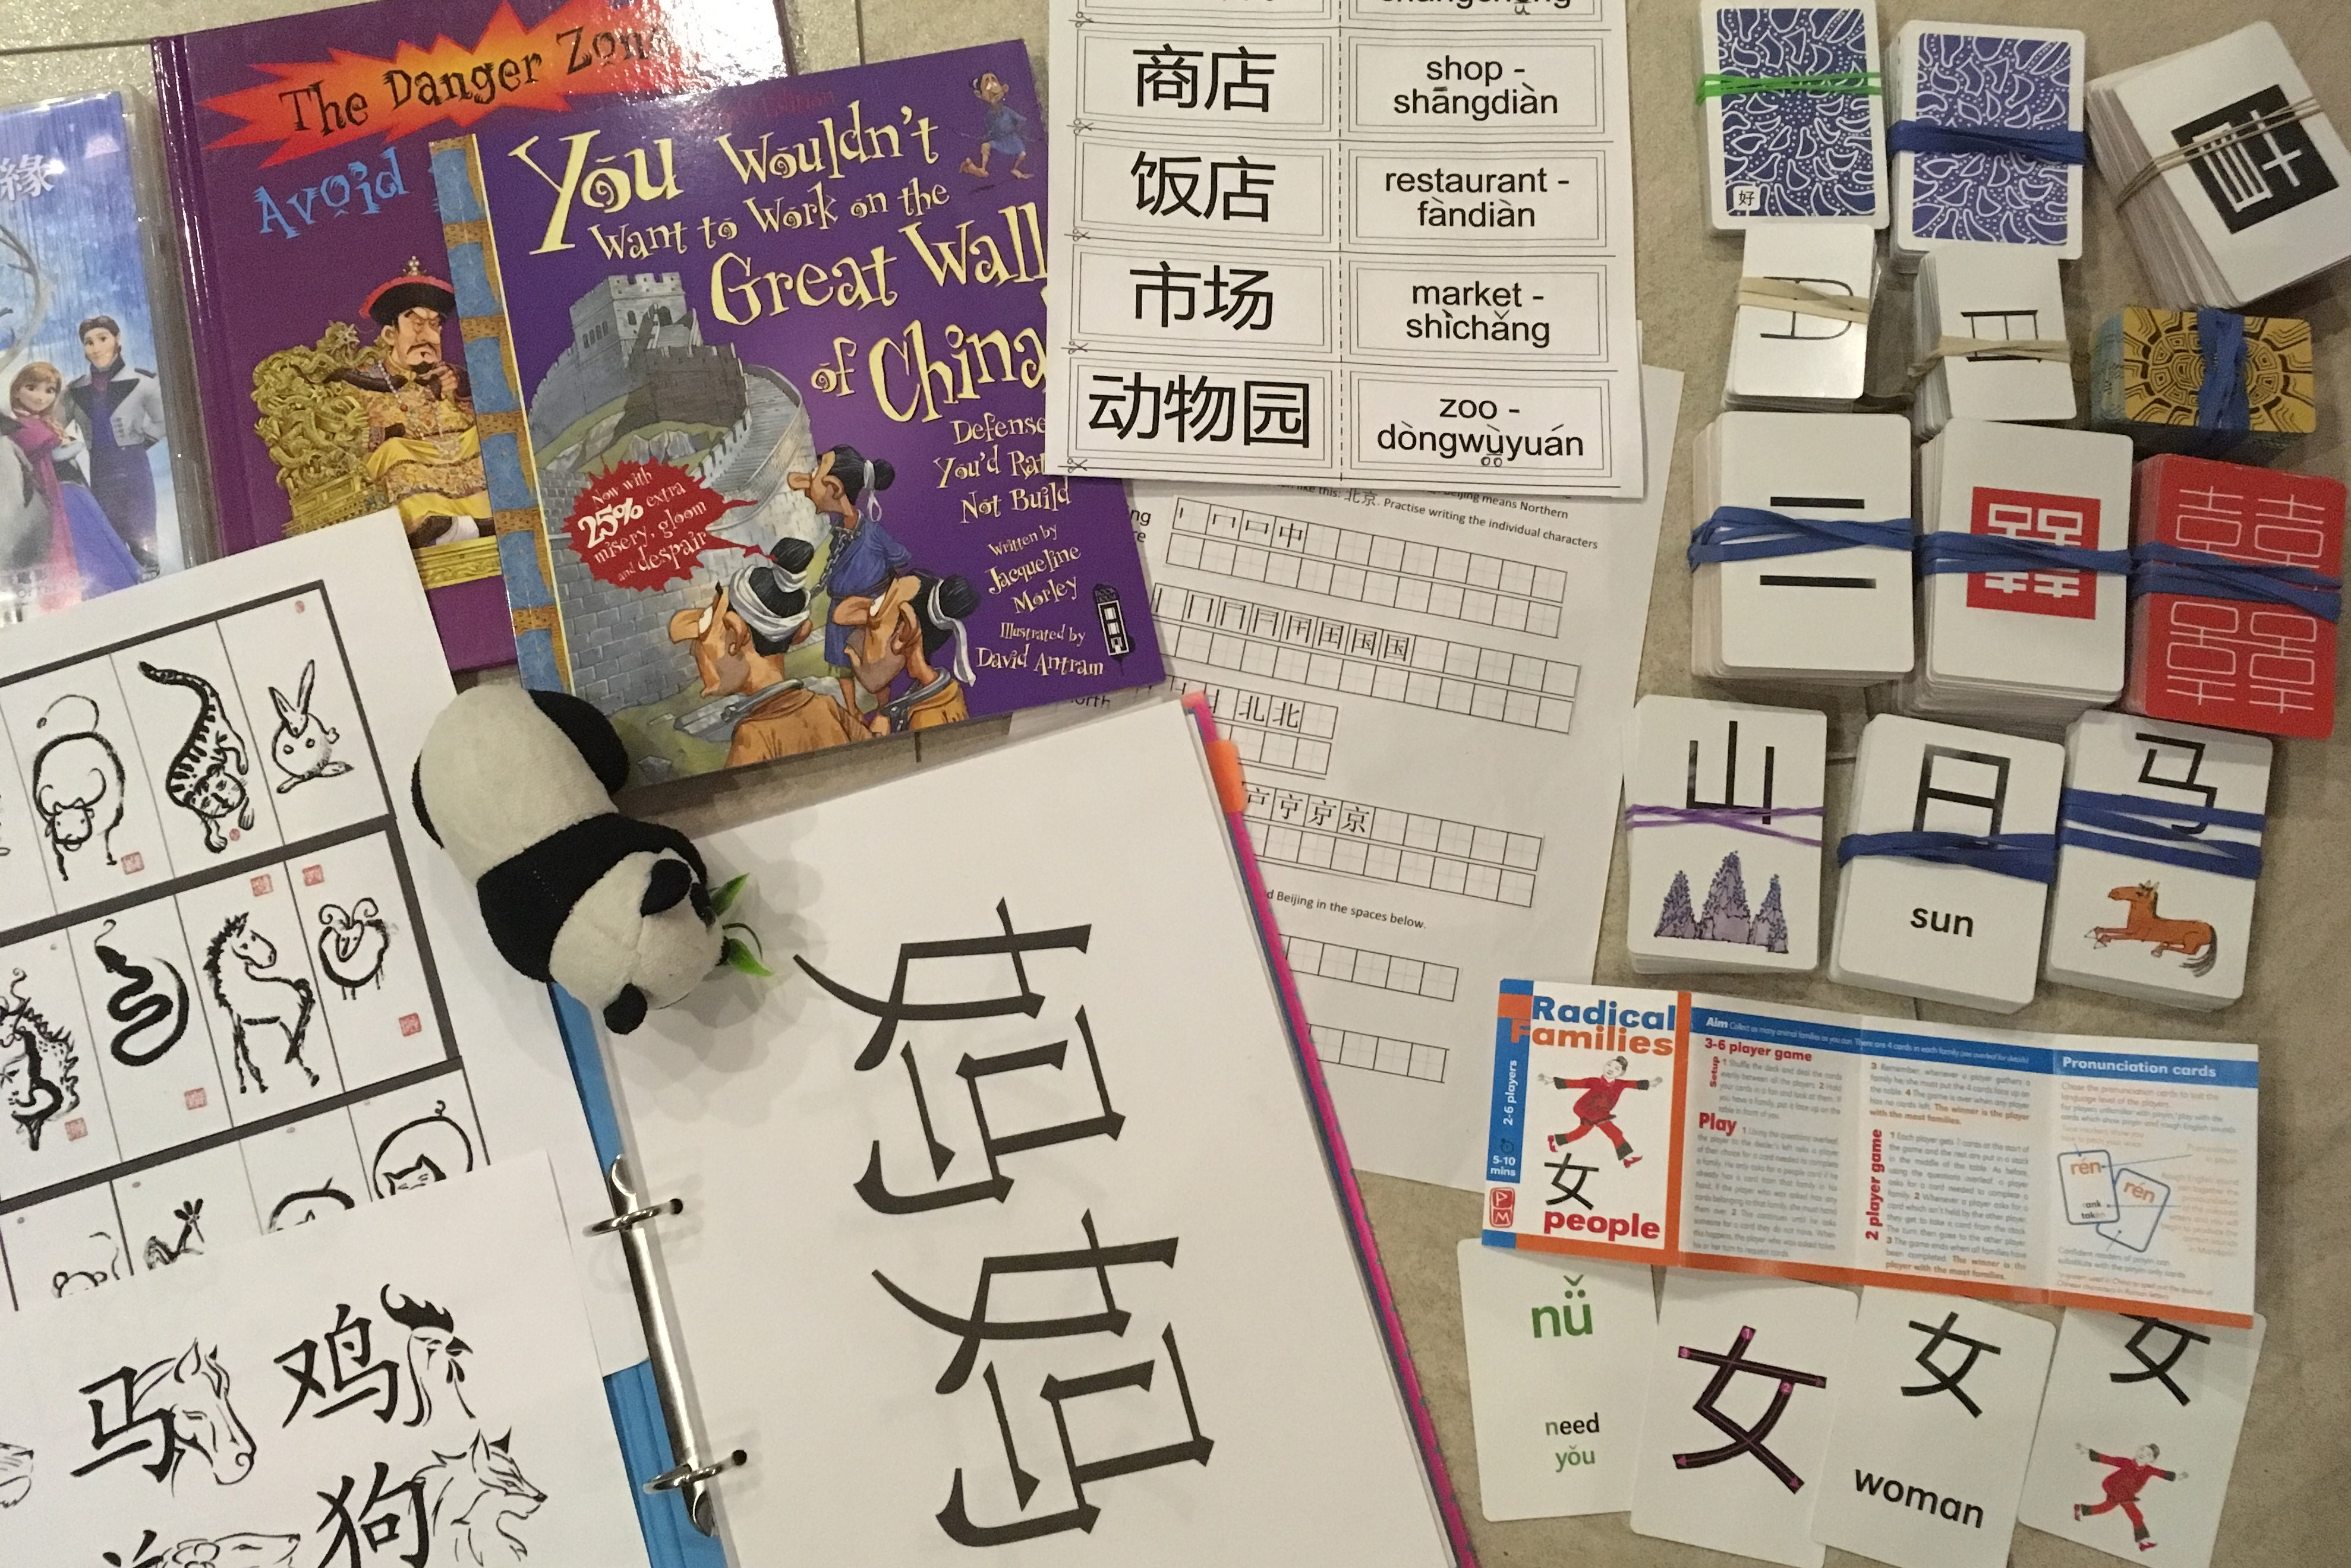
Review Box:

Slide 31
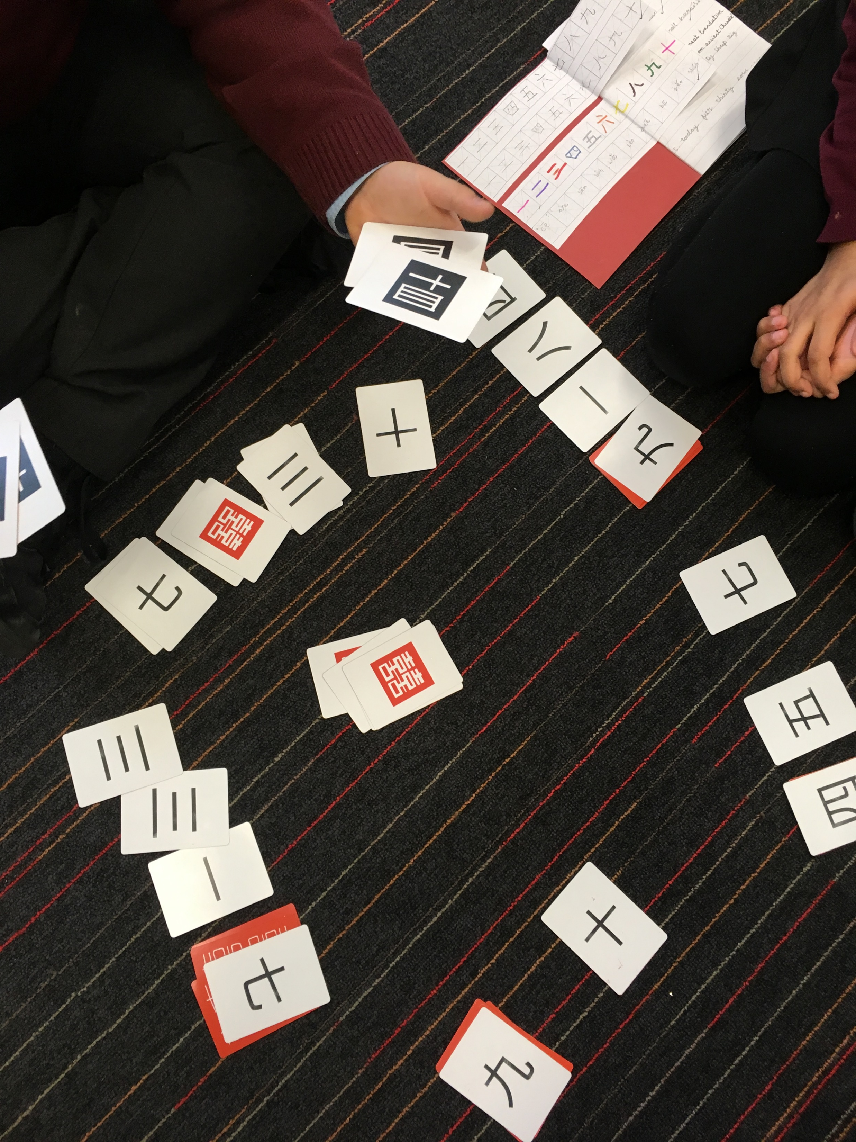

Using games to review
Game 1: numbers 1-10 Game 2: numbers 11-99

Slide 32
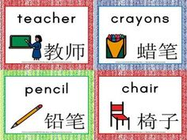
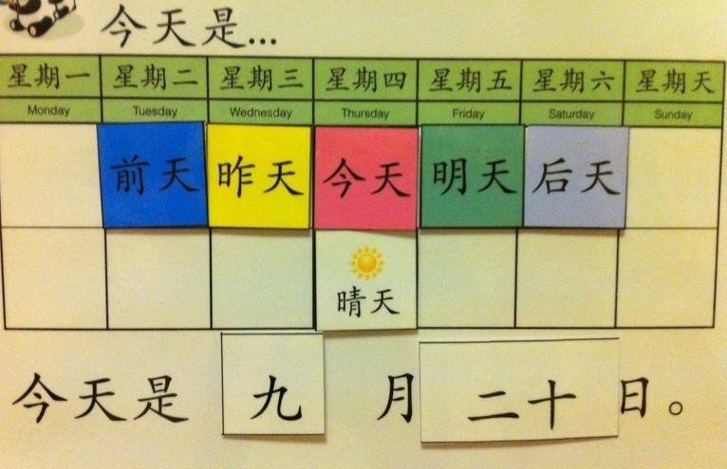
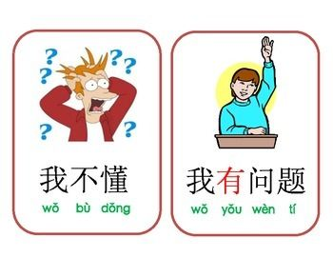
Classroom environment: labels, list of simple instructions, cards for the date and the daily timetable, learning mats, classroom Mandarin display.

Slide 33
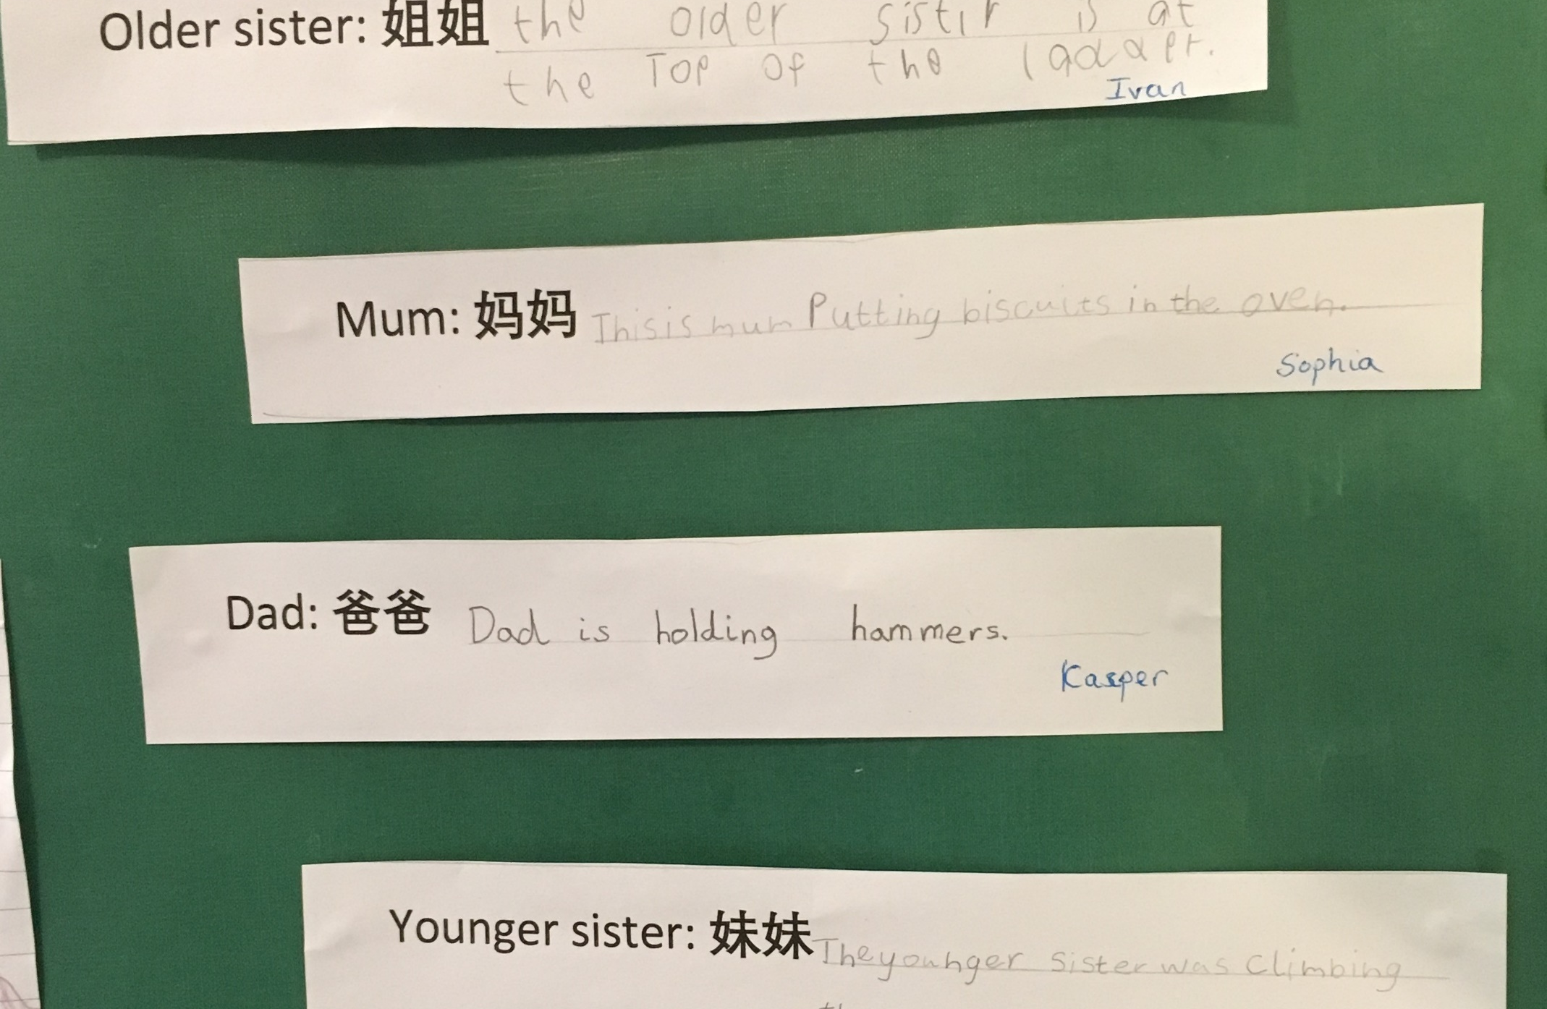
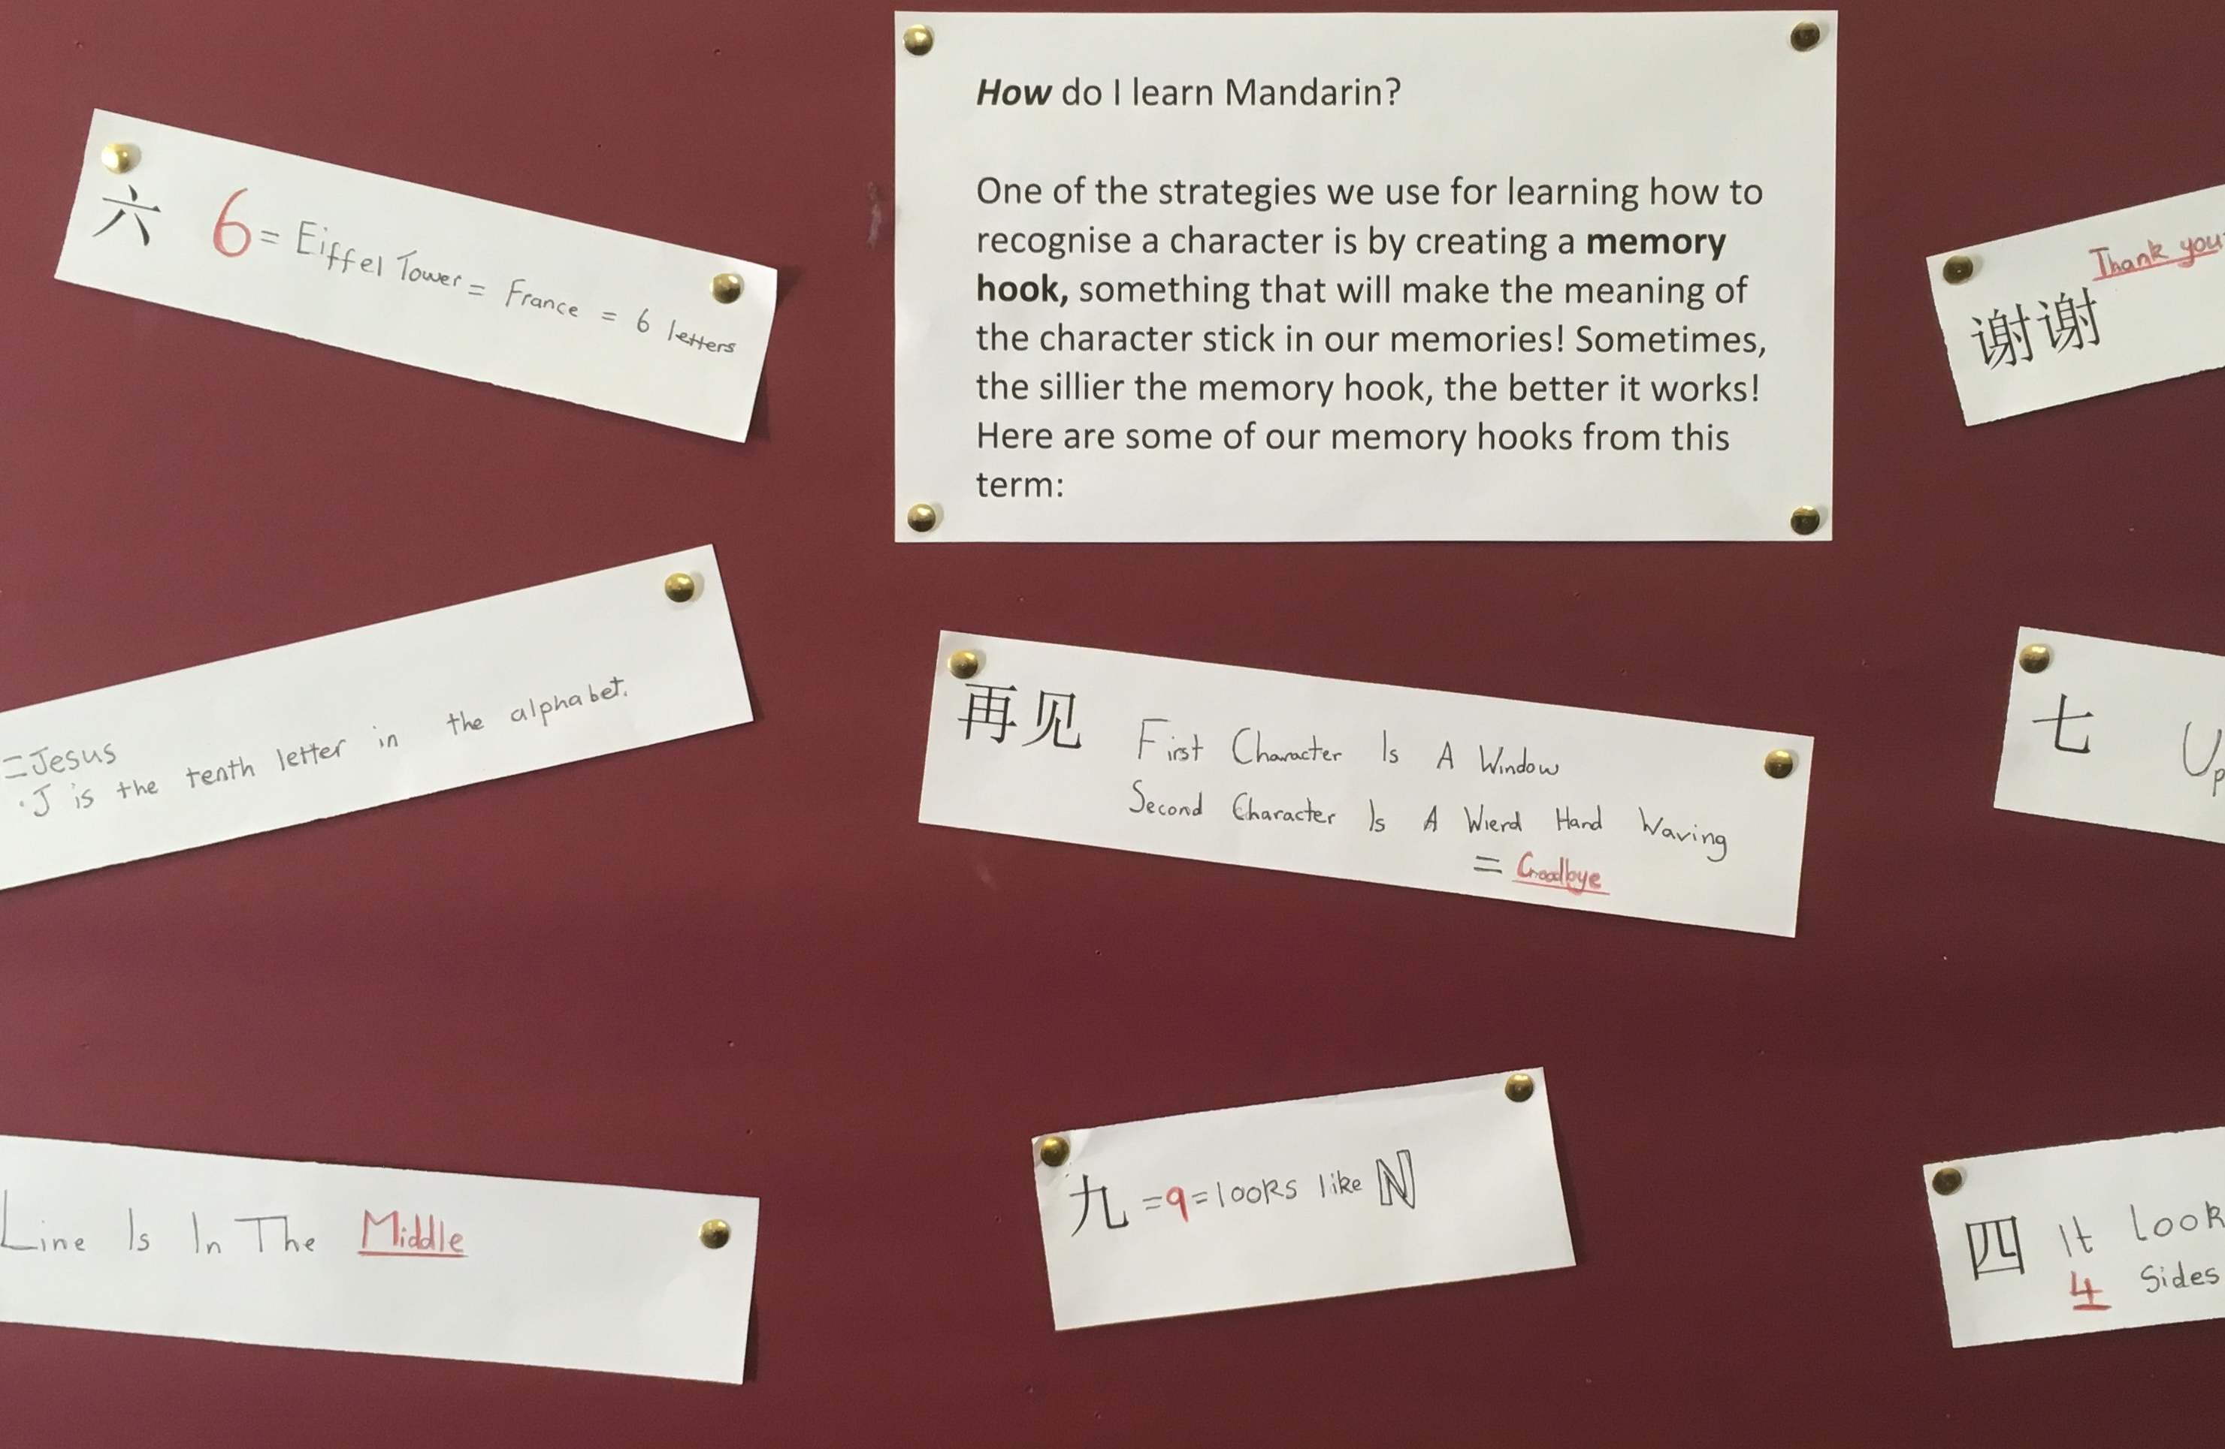
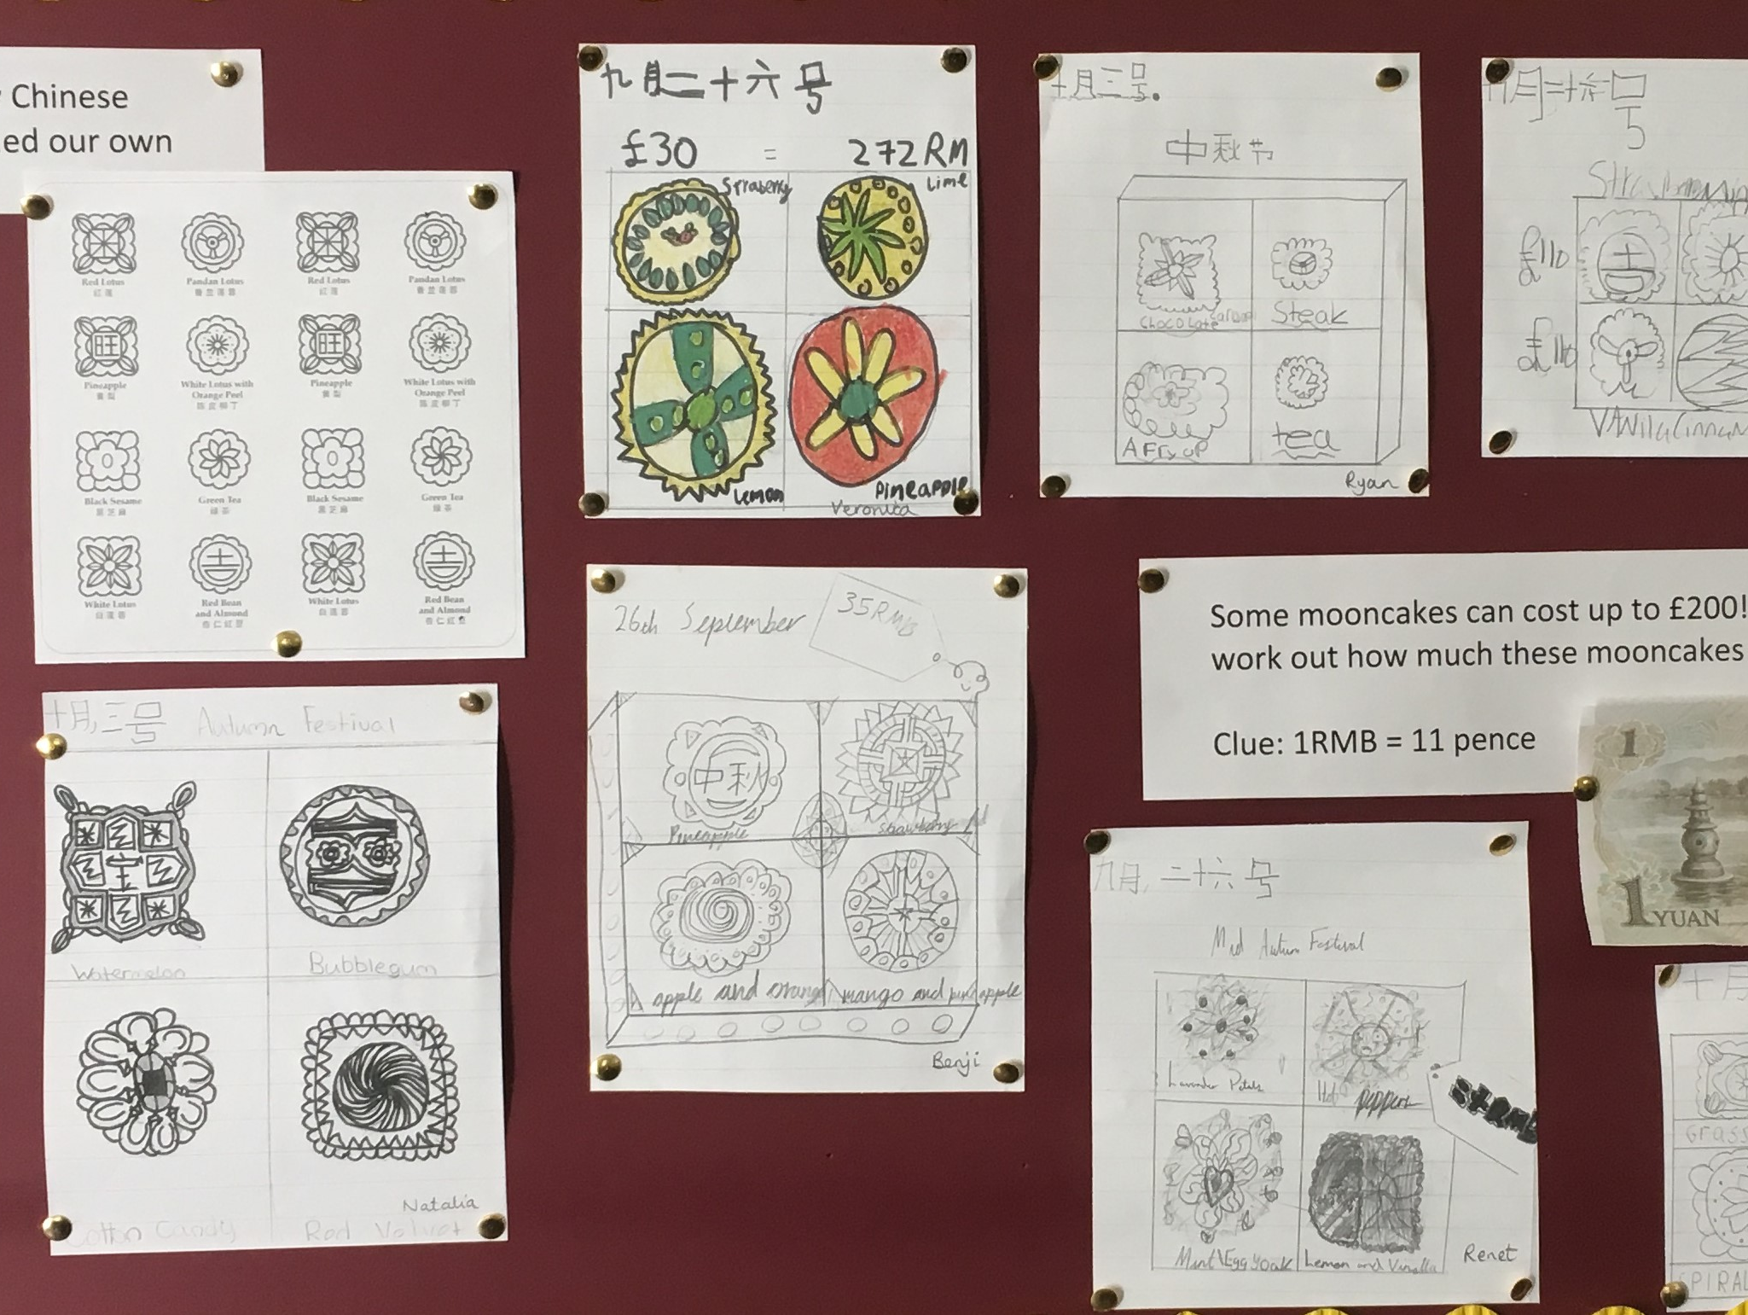
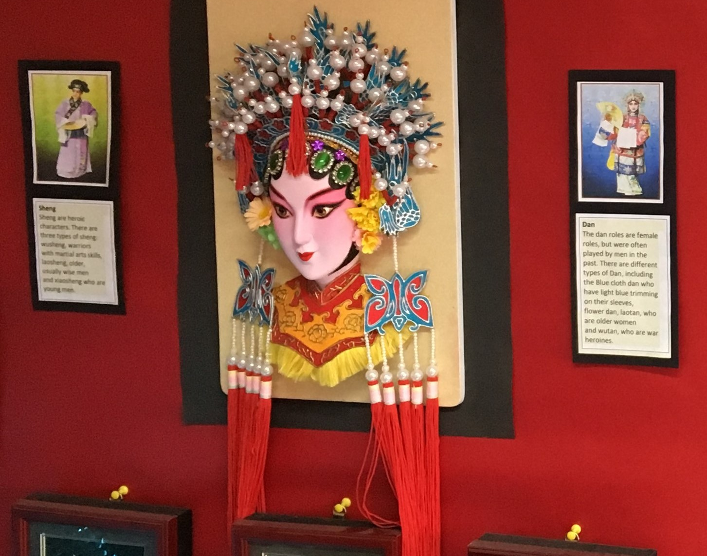
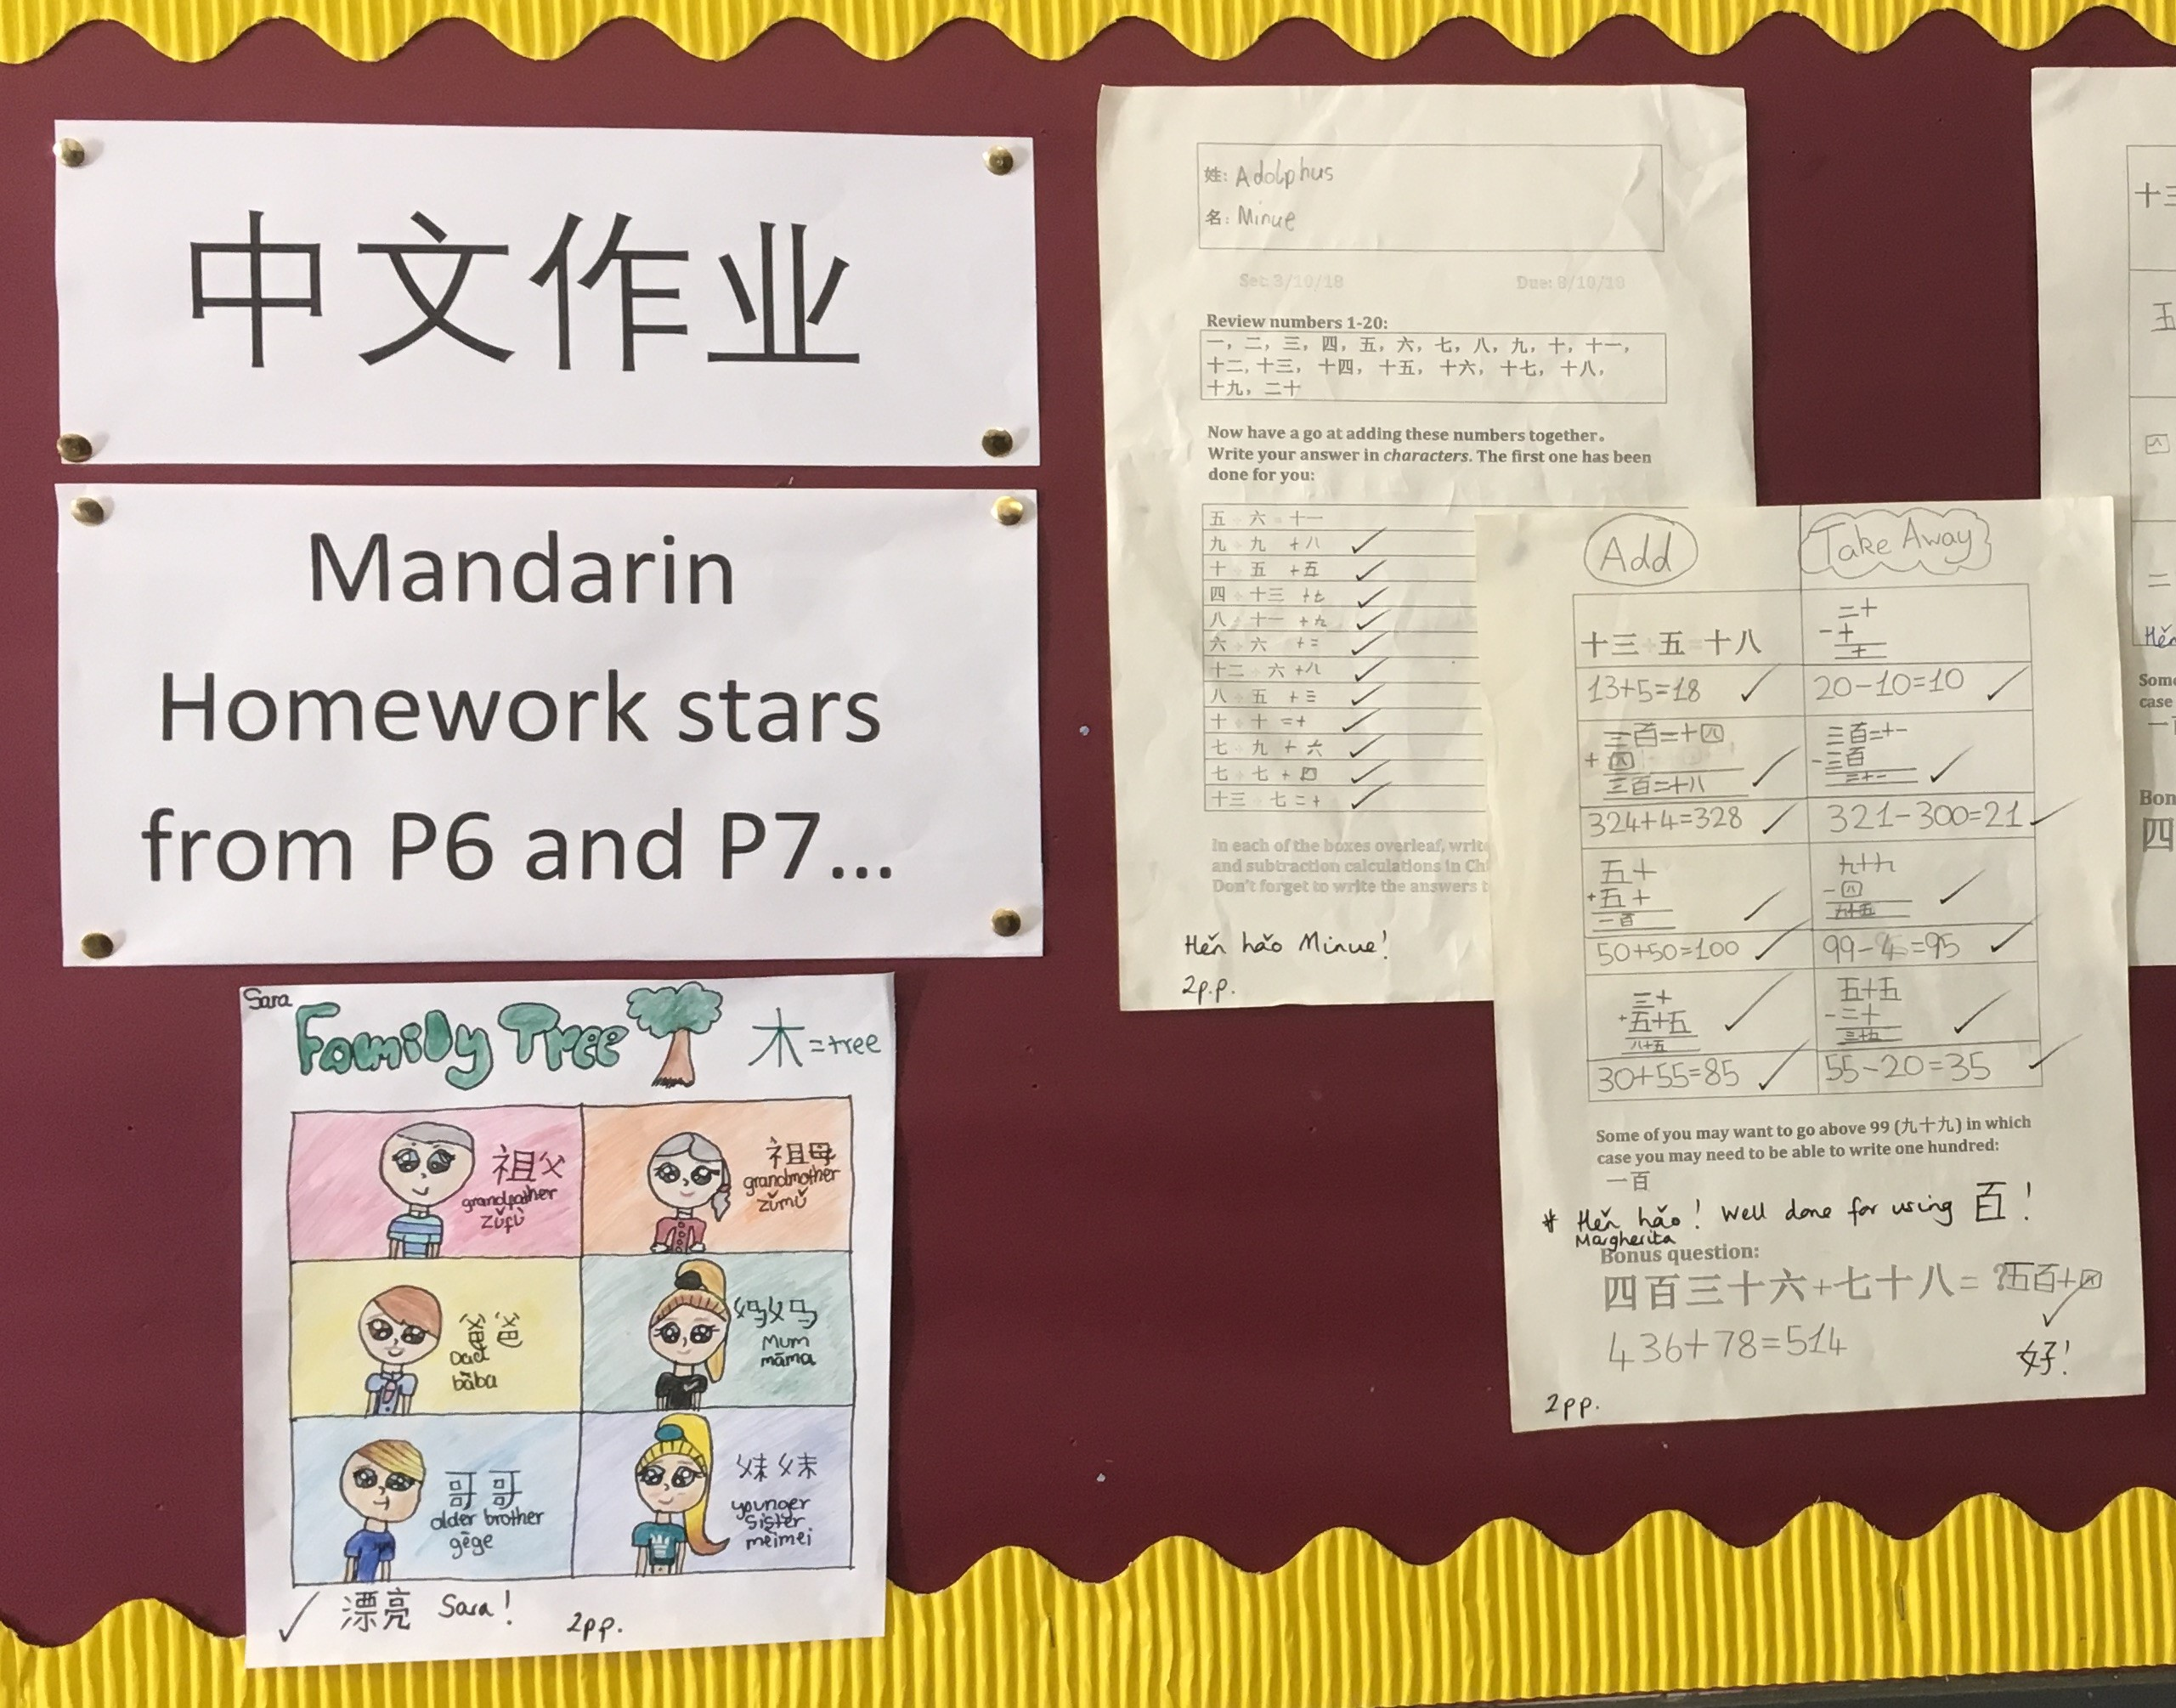

Slide 34
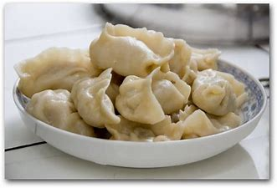
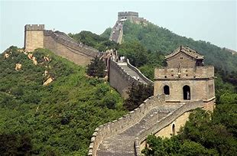
https://www.flickr.com/photos/chinesenetworks/albums

Slide 35
Activity 4:
Post training plan

Slide 36
Planning and Q & A

