Slide 1
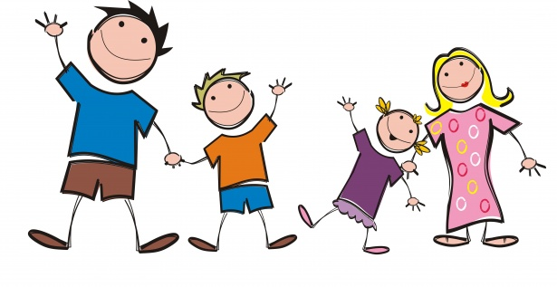
Family

Slide 2
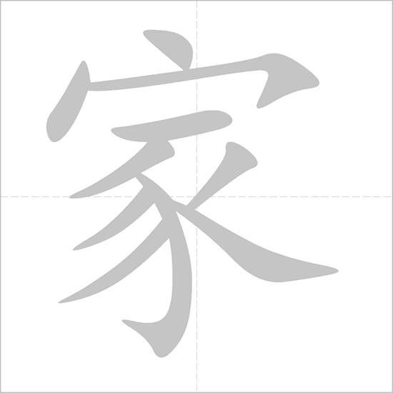
jiā
家
family

Slide 3
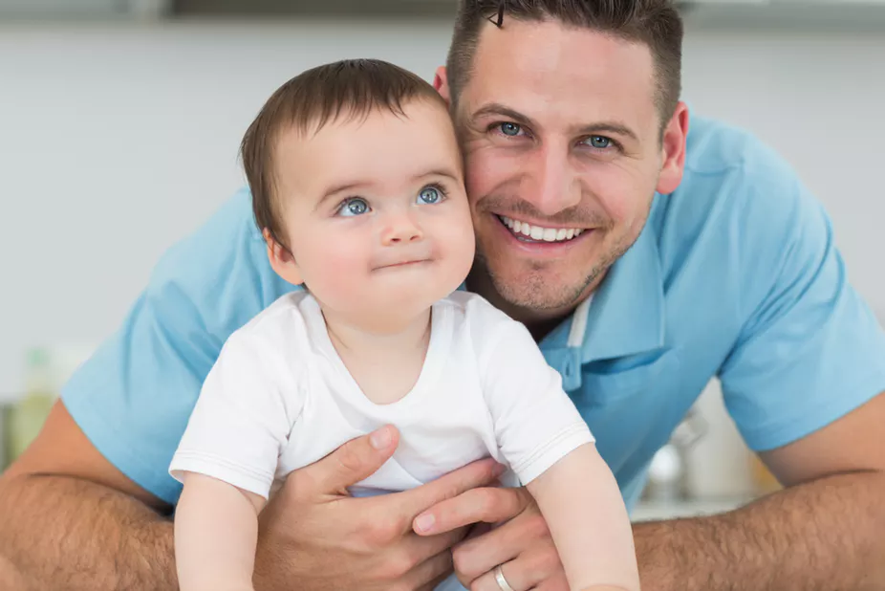

bà bɑ
爸爸
Dad

Slide 4
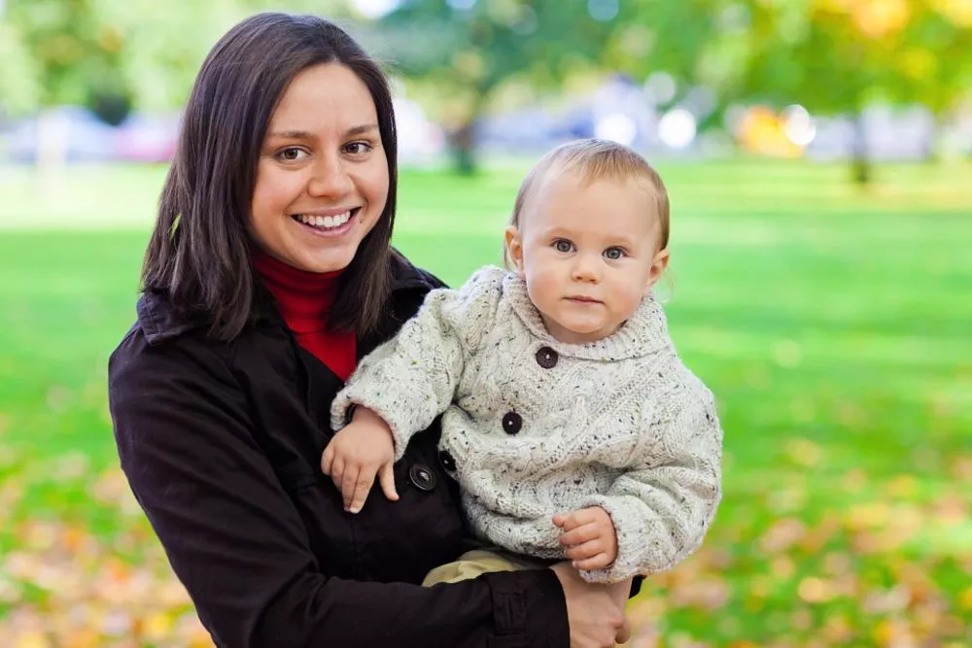
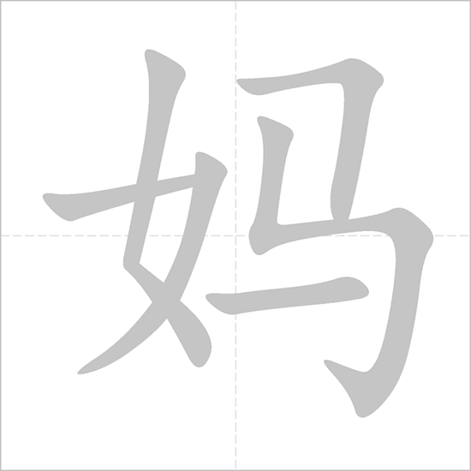
mā mɑ
妈妈
mom

Slide 5
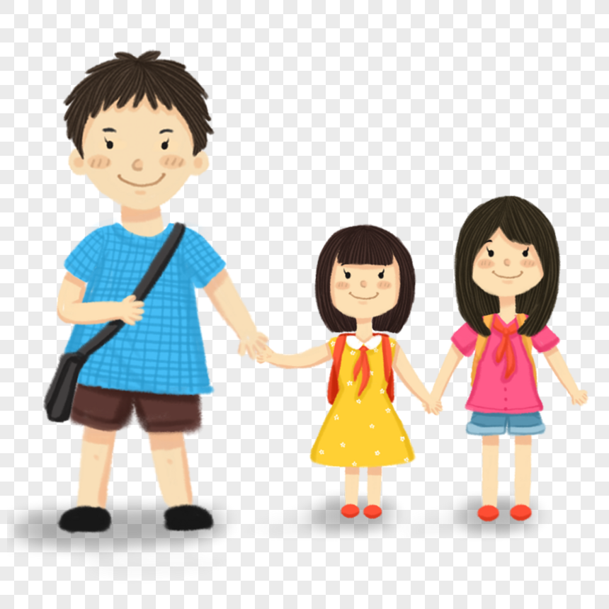
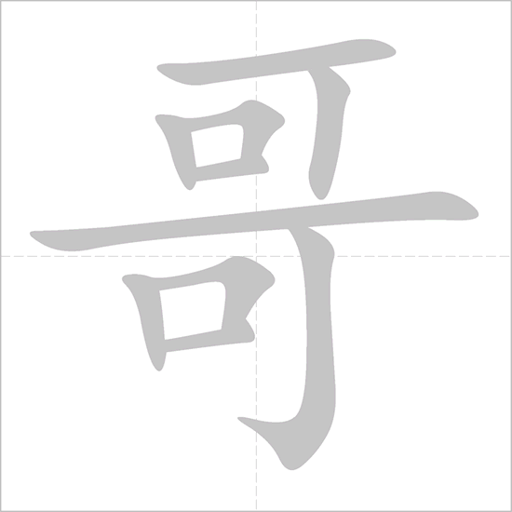
gē ge
哥哥
Older brother

Slide 6
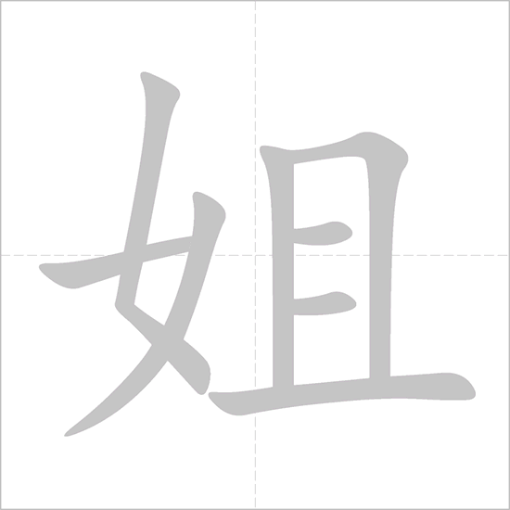
jiě jie
姐姐
Older sister

Slide 7
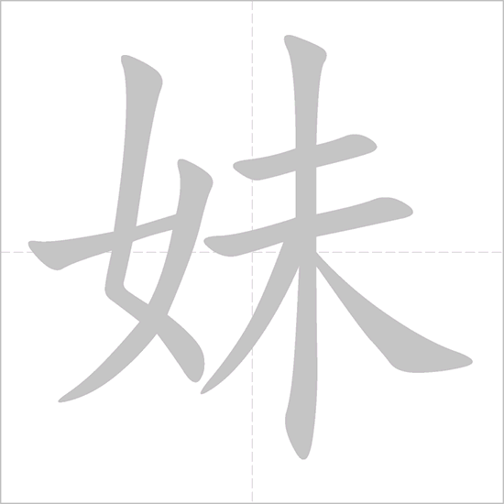
mèi mei
妹妹
Younger sister

Slide 8
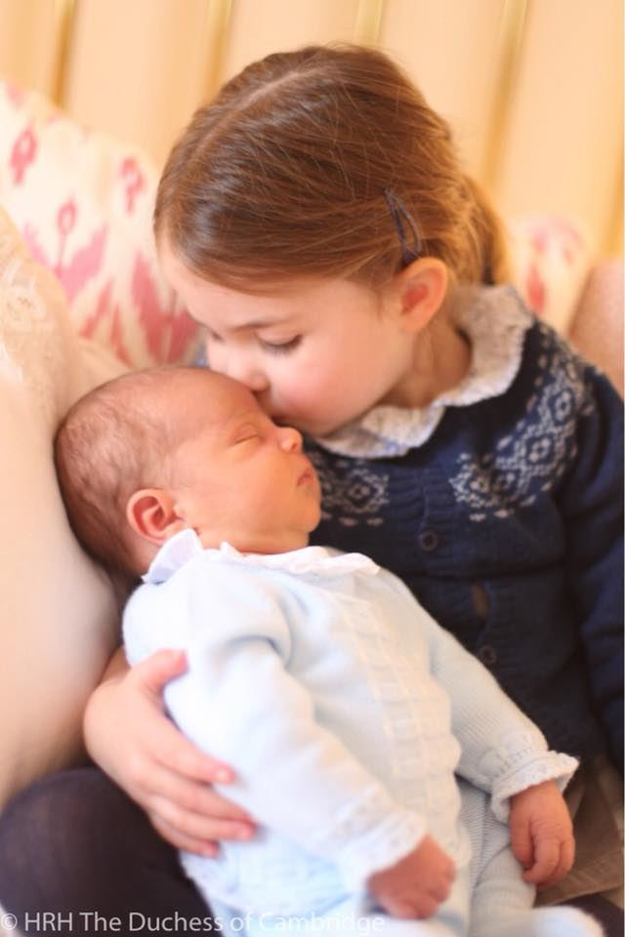
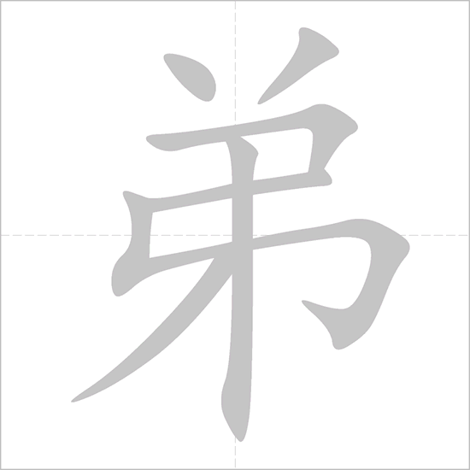
dì di
弟弟
Younger brother

Slide 9
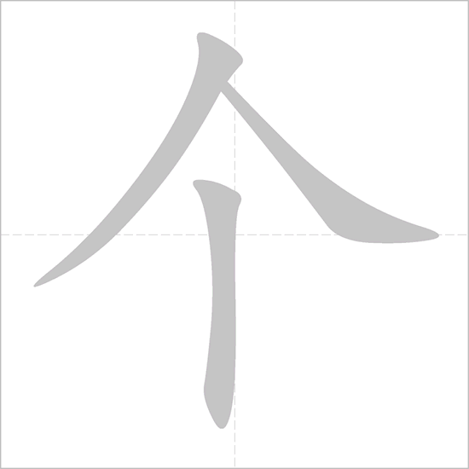
gè
个
measure word for person

Slide 10
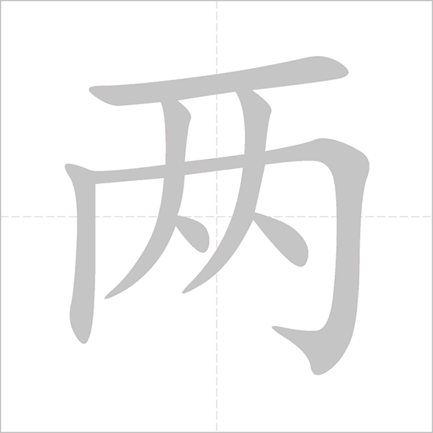
Translate:
一个哥哥
Two older sisters
Ten younger brothers
Twenty two younger sisters
liǎng
One older brother
两个姐姐
十个弟弟
二十二个妹妹

Slide 11
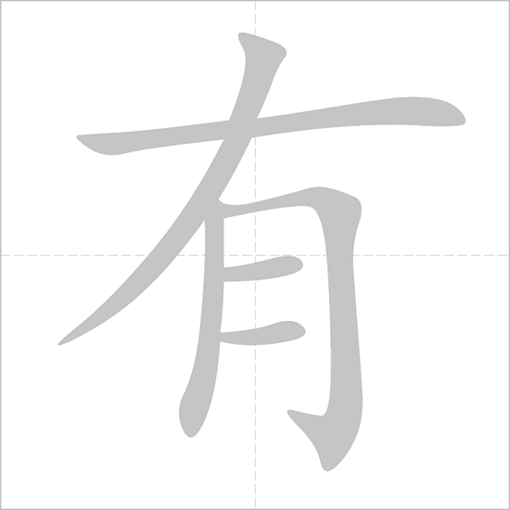
yǒu
有
have

Slide 12
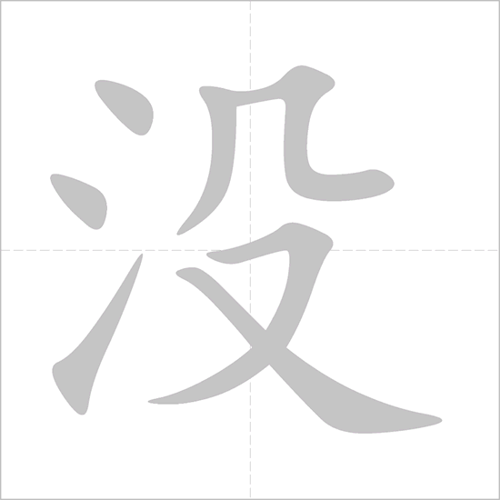
méi yǒu
没有
don’t have

Slide 13
你有哥哥吗？
Do you have older brothers?
I have one younger sister.
我有一个妹妹。
Does she have older sisters?
她有姐姐吗？
She doesn’t have older sister.
她没有姐姐。
Does he have younger brothers?
他有弟弟吗？
He has two younger brothers.
他有两个弟弟。

Slide 14
Lets strike the stroke!!

Slide 15
家

Slide 16
爸

Slide 17
妈

Slide 18
弟

