Slide 1

One, two, three, Mandarin!
中文一二三

Slide 2
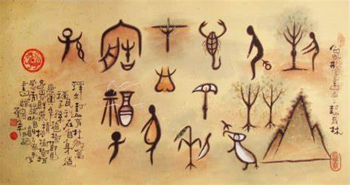
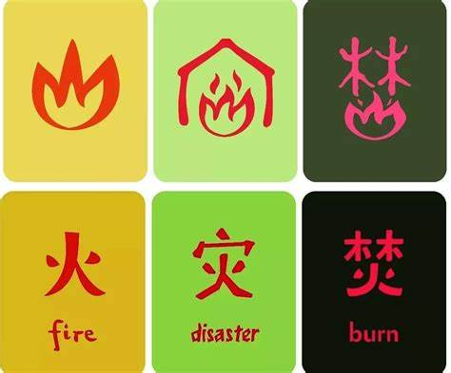
Learning Objective:
To learn about components in Mandarin

Slide 3
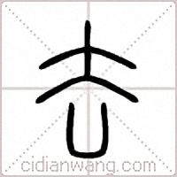
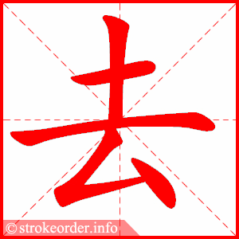
Drawing vs. Characters
Meaning:
Walking away back to back
Sound:
qu

Slide 4
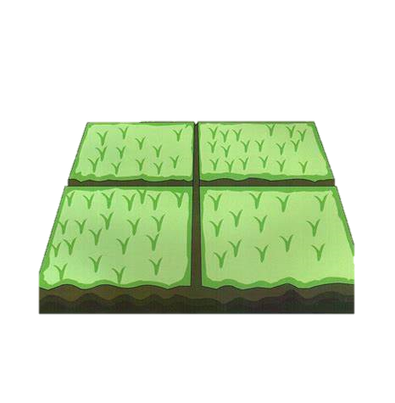
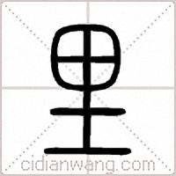
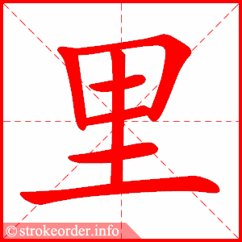

Drawing vs. Characters
lǐ
Meaning:
farm land
Meaning:
earth

Slide 5


Slide 6
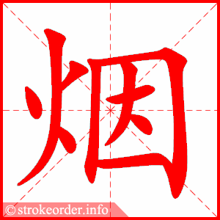
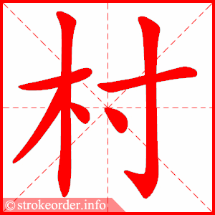
Find the fire and wood radicals in these two characters

Slide 7
qù
lǐ

Slide 8
yí qù èr sān lǐ
一 去 二 三 里
One go two three miles

