Slide 1

One, two, three, Mandarin!
中文一二三

Slide 2



一 ？水

Slide 3
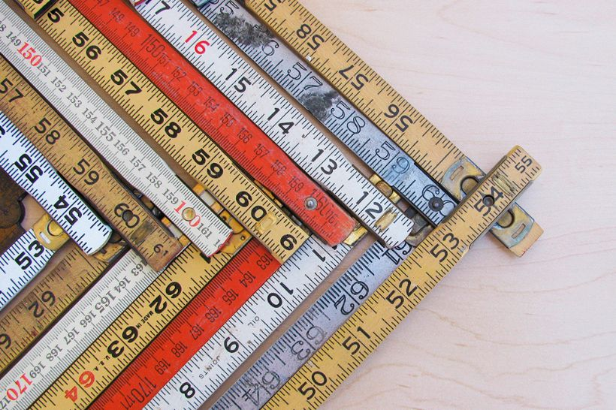
Learning Objective
To learn to count to seven in Mandarin
To learn about the concept of measure words
To learn the shapes of some characters

Slide 4



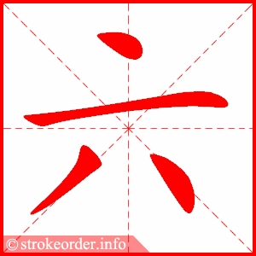
liù
qī

Slide 5

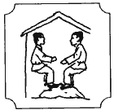
zuò
Measure word for buildings

Slide 6
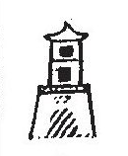
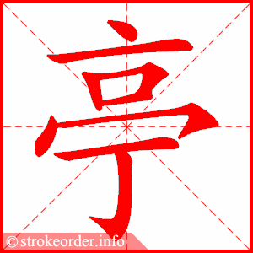

tíng
+

Slide 7

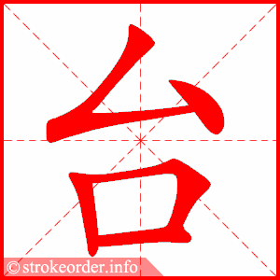
tái

Slide 8

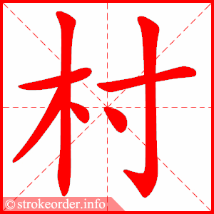


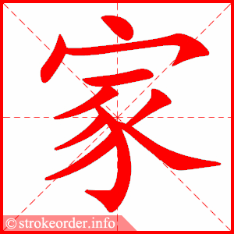
Read the sentence above and try to put the characters below to make a similar sentence

Slide 9
tíng tái liù qī zuò
six, seven pavilions

